Slide 1
Who Said It Best™ Elevator Pitch Workshop & Coaching
Gloria Larkin, President & CEO

Slide 2
Gloria Larkin
President & CEO at TargetGov
FAST@TargetGov.com 866-579-1346x 325
Creator of the FAST® Process and KickStart Program®
Invented the federal capability statement
Clients won $10+ billion in federal contracts
Nationally recognized federal contracting business development expert
Quoted in Wall Street Journal, Washington Post, INC Magazine, Bloomberg
Author of “The Basic Guide to Government Contracting”
Educational Foundation Board Chair Emeritus and Legacy Circle Inductee at WIPP.org

Slide 3
Agenda
Prizes!
Meet the Coaches
Six Steps Before the Conference and Contest
Matchmaking Pitch
Critical Six Sentences
Are You Ready for Your Matchmaking Sessions
Pitch Competition Details
Common Mistakes
FAQs

Slide 4
Cash Prizes!

Slide 5
Marie Myszkier
Procurement Specialist, 904-620-2053, marie.myszkier@unf.edu
Procurement Technical Assistance Center (PTAC) Procurement Specialist with the University of North Florida located in Jacksonville. She works with Florida companies who are interested in pursuing federal, state, county, and local government business. Her 15+ years of government experience encompasses the Department of Energy (DOE), M&O contractors, civilian agencies and all facets of business operations.
Prior to joining the University of North Florida’s PTAC she was the Lead Supplier Diversity Advocate at Sandia National Laboratories’ Supply Chain Risk Management & Supplier Diversity Department. Her previous rotations within the Laboratories included Small Business Advocate, Program Manager for SBIR/STTR programs, and Financial Lead for the Material Protection, Control & Accounting (MPC&A) Program within the International Security Program.

Slide 6
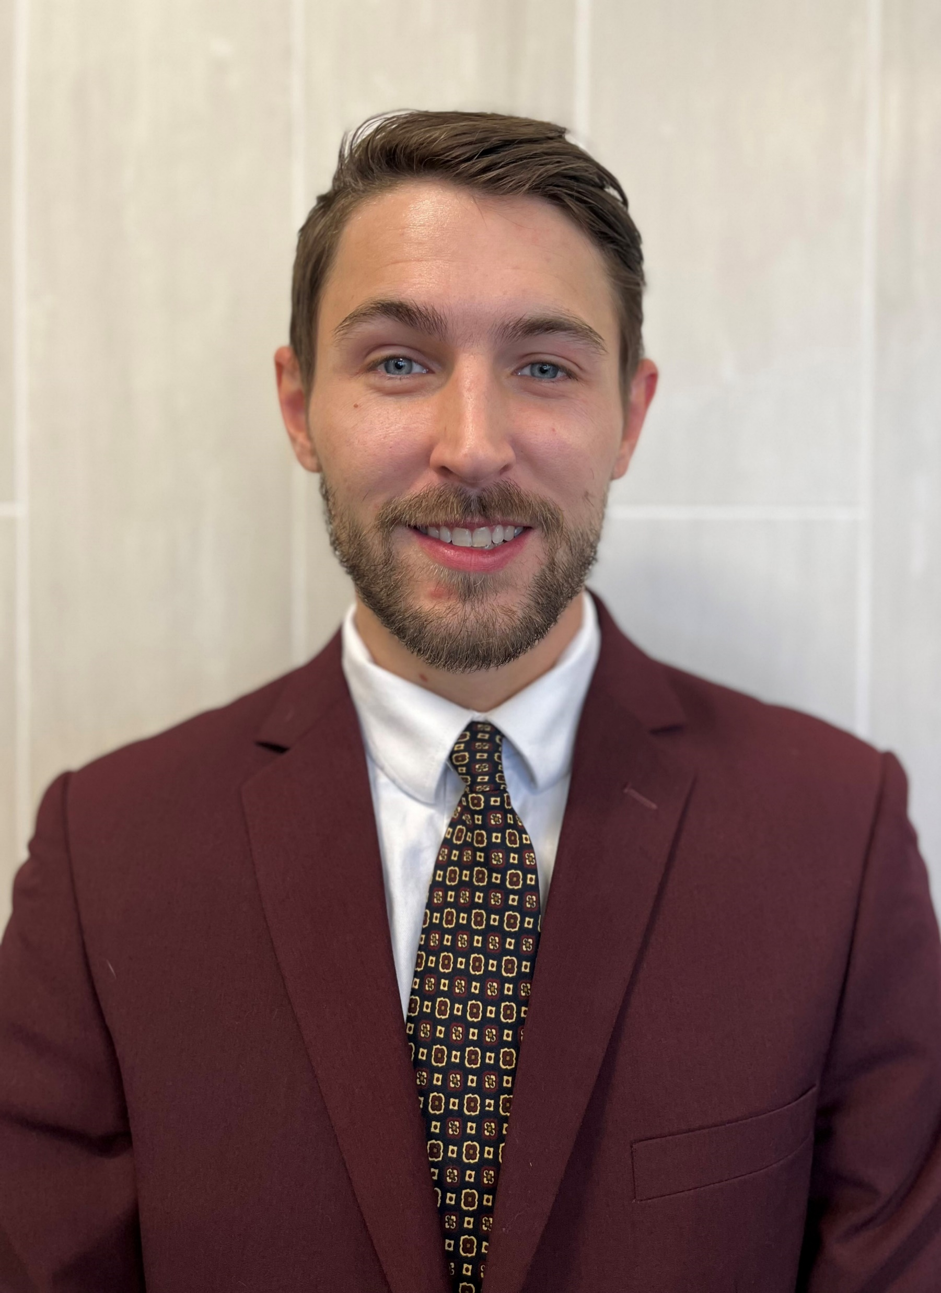
John McQueen
Business Development in Sales at TargetGov, a government procurement, related business development and marketing company offering the exclusive Federal Acceleration Strategies and Tactics (FAST®) Process, and the KickStart Program®, Capability Statements, and expert federal contracting services. TargetGov celebrates its 26th anniversary in 2023
In recent years, clients won over $10+ billion in federal contracts
Matthew Dellinger
FAST@targetgov.com 866-579-1346x 325
included Small Business Advocate, Program Manager for SBIR/STTR programs, and Financial Lead for the Material Protection, Control & Accounting (MPC&A) Program within the International Security Program.

Slide 7
Steps to Take Before the Contest
Create a strong niche statement
Write your draft 90 second elevator pitch
Practice your 90 second elevator pitch
Test record your 90 second elevator pitch

Slide 8
Perfect Matchmaking Pitch Starts
with Elevator Pitch
Develop a focused “Matchmaking Pitch” to communicate specific offerings matching decision-makers current and future needs
No company does “Everything”
Use this template Elevator Pitch for your talking points

Slide 9
Six Critical Sentences in Your 90 Second Elevator Pitch
I am [your name], [your title], with [your company name].
We provide __________________.
Our core competencies are ____________.
We are the absolute best at ___________.
We are different because _______________.
We can help your agency/office/company by _________.

Slide 10
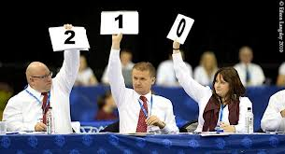
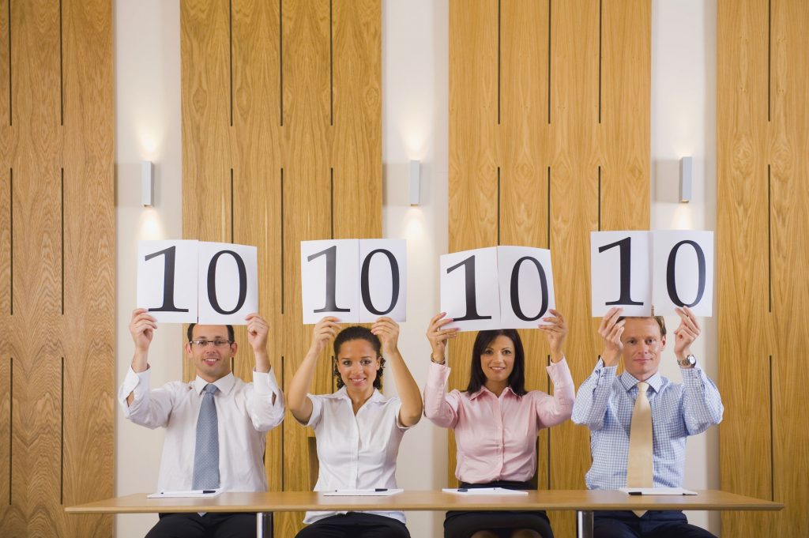
Perfect Registrations?
Today, how does your firm look in the eyes of your federal targets?
SAM.gov active and compete
SBA Profile at dsbs.sba.gov/dsbs
Keywords
Past Performance

Slide 11
Elevator Pitch Contest
Today, Monday, February 13th, 2023 from 4:00-5:00pm CDT
Location: Elite Hall AB
Finalists from both the video submissions and this workshop
Bragging rights!
Prizes!

Slide 12
FAQs
Can we just get on stage and compete? No, we have a limited number of slots available for the competition. You must meet with a coach and we will choose the best competitors for the live competition.
Does the owner need to compete? Anyone can represent your company, and they would then compete in live contest if selected as a finalist.
Can I be coached for matchmaking and not the contest? Yes, absolutely!

Slide 13
FAQs
Who can participate in the pitch contest? Anyone can represent any small business in the video, but they would then compete in live contest if selected as a finalist. Only small businesses are eligible to compete.
Why are you doing this contest? To help everyone in the audience and the contestants as well improve their pitch for matchmaking and the expo. Plus, to have fun and win prizes!

Slide 14
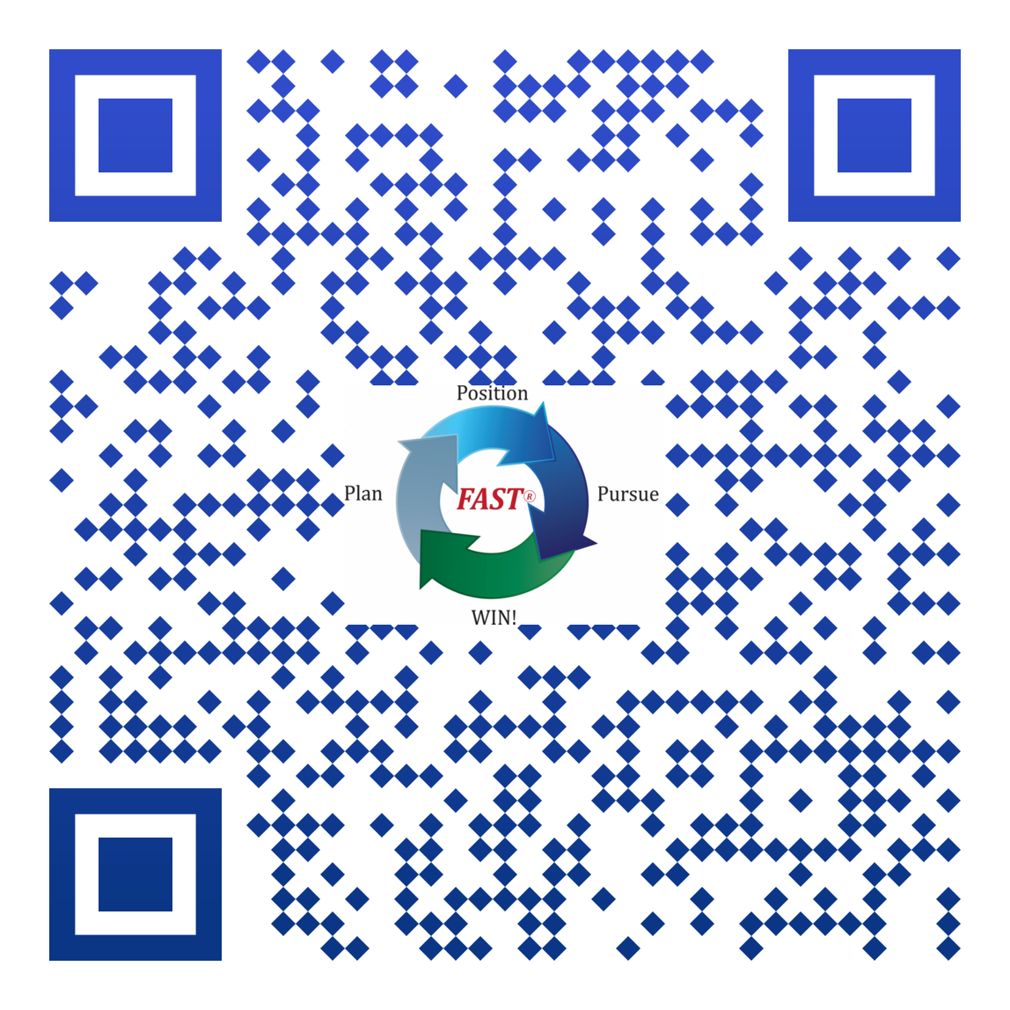
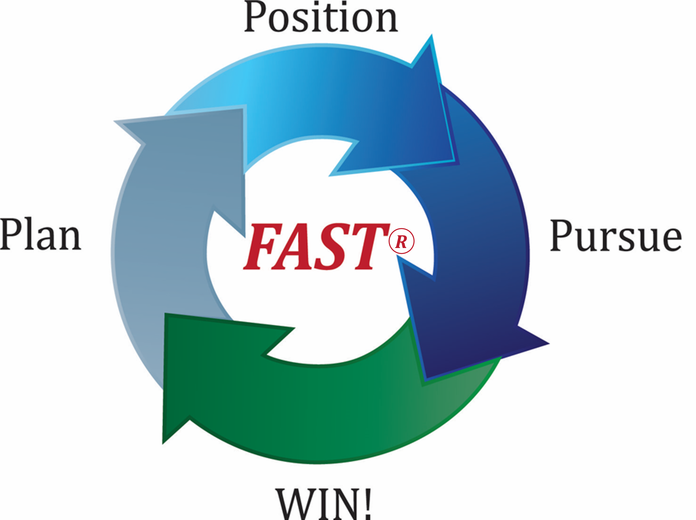
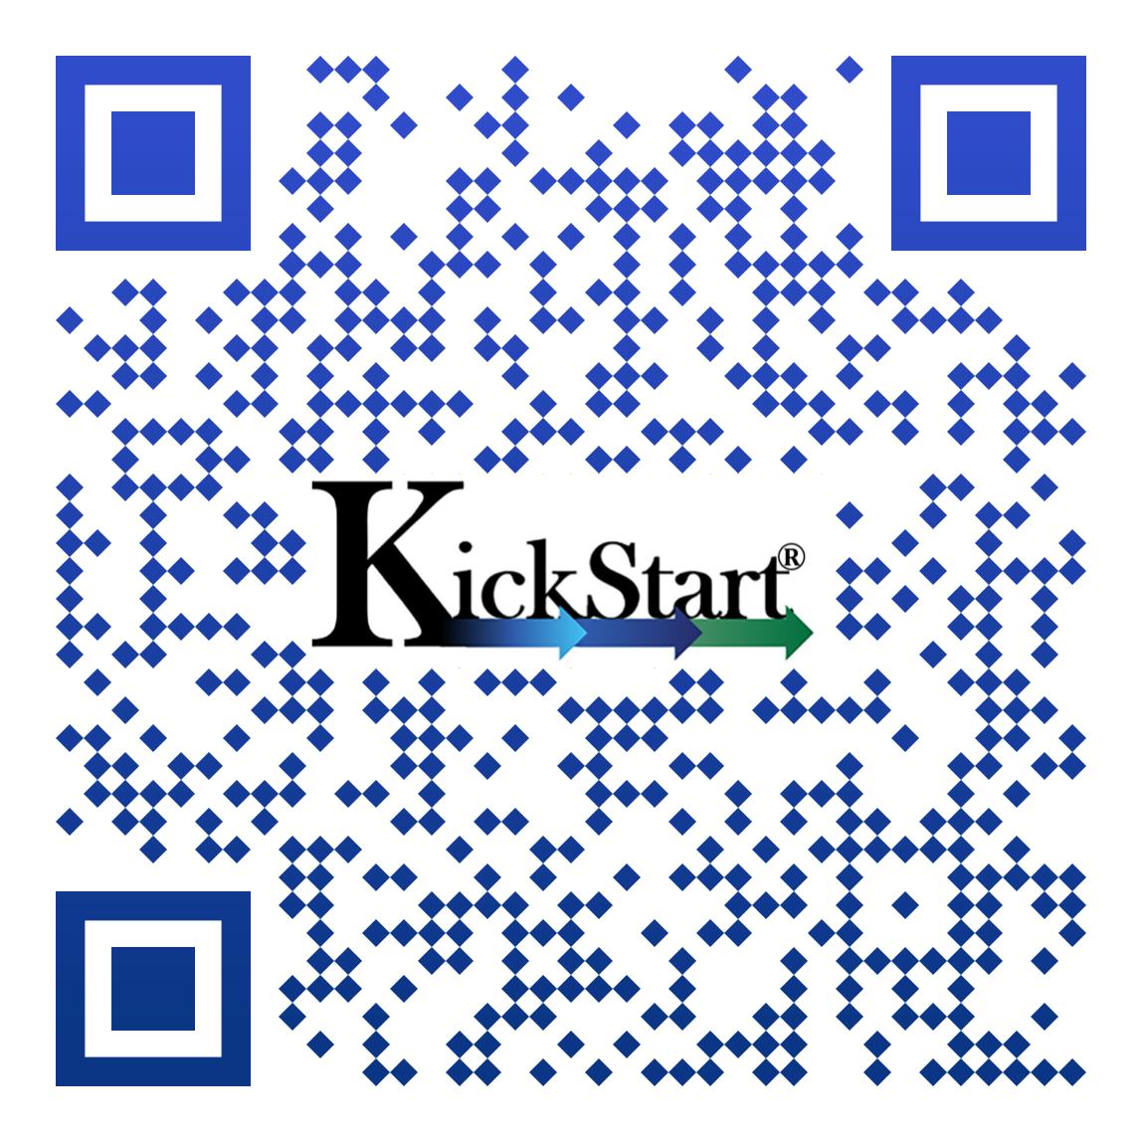
Questions?
Contact:
FAST@TargetGov.com
Toll-free: 866-579-1346 x 325
www.TargetGov.com
Sign up as a Preferred Client and receive our bi-monthly Newsletter, complimentary materials, contracting news and exclusive coupons.

