Slide 1
Doing Business with the
Department of Defense
Moderator: Edward DeLisle, Thompson Hine LLP
Speakers: Kyle Beagle, National Guard; Tim Cole, Missile Defense Agency; Elizabeth
Walker, Army Corps of Engineers; Paul Ward, U.S. Special Operations Command
& Arveice Washington, U.S. Department of the Navy

Slide 2
How to Do Business with the Missile Defense Agency (MDA)
February 14, 2023
National 8(a) Association
2023 National Small Business Conference
Tim Cole
Director for Small Business
DISTRIBUTION STATEMENT A. Approved for public release; distribution is unlimited.
Approved for Public Release 22-MDA-11324 (22 Nov 22)

Slide 3
MDA OSBP Overview
Missile Defense Evolving Threat
Delivering Capabilities to the Warfighter
Today’s Layered Missile Defense
Office of Small Business Programs (OSBP) Mission and Vision
FY21 Small Business Utilization & Performance
Upcoming Industry Days
Future Acquisition
OSBP Web Resources
OSBP Staff
3

Slide 4
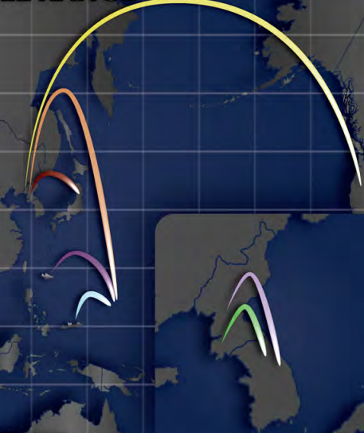

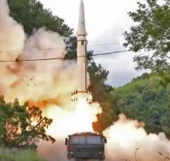
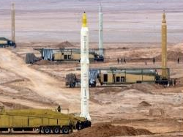
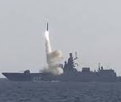
Missile Defense
Evolving Threat Environment
Intercontinental
ICBM
New missiles & existing system improvements
Precision strike
Decoys and jammers
Maneuvering in midcourse or terminal phase
  Depressed Ballistic Trajectories
  Multiple Independent Reentry Vehicle (MIRV)
  Maneuvering Reentry Vehicle (MaRV)
  Global Hypersonic Glide Vehicles (HGV)
  Long Range Hypersonic Cruise Missiles (HCM)
Integrated ballistic, hypersonic, air, cruise missile, unmanned and non-kinetic attacks
Intermediate
(IRBM)
Medium
(MRBM)
Air Launched
(ALBM)
Short
(SRBM)
Ship / Sub
Launched
(SLBM)
Close
(CRBM)
Notional Representation
(Mach)
1
5
10
25
Subsonic
Supersonic
Hypersonic
High
Hypersonic
(MPH)
770
3,800
7,700
19,200
Approved for Public Release 22-MDA-1134 (22 Nov 22)
North Korea
IRBM Hwasong-8
Iran
Multiple MRBMs
China
DF-15 SRBM
Russia
Tsirkon HCM
Ref: 2022 Missile Defense Review
Approved for Public Release 22-MDA-11324 (22 Nov 22)

Slide 5
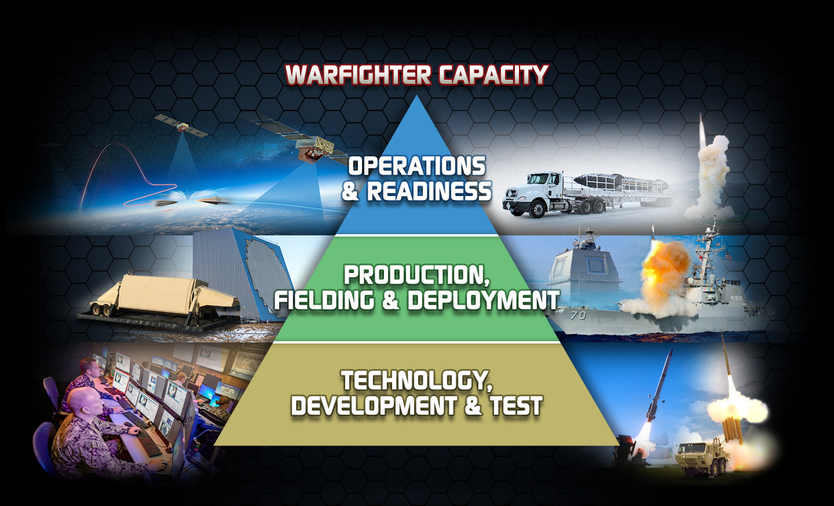
Missile Defense Agency
To develop and deploy a layered, Integrated Missile Defense System to defend the
United States, its deployed forces, allies, and friends from missile attacks in all phases of flight
Delivering Capability by, with and through the Services
to meet Combatant Command Requirements

Slide 6
Today’s Active, Layered Missile Defense System
Approved for Public Release 22-MDA-11324 (22 Nov 22)

Slide 7


MDA Office of Small Business Programs (OSBP) Mission/Vision
Mission: To facilitate access to ingenuity residing within the small business industrial base the Missile Defense Agency (MDA) relies on for missile defense.
Vision: We strive to remain an integral player and valued advisor to the workforce developing and implementing acquisition strategies supporting MDA’s foundation for missile defense, while effectively advocating for use of small businesses in our procurements.

Slide 8
FY 22 Small Business Utilization in MDA
Strategic Objectives to Strengthen the Small Business Industrial Base
Increase use of qualified small businesses to enhance operations and readiness
Maximize use of small businesses to optimize production and fielding
Increase use of SBIR/STTR programs to continue development of technology improvements for the Missile Defense System (MDS)
AbilityOne Program
Increase MDA’s participation
$647M in Prime Contracts to Small Businesses
+500M in Subcontracts to Small Businesses
$1.14B awarded to Small Businesses in FY22
Notes:
FY 22 Small Business Utilization in MDA
(Pie Chart) Currently, the largest share of our acquisition budget every year goes to our large business system integrators. There are many subcontracting opportunities with them at various tiers and our office can assist you in locating the right small business liaison officer in those companies so you can make them aware of your capabilities. MDA OSBP encourages utilization of set-asides and subcontracting to the maximum extent possible for socioeconomic procurement programs during the development of Agency acquisition strategies and consistent with the capabilities of the small business community.
(SB Objectives) The American defense industry is renowned for its ingenuity and ability to deliver cutting-edge military capabilities to the Joint Force.
Simply put, industry propels America’s military and technological future.
MDA relies on our large and small business contractors, domestic and foreign, as they develop, test, integrate, and field the missile defense system.
MDA plans to use small business to--
Increase use of qualified small businesses to enhance readiness and sustainment
Maximize use of small businesses to improve quality of products and services and build out force structure to outpace emerging threats
Increase the use of Small Business Innovation Resources and Small Business Technology Transfer programs, America’s seed fund to speed delivery of new capability addressing evolving missile threats
The bullet points here are three small business objectives of significant importance to MDA; the overarching strategic objectives aligned with the Director’s priorities and the Agency’s direction.
$647M in Prime Contracts to Small Businesses (this includes MDA SB Dollars spent through GSA BIC and NASA SEWP)

Slide 9
FY 2023 Small Business Goals/Performance to Date
 | Goals FY23 | Performance FY23 | Obligated Dollars FY23
Small Business | 7.55% | 7.02% | $95,078,781
Socio-Economic Categories
Small Disadvantaged Business | 2.36% | 2.04% | $27,660,088
Service-Disabled Veteran-Owned Small Business | 1.00% | .87% | $11,845,357
Women-Owned Small Business | 1.00% | 2.04% | $27,618,516
HUBZone Small Business | 0.20% | 1.22% | $16,539,325
Note: Each goal above is calculated separately; any socio-economic small business may be included in more than one category. Date range for this report is 10/01/022-1/17/2023
SOURCE: FPDS-NG
Note: Each goal above is calculated separately; any socio-economic small business may be included in more than one category.
Total SB Eligible Dollars: $1,354,518,664.96
Socioeconomic goals established by MDA Office of Small Business Programs (OSBP) Director
Small Business goal established by The Office of the Secretary of Defense (OSD) OSBP

Slide 10
Industry Days
M & S Futures - Modeling and Simulations
  Request for Proposal (RFP) tentatively scheduled for 3Q FY24
    Industry Day - 4Q FY23 (July – September 2023)
Ground Sensor (SN)
  Sea-Based X-Band Radar Mission Integration (SBX-MI) Follow-on Industry Day Event Mission Support Facility Sustainment
  RFP tentatively scheduled for Q2 FY23
    Small Business Set-Aside
    PSC: AC13, 9999
    NAICS: 541330 – Engineering Services
    Industry Day – Held January 12, 2023
  More information will be posted on SAM.gov
NOTE: Time frames are estimates.
Notes:
M&S Futures – There might be a draft RFP for this effort coming out prior to the RFP timeline.

Slide 11
Future Acquisition
MDA Integration & Operations for Enterprise Solutions (MIOES) (IRES Follow-on)
  Currently in development of the Market Research Report released in December 2022.
  Expected award: Spring 2025
Technical Areas (Scope)
  Enterprise Information Environment and RDT&E IT Services and Solutions
  MDS Mission IT Support and Solutions
  MDS Mission Operations
  Missile Defense Integration & Operations Center (MDIOC) Facility Operations & Sustainment
  Systems Engineering & Program Integration
Note: Time frames are estimates.

Slide 12


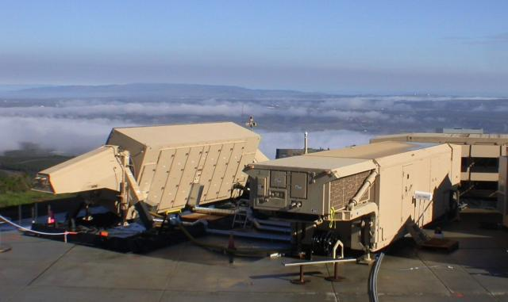
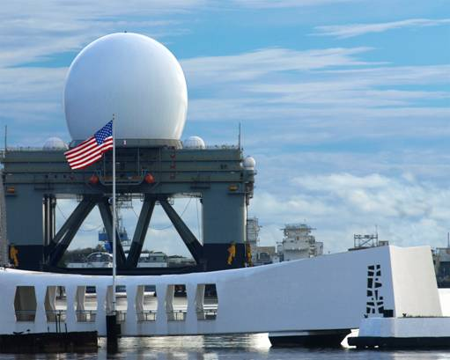
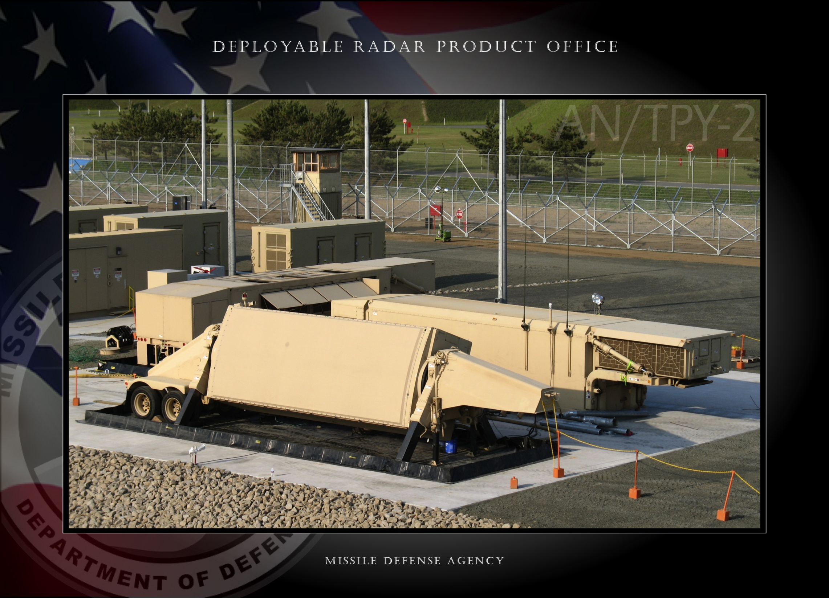


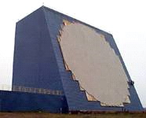
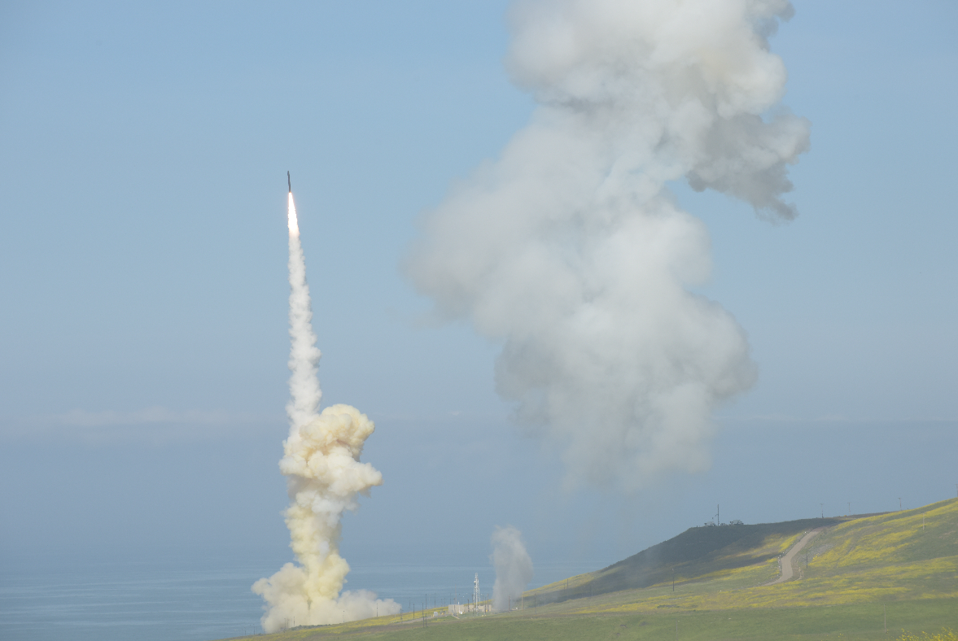
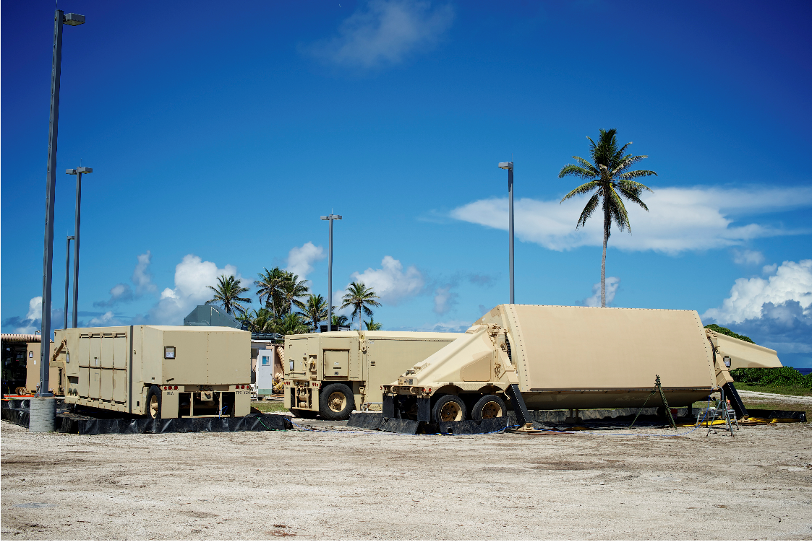
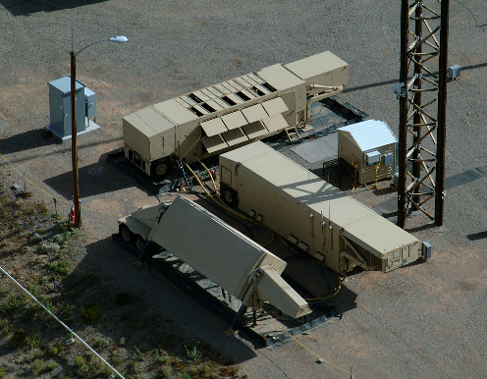
Potential Sub-Contracting Opportunities
Contract | Description | Prime(s) | Current PoP End
SBX Mission Integration | SBX vessel integration and coordination of services (tech, ops, supply, etc) through various sources | Gryphon Technologies | June 2024
Radar Development Contract (RDC) | Program Management Hardware & Software Development and Sustainment for AN/TPY-2 Radars and SBX Engineering Services | Raytheon Technologies | October 2024
Contractor Logistics Support (CLS) | Operations and Sustainment activities for all AN/TPY-2 Radars and SBX Deployment and Site Support Depot transition support | Raytheon Technologies | October 2024
Radar Test Contract (RTC) | Flight and ground test support to Upgraded Early Warning Radars (UEWRs) and COBRA DANE (CD) and X-Band Radars Models and Simulations | Raytheon Technologies | November 2024
AN/TPY-2 FMS – United Arab Emirates (UAE) | Operations and Sustainment of 2 AN/TPY-2 Radars in-country Spares, Sustainment, Maintenance, and Training | Raytheon Technologies | September 2025
AN/TPY-2 FMS – Kingdom of Saudi Arabia (KSA) | Production and initial CLS of 7 AN/TPY-2 Radars in-country Spares, Sustainment, Maintenance, and Training | Raytheon Technologies | August 2032

Slide 13



Potential Sub-Contracting Opportunities (cont.)
Contract | Description | Prime(s) | Current PoP End
AN/TPY-2 US Radar Production | Radar Production Spares Production Major components | Raytheon Technologies | March 2025
Long Range Discrimination Radar (LRDR) | Radar Development and Production Site construction Deploy Sustainment | Lockheed Martin | July 2024
Homeland Defense Radar (HDR) | Multi-Award Indefinite Delivery / Indefinite Quantity (MAIDIQ) Radar Development and Production Site construction Logistics | Lockheed Martin, Northrop Grumman, Raytheon Technologies | July 2025

Slide 14
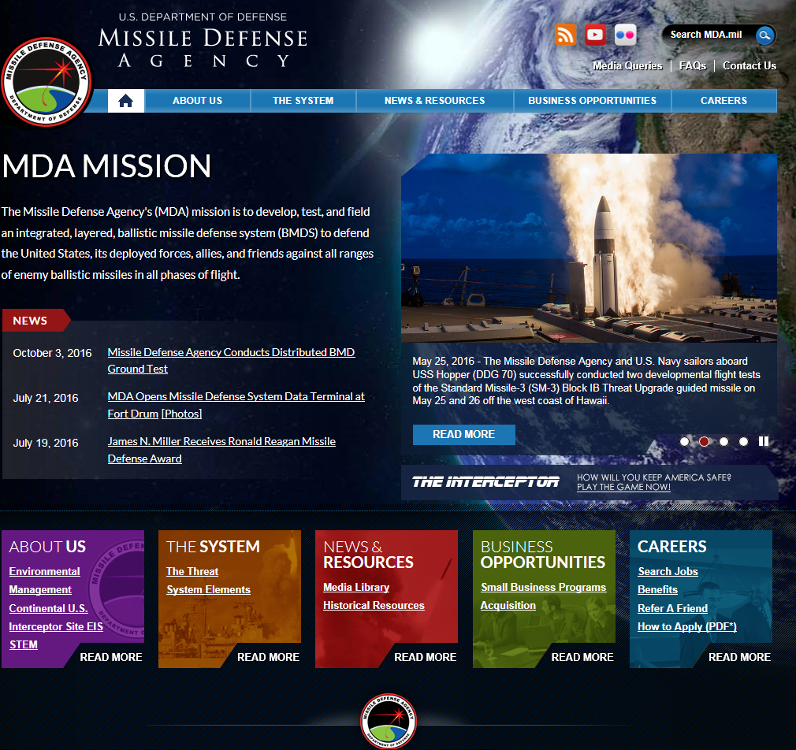

MDA OSBP Website
www.mda.mil

Slide 15
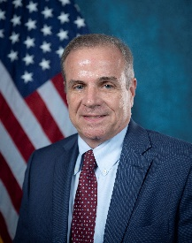
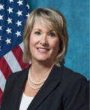
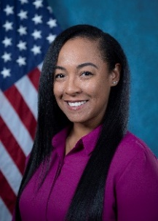
MDA OSBP STAFF
Laura Anderson
Small Business Advisor for Policy
Tim Cole
Director
Pam Parker
Small Business Advisor for Research and Development
Cheryl Michael
Analyst/Contractor Support. Outreach Coordinator
Jo Brown
Small Business Office Media Analyst/Contractor Support.
Nicole Greene
Mentor- Protégé Program Analyst/Contractor Support
To make an appointment, contact Outreach@mda.mil.
15

