Slide 1
Is Your Business Prepared to Capitalize on 2023 Growth Opportunities
Kevin Plexico, SVP, Information Solutions, Deltek

Slide 2
Kevin Plexico
SVP, Information Solutions
Deltek

Slide 3
Purpose Built For Project-Based Industries
Government Contracting
Professional Services
Aerospace & Defense
Construction
Engineering
Nonprofit
Consulting
Energy, Oil & Gas
Architecture
Engineering
Construction
Consulting
Creative Agencies
Powering the Project Lifecycle
Win
Manage
Develop
Deliver
Measure
Discover the right business opportunities
Optimize resource allocation efficiently and cost-effectively
Find, cultivate, and retain top talent
Ensure financial control and agility to unearth opportunities & problems
Gain 360° view of project and company performance
Notes:
Use this slide to demonstrate that we have solutions which align with all parts of their organization and what they need to do to be a successful project-based organization
This is one differentiator for us in that we not only support you and your sales efforts on winning and being competitive and effective in the public sector, but our sister products support other functions within your buisness on elements that they're responsbile for when managing and delivering on projects
We provide software and solutions for organizations across all industries and support project based organizations throughout their entire project lifecycle
Unlike our competitors who might just provide resources to support one part of the project lifecycle

Slide 4
AGENDA
Government Contracting Market Environment
FY 2023 Trends to Watch
Small Business Policy Trends

Slide 5
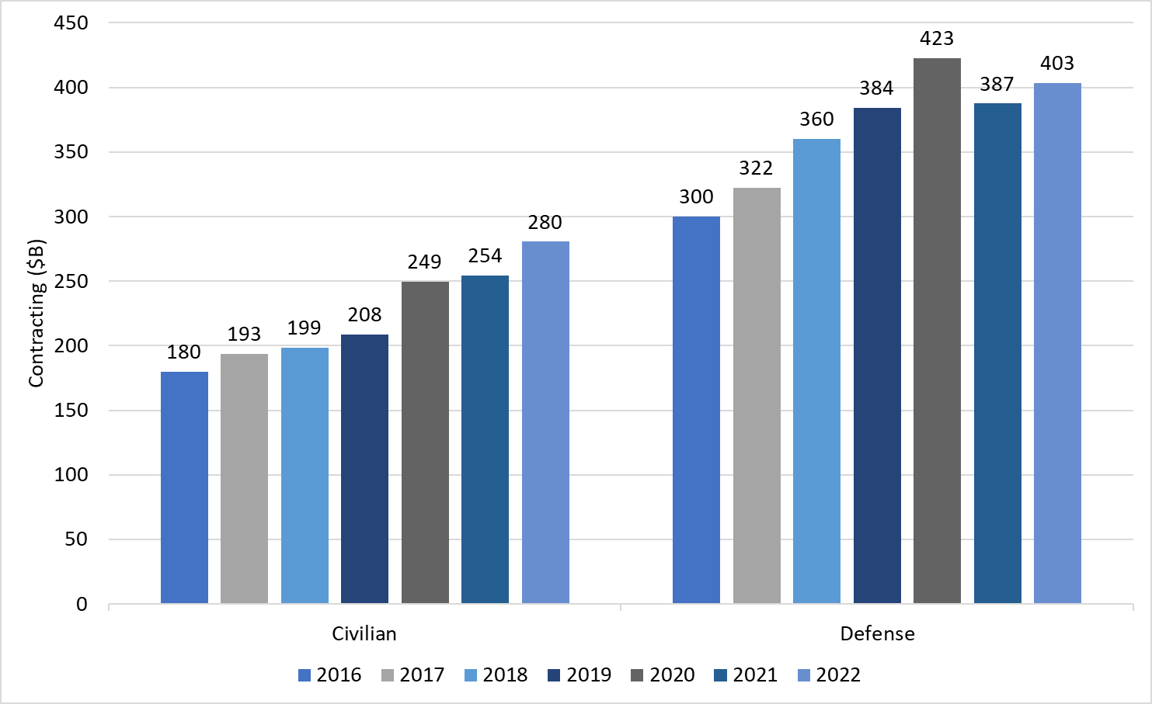
In FY 2022 Federal Contracting Jumped to Record Levels
Contract spending totaled $684B – rebounding 6% after slight decline in 2021
Civilian increased 10%
Defense increased 4%
Outlook for 2023 promising given record level of appropriations and early enactment compared to recent years

Slide 6
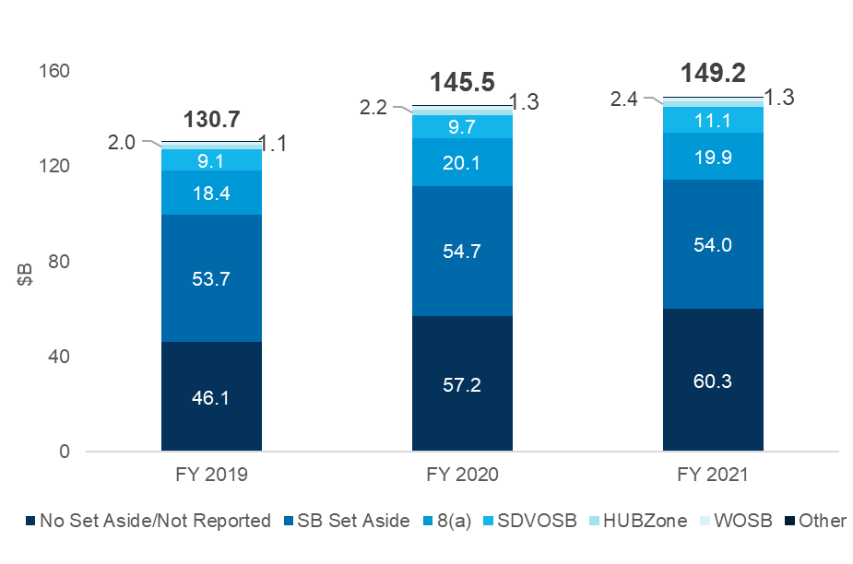
Most Small Business Classes Seeing Increased Spending
Small Business Spending, FY 2019-2021
Federal spending on small business contracts is rising, but growth is uneven across the sector.
Women-Owned, HUBZone, Service-Disabled Veteran Owned and 8(a) spending in FY 2021 was all higher than in FY 2019 but generic small business spending was unchanged.
Sources: Deltek, FPDS-NG
6
Notes:
Small business contracting has held its own as federal contract spending has increased
Most socioeconomic categories have experienced increases in spending
SDVOSB = Service-Disabled Veteran-Owned Small Business
HUBZone = Historically Underutilized Business Zone
WOSB = Woman-Owned Small Business

Slide 7
FY 2023 Discretionary Appropriations Passed
Department | FY 2023 Appropriation ($B) | FY 2022 Appropriation ($B) | $Change vs. FY 2022 ($B) | %Change vs. FY 2022
Defense | 797.7 | 728.4 | 69.3 | 9.5%
Agriculture | 25.5 | 23 | 2.5 | 10.9%
Commerce | 11.2 | 9.9 | 1.3 | 13.1%
Education | 79.6 | 76.4 | 3.2 | 4.2%
Energy | 46.5 | 44.8 | 1.7 | 3.8%
Health and Human Services | 120.7 | 110.8 | 9.9 | 8.9%
Homeland Security | 60.7 | 57.5 | 3.2 | 5.6%
Housing and Urban Development | 58.2 | 53.7 | 4.5 | 8.4%
Interior | 14.7 | 14.1 | 0.6 | 4.3%
Justice | 38.7 | 35.2 | 3.5 | 9.9%
Labor | 13.8 | 13.1 | 0.7 | 5.3%
NASA | 25.4 | 24.1 | 1.3 | 5.4%
State | 59.7 | 56.1 | 3.6 | 6.4%
Transportation | 106.3 | 102.9 | 3.4 | 3.3%
Treasury | 14.2 | 14.3 | 0.1 | -0.7%
Veterans Affairs | 134.7 | 112.2 | 22.5 | 20.1%
Ukraine Support*: $45.0B
Ukraine Support excluding humanitarian and economic support: $27.3B
Source: House and Senate Appropriations Committees
Notes:
Congress ushered in an early Christmas present for agencies and industry with the passage of the FY 2023 appropriations legislation just before Dec 25. One more one week CR was snuck in to allow time for full enactment and President Biden signed it into law on Dec 29.
We have more details summarizing each department’s movements in our research team’s article posted on Dec 27. Please go to GovWin.com to read up on that. We will also be posting additional articles going deeper into specific departments and themes in the coming weeks.
Overall, the legislation provided $1.7T in discretionary spending. The funding includes $800B in non-defense spending, a 9.3% increase over FY 2022. And $858B in national defense funding, tying off to the level in the National Defense Authorization legislation passed weeks before
Difference between the $858B and the Defense Dept funding reflects the investments in the National Defense Auth legislation that goes to other federal agencies, such as DOE
Base defense spending increased to $798B, a 9.5% increase over 2022.
So all told just south of a 10% increase in federal discretionary budgets, which should lead to a significant boost to contract spending in 2023
Some highlights from the legislation:
45B in Ukraine support, which includes funding for weapons as well as humanitarian and economic support
Across the military branches, more than a 10% increase in RDT&E
Many agencies receiving nearly 10% increases in budget authority including the USDA, Commerce, HHS, Justice and the VA
Significant increase in Commerce to fund future weather satellites and systems for the National Weather Service
DHS approprs replete with investments in transportation, immigration and travel security, such as border technology, credentialing and personnel systems, coast guard air and marine fleet and infrastructure and as we have seen in recent years, continued rapid growth in funding for the Cybersecurity and Infrastructure Security Agency
VA – boosts in funding for medical prosthetic research, construction programs and the VA electronic health record system
Air Force
Provides $60.3B for Operations and Maintenance (excluding Reserves and National Guard) and $4.1B for Space Force O&M, $5.2B and $665M more than enacted in FY 2022, respectively
Provides $54.0B for Procurement, $8.4B more than the level enacted in FY 2022
Allocates $44.9B for Research, Development, Test and Evaluation, $3B more than enacted in FY 2022
Army
Includes $59B for Operations and Maintenance (excluding Army Reserves and National Guard), $4.0B more than enacted in FY 2022
Provides $23.6B for Procurement, $835M more than the level enacted in FY 2022
Allocates $17.15B for Research, Development, Test and Evaluation, $2.6B more than enacted in FY 2022
Navy
Provides $68.3B for Navy Operations and Maintenance (excluding Reserves) and $9.9B for Marine Corps O&M, $5.8B and $715M more than enacted in FY 2022, respectively
Provides Procurement funding of $68.9B for Navy and $3.9B for the Marine Corps, $8.5B and $576M more than the levels enacted in FY 2022, respectively
Allocates $26B for Research, Development, Test and Evaluation, $3.9B more than enacted in FY 2022
Defense Agencies
Includes $49.6B for Operations and Maintenance, $3.7B more than enacted in FY 2022
Provides $6.14B for Procurement, a reduction of $37M from the level enacted in FY 2022
Allocates $34.6B for Research, Development, Test and Evaluation, $5.5B more than the level enacted in FY 2022
Funds European Command (EUCOM) operations related to Ukraine assistance with $7.0B for mission support, intelligence support, pay and equipment
Ukraine
Includes $9.3B for the Ukraine Security Assistance Initiative for training, equipment, weapons, supplies and services, salaries and stipends, and intelligence support to Ukraine’s military. This also supports European allies and partners facing Russian aggression
Provides $11.9B to replenish United States stocks of equipment sent to Ukraine
Supplies $7B for European Command operations and related activities for mission support, intelligence support, pay, equipment, and related activities
Provides $6M for the DOD Inspector General for oversight and reporting on activities to execute these funds and requires the DOD to report on measures taken to require enhanced end-use monitoring of equipment provided to Ukraine

Slide 8
Trends to Watch in 2023
Budget Uncertainty
Inflation Outlook
Small Business Support
GWAC/IDIQ Environment
Supply Chain
Cyber Compliance
Environmental, Social, Governance (ESG)
Digital Transformation
Mergers & Acquisitions
Workforce
© Deltek, Inc. All Rights Reserved.
8
Notes:
For this year, we’ve identified 10 major trends for contractors to watch.
Some are issues affecting all industries, not just the federal market, such as inflation, the competition for talent and environmental, social and governance issues
Others are issues brought to the forefront with the Biden Administration, such as a renewed focus on small business, supply chain issues
And yet others are in response to outside threats and risks posed by govt technical debt, such as increasing cyber protections, and transforming the government’s IT platforms
Lastly are those trends that are a function of changes to government contracting, such as the adoption of GWACs and IDIQ
All of these are driving a challenging and active competitive environment, fostering opportunities that companies can exploit through M&A

Slide 9
Small Business Policy Trends

Slide 10
Small Business Participation – Advancing Equity in Federal Procurement
Agencies are executing requirements set forth in OMB’s guidance, “Advancing Equity in Federal Procurement” to improve small business participation.
AGENCY GOALS
CATEGORY MANAGEMENT
ATTRACT NEW MARKET ENTRANTS
SBA will work with agencies to develop interim FY 2022 SDB goals, that when viewed government-wide, will result in an increase of SDB awards to 11% growing to 15% in 2025.
SBA plans to incorporate the new goal into agencies’ FY 2022 scorecards, as well as work with OMB, the Domestic Policy Council (DPC) and the National Economic Council (NEC) to come up with ideas to increase spending goals for Women-Owned Small Businesses (WOSBs), Service-Disabled Veteran-Owned Small Businesses (SDVOSBs) and HUBZone businesses in FY 2023.
Develop new Tier 2-Socioeconomic Small Business Spend Under Management (SUM) metrics under category management to improve small business access to opportunities.
Encouraged agencies to incorporate socioeconomic responsibilities into category management plans.
Remind agencies not to avoid prioritizing the use of BIC contracts – which can often be challenging for small businesses to gain access – over meeting socioeconomic goals.
Recognize SBA and the Minority Business Development Administration (Department of Commerce component) as voting members of the Category Management Leadership Council (CMLC).
Establish a common definition for “new entrant” to streamline tracking and benchmarking.
Improve the availability and quality of procurement forecasting tools.
Improve data management and analytic capabilities to facilitate deeper market observations and inform strategies for adjusting procurement practices for more equitable opportunities.
Make USAspending.gov more user friendly.
Provide procurement process recommendations to agency equity teams.
Include small business equity progress in the performance plans for key Senior Executive Services (SES) leaders involved in acquisition planning or source selection.
Notes:
OMB’s guidance was required in President Biden’s “Executive Order on Advancing Racial equity and Support for Underserved Communities Through the Federal Government.
Strategies for Meeting and Exceeding the Small Disadvantaged Business Goal for Fiscal Year 2022 - https://www.whitehouse.gov/wp-content/uploads/2022/07/SDB-Quick-Hits-Memo-508-1.pdf

Slide 11
SDB Government-Wide Goal 12% in FY 2023 – Not Quite There Yet
23%
SBA Government Wide Goal
5%
5%
3%
3%
Source: SAM; SBA Procurement Scorecards; *FY 2022 numbers unofficial – VERY ROUGH

Slide 12
Methods OMB is Recommending to Agencies to Meet SDB Goals
Use both existing and open market contracts to reach a mix of new entrant and seasoned 8(a) and other SDBs.
Review acquisitions under the simplified acquisition threshold (SAT).
Find Firms in SBA’s DSBS.gov by NAICS.
Consider WOSB set-asides or HUBZone set-asides.
Use innovative buying practices.
Work with SBA’s Procurement Center Representatives.
Proactively use the “Acquisition 360” survey & meet with new SDBs.
Maximize opportunities for SDBs when using the General Services Administration’s Federal Supply Schedule (FSS) program.
Use the category management Quick Decision Dashboard and the Small Business Dashboard to quickly identify the many existing contracts that provide access to SDB contractors.
Take advantage of GSA’s new 8(a) STARS III government-wide acquisition contract.
Review SBA’s 8(a) no-contracts list of eligible firms.
Use 8(a) sole-source authority, or seek approvals from SBA to run competitions among8(a) firms, for contracts below the 8(a) competitive threshold.
Leverage an 8(a) contractor for a construction project.
Consider software development requirements that might be suitable for the 8(a)program.
Source: OMB Memorandum 06/29/2022, “Strategies for Meeting and Exceeding the Small Disadvantaged Business Goal for Fiscal Year 2022”

Slide 13
SBIR / STTR Overview
Highly competitive
Focus on Federal Research/Research and Development (R/R&D)
Potential for commercialization
Small Businesses are ALWAYS the applicant and awardee
Source: SBIR.gov website; SBIR/STTR Policy Directive October 1, 2020

Slide 14
Total Value of SBIR / STTR Contracts, per Fiscal Year
*FY 2022 reporting is not expected to be complete until September 2023
Source: SBIR.gov website; SBIR/STTR Policy Directive October 1, 2020

Slide 15
2023 DOD Small Business Strategy
Strategic Objective 1: Implement a Unified Management Approach
Strategic Objective 2: Align SB Activities to National Security
Strategic Objective 3: Strengthen Engagement and Support of Small Businesses
Establish group to integrate SB programs and activities
Train/credential a unified SB workforce
Streamline SB entry and access to decision-makers
Stabilize and scale programs that help small technology and manufacturing businesses deliver capabilities to the warfighter
Utilize data tools to assess SB participation and spending trends
Expand engagement of SBs on policy and process
Improve outreach and communications
Provide cybersecurity training and resources
Provide education on risks of foreign ownership, control, and influence
Notes:
2023 DOD Small Business strategy: https://media.defense.gov/2023/Jan/26/2003150429/-1/-1/0/SMALL-BUSINESS-STRATEGY.PDF

Slide 16
The 4C Strategic Foundation for a Small Business in the Federal Market
Strategic Foundation
Capabilities
Customers
Compliance
Contract Vehicles
These four pillars are critical for a company to assess and master to be a successful small business in the federal market

Slide 17
Capabilities
Strategic Foundation
Capabilities
Customers
Compliance
Contract Vehicles
A strategy starts with who you are and what you do?
Your competition
327k small businesses
90k unique primes
Average procurement has 9 bidders
How are you different?
What unique capabilities do you bring that offer you competitive differentiation?
Can you demonstrate or prove your differentiation?

Slide 18
Customers
Strategic Foundation
Capabilities
Customers
Compliance
Contract Vehicles
Federal agencies spend $600B in contracts annually
There are ~1,000 unique buying organizations (agencies are grossly outnumbered!)
Each agency will have a different profile of products/services they buy
How do your capabilities map to your target customers’ missions

Slide 19
Contract Vehicles
Strategic Foundation
Capabilities
Customers
Compliance
Contract Vehicles
A key component unique in the federal market is understanding how agencies buy
What are their preferred contract vehicles and purchasing mechanisms?
Contract vehicles and mechanisms are selected by the procurement office, not your buyer
Small businesses need to make sure they are easy for their buyers to access

Slide 20
Compliance
Strategic Foundation
Capabilities
Customers
Compliance
Contract Vehicles
Selling to federal agencies has many strings attached
Compliance requirements affect every function in your business
HR
Finance
Program/Project Management
Compliance is a way to competitively differentiate and should not be looked at as a begrudged task
Prepare long in advance to comply with your target customers’ requirements

Slide 21
Kevin Plexico, Deltek
KevinPlexico@deltek.com
571-306-5594
http://www.deltek.com
http://www.govwin.com
For copies of slides, please drop card or get scanned at the Deltek Booth (#219)

