Slide 1
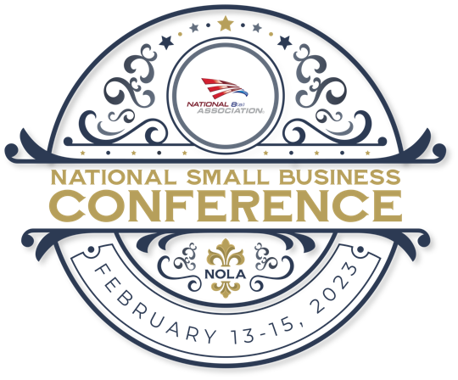
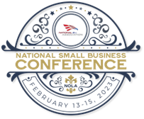
Financing Considerations for 8(a) Companies
Moderator: Jackie Robinson-Burnette SES2
Speakers:
Patrick Thom Action Capital
Peter Timbas TFN Lending
Teresa Moon Parabilis

Slide 2
Financing Considerations for 8(a) Companies
Establishing Financing Capacity
And Demonstrating Financial Capability
Patrick Thom & Peter Timbas

Slide 3
Patrick Thom – President & CEO Action Capital
19 Years with Action Capital
Former Global Relationship Manager ABN AMRO Bank - providing global banking, investment banking, tax structure and advisory services - 12 years
Former Director KPMG Corporate Finance- providing M&A Advisory services both sell side and buy side and equity and debt capital raising advisory – 3 years
Wisconsin native - UW Madison graduate
Atlanta resident – golfer, tennis, sailing, wild boar hunting

Slide 4
About Action Capital
Established in 1959
HQ in Atlanta, GA – but National Lending Presence
Pioneered the Federal Contracting Lending Market – 64 Years of Experience!
Fills a Niche Unserved by Traditional Bank Financing
Expert on Working Capital Financing for Small and Medium Sized Businesses
One of the Nation’s Largest Independent Receivables Based Finance Companies
Over $2 Billion in Funding Annually
“Lending to the Opportunity” – NOT financial statements

Slide 5
Action Capital Provides
Lending to the Opportunity
Immediate Access to Decision Makers
Accounts Receivable Lines of Credit up to $10,000,000
Accrued Revenue Advances/Payroll Funding
Aggressive advance rates up to 90%
Competitive Interest Rates and Fees
Financial Support Letters

Slide 6
Sources of Capital & Liquidity
Equity from Principal or Outside Sources
Merchant Cash Advance / ACH loans
Credit Card
Mezzanine Debt
Factoring
Action Capital (Finance Company)
Traditional Bank Debt
Normal Trade Terms
Highest Cost
Lowest Cost

Slide 7
Comparison of Working Capital Financing Sources
Traditional Bank LOC | Action Capital A/R Based Line | Factoring | Merchant Advance Loans
Lower Notional interest Rate 7.7% - 10% Attorney cost and closing fees | 12-18% APR (Interest + Processing fee No legal costs, no closing costs | 20-30% APR with a discount on the face amount of the invoice and a per diem on balance advanced. Sometimes difficult or impossible to know actual rate | Stated Rates 25% to 40% Actual Rates over 100%!!!
Difficult for Government Contractors & Service Companies to Qualify for in large amounts | 64 Years as Demonstrated Experts Supporting Government Contractors. Excellent fit with services based companies. | Can be a fit for Government Contractors and other industries – but… | All industries – no industry distinction. Easy to qualify little financial underwriting Based on bank account deposits
If Borrowing Base - ONLY 80% - 85% A/R based advances | 90% Advances on A/R 85% Advances on Accrued Revenue Sometimes Mobilization | 85% - 90% Advances on A/R only | Initial Draw – term structure only Daily/Weekly Amortization makes effective life short Effective Yield Typically 100% +
Requires CPA Financials, historical profits, 3 years of operating history, low debt to worth ratios and other covenant compliance | Requires Financial Statements but not lending to financials Asset Based Lending Approach Allows Easy Qualification Startup, limited operating history, losses, concentrations are all mitigated by asset based lending approach | Typically requires a high level of confirmation of invoices and direct contact with your customers. Focus on each invoice with upfont verification, stamping of invoices, mailing and collecting invoices, and high notification to your customers. Can cause unhappy customers, funding timing uncertainty | Bank statement lending. Single draw term loan with daily or weekly direct debits from your bank account. Severe drain on future cash flow (short term repayment at very high interest rate)
Requires Guarantees | Requires Guarantees | May require a guarantor – or pre-validation of every invoice | Requires Guarantors & Confessed Judgement Default
Requires Collateral - Accounts Receivable and Assets like Real Estate or Equipment | Collateral – only A/R and related contract rights – NO other assets | Typically A/R and related contract rights – often takes blanket lien on all assets | Requires Collateral – A/R and future receivables – may or may not file UCC
Long Approval process | Typically 1 Week Approval – 2 – 3 business days to fund. In rush situations have completed entire process n 1 day | Typically short approval process – 7 – 14 days but verification of receivable required prior to funding | Very Quick Approval – 2 – 3 days
Other Costs include Unused or Commitment Fees Other Nuisance Admin Fees | No other cots, no fees, no hidden costs (float days), no long term contract or minimum charge | Sometimes closing costs. Often requires a committed long term contract with mimum spend and audit fees. | Lots of nuisance fees and costs.
Little to No Verification of Invoices | Little to No Verification of Invoices | High verification process
Regular Financial Reporting (looking in rear view mirror) | Requires Quarterly Financial Reporting | Requires quarterly financials and monthly bank statements
Very strong, long track record operating companies. | Startups and young companies. Companies with losses, customer concentrations, tax liens, High Growth and Bankruptcy | Startups and young companies. Companies with losses, customer concentrations, tax liens, High and Low in Growth and Bankruptcy

Slide 8
Ideal Situations for Asset Based Approach
New federal contract award
Service companies without hard assets
Start up companies or companies with limited operating history
Turn around situations (sudden change in financial performance)
Large customer concentrations
Sales to government agencies
High financial leverage
Joint ventures

Slide 9
Benefits of Utilizing an Asset Based Lender
Look past obstacles that cause issues for traditional lenders
Limited Operating History
Mixed Operating Results
High Growth Situations
High Leverage
Customer Concentrations
Provides significantly higher levels of liquidity and capital than traditional lenders can provide
Financial support letters can help win new contracts
No upfront costs, annual costs, or fixed costs
Quick turnaround

Slide 10
How Action Capital Funding Mechanics Work
Action Capital Builds a Borrowing Base You Can Draw Against
Borrowing Base Consists of Billed Invoices for Completed Work/Deliverables and Accrued Revenue for Work Not Yet Invoiceable Under Your Contract
Collateral Reports Submitted to Action (as easy as generating invoices and reporting Accrued Revenue).
No Change to How You Invoice Your Customers
Payments on Invoices Remitted to Collections Account in Your Name – Payments Received Pays Down Any Advances and Reduces Reported Collateral
Interest Billed on Net Borrowed Balance Monthly In Arrears
Advances/Borrowings Sent to Your Bank Account Electronically Same Day Requested
Action Pushes Reports to you Daily Reporting Payments Received, Invoice Application Detail and Updated Collateral and Borrowing Capacity.
Secure Website Also Provides Detailed Reporting Updated Real Time
No Costs or Fees – Only Pay Interest on What You Borrow

Slide 11
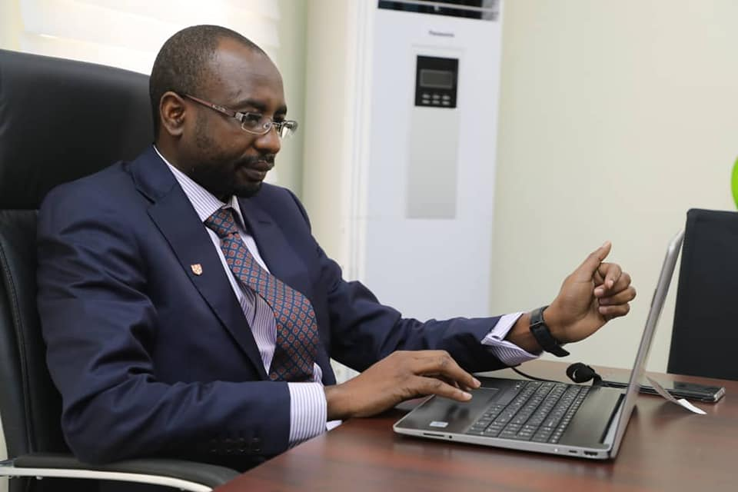
What are contracting officers looking for?
Demonstration that you have financial capacity to perform a new award
Identification of your truly unique capabilities and expertise
Highlights of your past performance

Slide 12
Marketing Your Financially Strong Company
Be procurement ready
Find decision makers – in advance
Engage decision makers
Differentiate your company
Leverage your financial support
Use your Socio-Economic status
Give them a reason to say yes

Slide 13
Leveraging Letters of Financial Support
Letters of financial support will give the client a competitive advantage with the potential to increase the win rate on contracts
Financial support will allow the leveraging of business with Action Capital
Receivables line of credit increase to match business volume rather than being based off of financial statements

Slide 14
Action Capital & TFN Contact Information
Patrick Thom Peter Timbas
President & CEO President
Action Capital Corporation TFN Lending
Tel. 404-524-3181 Tel. 202-400-1123
Email: Patrick@actioncapital.com Email: peter@tfnlending.com
230 Peachtree Street
Suite 1910
Atlanta, GA 30303

Slide 15
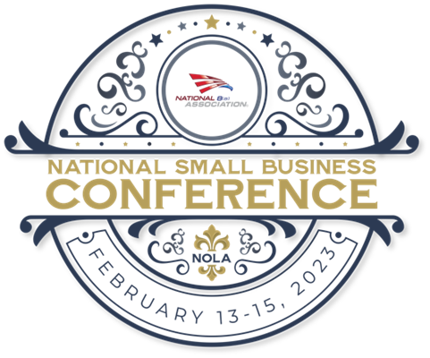
Funding your Growth Teresa Moon
National 8(a) Small Business Conference
2023
Who is new to government contracting?
Who already has a funding plan and partner in place?
What is most important to you in a financial partner?
Are you tracking cash flow, and do you know how it is effecting your profitability?

Slide 16
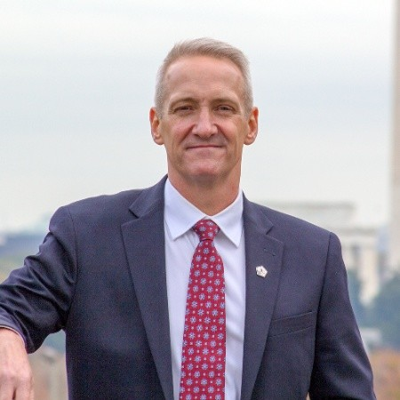
We can all do well if we start by doing good!
Chairman of the Board:
* Dr. Edward Bersoff founded Parabilis in 2013. With over 40 years of experience in government contracting, he understood the need small businesses have in accessing flexible and affordable capital when traditional financing is outside of their reach.
Chief Executive Officer
* Retired Col. Bruce Lyman has 30 years of service with USAF both enlisted and as a reservist with most notably 20 deployments to Afghanistan, Iraq and CENTCOM AOR. He retired as Chief Information Officer of USAF Intelligence. Additionally, Bruce has 20+ years in government contracting experience having led multiple businesses prior to joining Parabilis in 2016.

Slide 17
A Better Financial Partner for government contractors
“We scaled with a very significant double digit million-dollar contract and we were looking for a partner to immediately come in and provide working capital, be flexible in terms of our growth, and be able to scale and make adjustments on an every few month period. Parabilis is our white knight that came in and provided the financing that we needed.”
Diana Hage, CEO of RFID Global Solutions Parabilis client since 2015
“The Parabilis model represents a revolutionary approach to financing within the government contracting industry. The team at Parabilis really understands the mechanics of federal contracts and perhaps, more importantly, they invest the time to understand your business beyond just the numbers. I highly recommend giving them a call before you consider any other solution for your cash flow needs.”
President, $15M SDVOSB Prime Contractor Serving the DoD and DOJ CONUS and OCONUS

Slide 18
If you win it, can you fund it?
Borrow against any of the following at any time and all at once:
BILLED INVOICES
Up to 90%
You are not selling invoices to Parabilis, you are borrowing against your prime and sub-contract invoices that have been billed.
WORK IN PROGRESS
Up to 65%
You are eligible to borrow against work that has been completed but not yet billed, further increasing access to capital.
DELIVERY ORDERS
Up to 30%
You can also borrow against delivery orders from the government to purchase physical goods in support of a contract or to fulfill an order.
Have partners that understand your industry
Have reliability of access in good times and bad
Get advice, support, resources and advocacy without fear of loan termination

Slide 19
Let’s chat! Teresa Moon Director of Business Development Teresa@parabilis.com
If you would like to be a guest on our podcast, “Spilling the Tea on GovCon”or you would like to provide information to be shared in a partner blog that will appear in our monthly newsletter, let’s schedule a meeting and chat!
We strive to meet you where you are and connect you with the information, resources and access to additional opportunities provided by our vast community can to you!

Slide 20
Questions

