Slide 1
The Service Contract Act: Issues & Solutions for Government Contractors and Subcontractors
Alex Major, McCarter & English; Vanessa Quiñones, GSA National; & Jeffrey Ramsey Assured Partners

Slide 2
Alex Major
Attorney/Co-Leader, Government Contracts & Global Trade Group
McCarter & English

Slide 4
The McNamara-O’Hara Service Contract of 1965 (SCA)
Intended to address areas not covered by the Fair Labor Standards Act and similar labor laws
Leveled the playing field by removing wages as a bidding factor in contract competition
Frequently amended; most prominently:
1972 – to address predecessor wages and discretion in allowable exemptions
1989 – to be included in the FAR

Slide 5
The McNamara-O’Hara Service Contract of 1965 (SCA)
Requires contractors and subcontractors performing services on prime contracts in excess of $2,500 to pay service employees in various classes no less than the wage rates and fringe benefits found prevailing in the locality, or the rates including prospective increases contained in a predecessor contractor’s CBA
The Department of Labor (DOL) issues wage determinations on a contract-by-contract basis in response to specific requests from contracting agencies.
These determinations are incorporated in the contract
…and sometimes not…but should’ve been…but weren’t…but…
SCA Elements:
Contracts entered into by Federal Government and District of Columbia
Contracts principally for services
Contracts performed in the U.S.
Contracts performed through the use of service employees

Slide 6
The McNamara-O’Hara Service Contract of 1965 (SCA)
SCA defines service employee as:
Any person engaged in performance of contract, except
Employees who qualify for exemption as bona fide executive, administrative or professional employees under the FLSA
Employee coverage does not depend on contractual relationship
For example, “owner operator” or “independent contractor” labels immaterial
Not SCA covered Contracts
Contracts primarily for something other than services, e.g., construction
Contracts for leasing of space
Contracts for professional services
Federally-assisted contracts for services entered into by state governments, e.g., Medicaid and Medicare programs

Slide 7
Key FAR Provisions/Triggers
Explanation & Scope
48 CFR Subpart 22.10 - Service Contract Labor Standards
Relevant Clauses
48 CFR § 52.222-41 - Service Contract Labor Standards.
48 CFR § 52.222-43 - Fair Labor Standards Act and Service Contract Labor Standards - Price Adjustment (Multiple Year and Option Contracts)
48 CFR § 52.222-44 - Fair Labor Standards Act and Service Contract Labor Standards - Price Adjustment
48 CFR § 52.222-48 - Exemption From Application of the Service Contract Labor Standards to Contracts for Maintenance, Calibration, or Repair of Certain Equipment - Certification
48 CFR § 52.222-49 - Service Contract Labor Standards - Place of Performance Unknown

Slide 8
Service Employees
FAR 37.101 defines “service” contract as a contract that directly engages the time and effort of a contractor whose primary purpose is to perform an identifiable task rather than to furnish an end item of supply
Characteristics of services (one or more may apply):
Buying effort and labor hours
Performing an identifiable task
Work performed on an end item
May not have a tangible end item
Look to the Wage Determinations and think “broadly”

Slide 9
Not Service Employees
FLSA Salary Basis Test ($684/week or $35,368/year*)
Exempt Duties:
Professional
Administrative
Executives
Computer-Related Jobs
Exempt computer employees may be paid at least $684 on a salary basis or $27.63 per hour
Highly Compensated Employees

Slide 10
SCA Requirements
Wages
Fringe Benefits
Health and Safety Protections
Required Notifications to Employees
Sick leave per EO 13706

Slide 11
Vanessa Quiñones
EVP of Client Development
GSA National

Slide 12
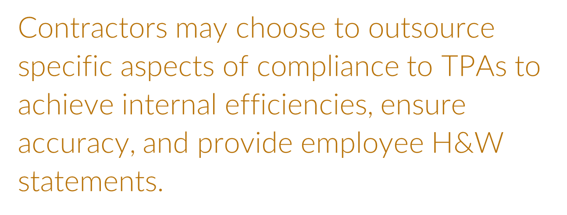
Compliance Challenges

Slide 13
Wage Determinations

Slide 14
Wage Determination – Health & Welfare Rate

Slide 15
H&W Rate Increases
Although the H&W rate is published each June-July, the rate is not applied to all contracts on that date.
Wage Determination revisions are incorporated either at contract option periods, or if there are not contract option periods, no less than every 2 years.
Some contracts are not funded with annual appropriations. In these situations, the contract will not have option years and thus the WD will be incorporated into the contract the second year on the anniversary date, not the first year anniversary date.
However, the contractor should only provide the new H&W rate after their Contracting Officer has formally notified the contractor of the rate increase.
It is the Contracting Officer’s responsibility to ensure that contractors are notified of these rate increases.

Slide 16
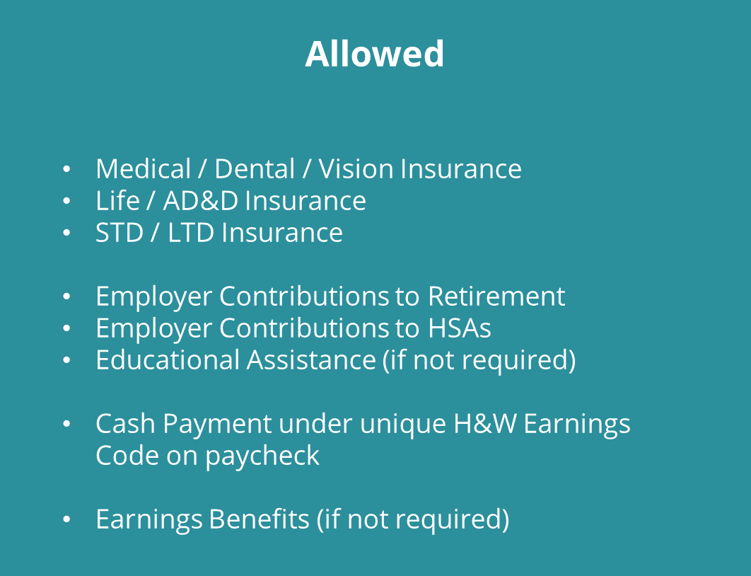
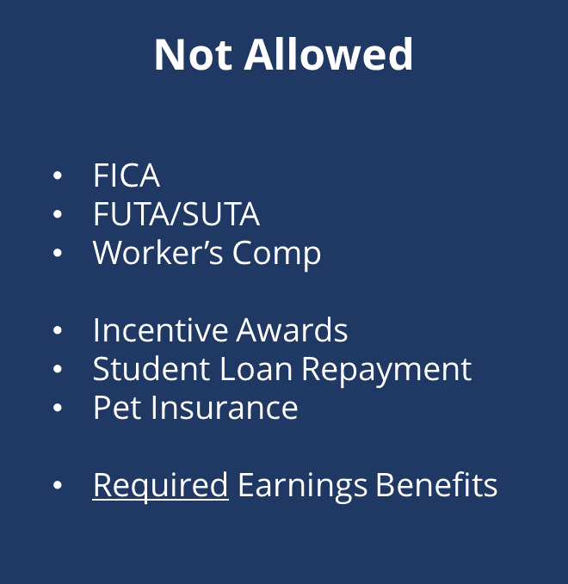

Slide 17
Health and Welfare Compliance Measurement
Calculate Employer’s Health & Welfare Obligation
(Hours x H&W Rate)
No Action Required. Employer has over-funded benefits.
?
YES
Do the Employer-Paid Benefits exceed the Employer’s H&W Obligation?
Calculate “Bona Fide” Employer-Paid Benefits
and H&W Earnings,
if applicable.
Employer must “true up” underfunded amount (H&W earnings, retirement, etc.)
NO

Slide 18
Best Practices for working with Contracting Officers

Slide 19
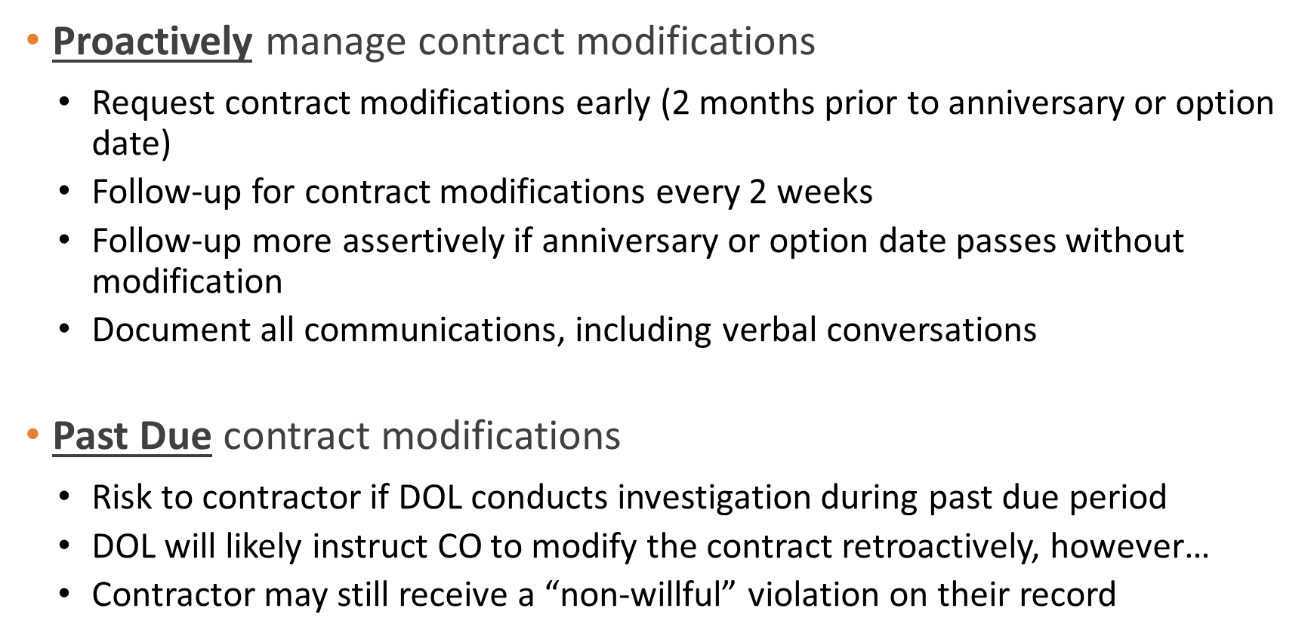
Best Practices for working with Contracting Officers

Slide 20
Jeffrey Ramsey
Vice President of Employee Benefits
Assured Partners

Slide 21
Budgeting H&W Benefits and the SCA
Assumptions
Contract is not subject to E013706 Fringe Rate is $4.80
Contract is Even numbered. Subject to individual accounting and hours worked

Slide 22
What is my Budget?
HEALTH & WELFARE: $4.80 per hour paid up to 40 hours per week or $192 per week or $832 per month
$832 is NOT the budget for a Full Time employee
FTEs may be scheduled to work a 40 hour week however there are variables. Sick, PTO change in employment status.
ACA mandate changes FTE in Benefits Category

Slide 23
ACA Defines Benefits
An employee working 30 or more hours a week is considered full-time. (Applies to 50 FTEs or combined hours of part timers are equivalent to 50 FTEs)

Slide 24
$623.52 What are My Options?
Pay the Health and Welfare as Cash
Offer Medical, Dental, Vision, Life, Disability
Retirement

Slide 25
Medical Dental Vision Life Disability
Popular option: Create multi level plans with the minimum plan cost not to exceed $623.52. After benefits are selected, the available balance of the fringe may go to retirement.

Slide 26
Base Plan

Slide 27
High Plan Options

Slide 28
Part Time and Voluntary Option

Slide 29
Sample Reporting

Slide 31
Alex Major, McCarter & English
amajor@mccarter.com
202.753.3440
www.mccarter.com
Vanessa Quiñones, GSA National
vquinones@gsanational.com
800-250-2741 ext. 193
www.gsanational.com
Jeffrey Ramsey, Assured Partners
Jeffrey.Ramsey@assuredpartners.com
972.461.7334

