Slide 1
Maximizing Growth Through Targeted Subcontracting with Large Businesses
Gwen Johnson, Rita Brooks, Shawn Ralston, Tyler Brooks-Craft, and Meredith Koons

Slide 2
Who is in the audience today?
I’m with a Small Business
I’m with a Large Business
I’m with a Non-Profit, PTAC,
or Educational Institution
I’m with the government
I’d rather not say. I’m undercover!

Slide 3
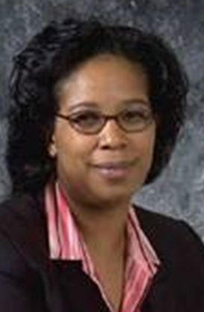
Gwen Johnson | Parsons
Director of SB Programs & SBLO
Favorite Sports Team |  | Hobbies |  | Did You Know…
The Nationals |  | Traveling, particularly sightseeing |  | I am a licensed minister

Slide 4
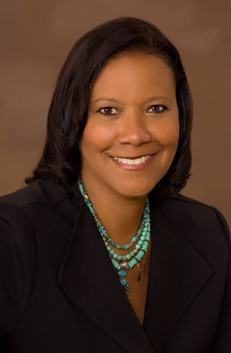
Rita Brooks | SAIC
Director of SB Programs
Favorite Sports Team |  | Hobbies |  | Did You Know…
Ravens. I have had a personal seat license (with season tickets) with my husband since they started in 1996. Not happy with them right now! |  | I Love to read |  | Me and my family have spent Christmas in a warm place for the past 6 years now that my daughter is grown up (25). This year it is Aruba. Can’t wait!

Slide 5
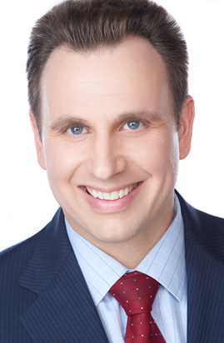
Shawn Ralston | AECOM
SB Program Director & SBLO
Favorite Sports Team |  | Hobbies |  | Did You Know…
Any University of Virginia team |  | Running and Vacationing with my wife and four year old daughter |  | I’ve completed a marathon in every state.

Slide 6
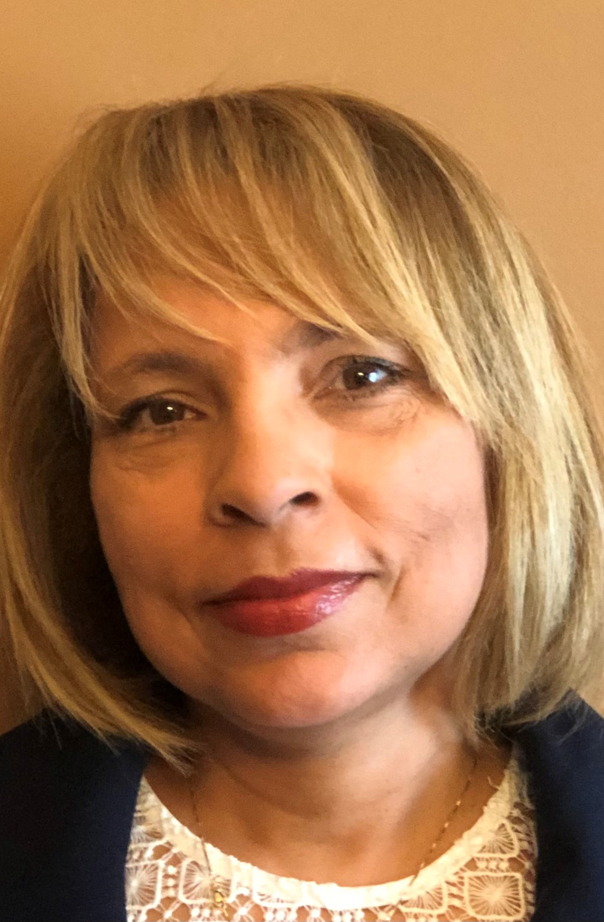
Tyler Brooks-Craft | CGI Federal
Director, Small Business Engagement/Supplier Diversity Advocate
Favorite Sports Team |  | Hobbies |  | Did You Know…
James Madison University (JMU) football team GO DUKES! |  | Reading and traveling |  | I am a collector of beanie babies and wheat pennies

Slide 7
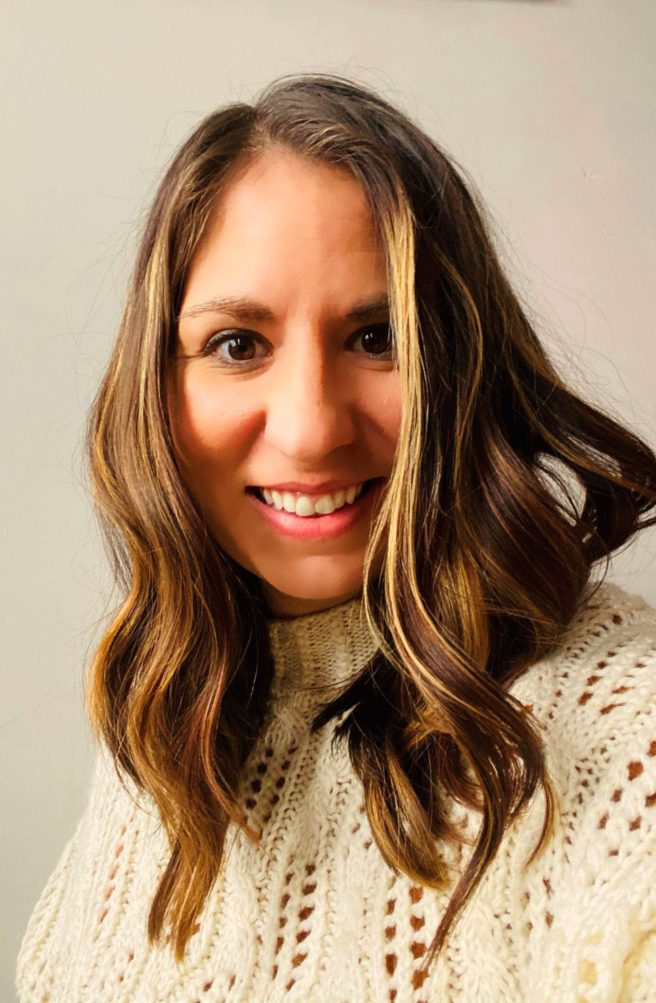
Meredith Koons| Conti Federal
Director of Marketing and
Small Business Programs
Favorite Sports Team |  | Hobbies |  | Did You Know…
Notre Dame football |  | Kickboxing, Hiking, Biking, Paddleboarding |  | I met Bryan Cranston 3 times – does this make us best friends?

Slide 8
Maximizing Growth Through Targeted Subcontracting with Large Businesses
Gwen Johnson | Rita Brooks | Shawn Ralston | Tyler Brooks-Craft | Meredith Koons
Parsons Director of SB Programs & SBLO | SAIC Director of SB Programs | AECOM SB Program Director & SBLO | CGI Federal Director, Small Business Engagement/Supplier Diversity Advocate | Conti Federal Director of Marketing and Small Business Programs
703.988.8532 gwen.johnson@parsons.com | 830.755.8795 Marguerite.Brooks@saic.com | 703.559.1338 shawn.ralston@aecom.com | 703.227.6000 tyler.brooks-craft@cgifederal.com | 732.540.9478 mkoons@contifederal.com
Parsons, a leading disruptive technology provider in national security and critical infrastructure markets, has capabilities across cybersecurity, missile defense, space, C5ISR, transportation, enviro. remediation, & water/ wastewater treatment. | SAIC is a premier technology integrator driving our nation’s technology transformation Our secure solutions include engineering, digital, artificial intelligence, and mission solutions. | AECOM has partnered with federal agencies for 100+ years to deliver com-prehensive infrastructure, facilities, energy, environment, disaster resilience and civil works services for our clients’ most challenging projects. | CGI is among the largest IT and business consulting services firms in the world and provides comprehensive, scalable and sustainable IT and business consulting services that are informed globally and delivered locally. | Conti Federal Services is a leading global construction and engineering company with roots dating back to 1906. The company has delivered some of the most demanding projects for the U.S. federal government, specializing in military and secure construction, critical infrastructure, environmental remediation, and disaster response and recovery.

Slide 10
Gwen Johnson, Parsons
Shawn Ralston, AECOM
gwen.johnson@parsons.com
shawn.ralston@aecom.com
703.988.8532
703.559.1338
parsons.com
aecom.com
Rita Brooks, SAIC
Tyler Brooks-Craft, CGI
Marguerite.Brooks@saic.com
tyler.brooks-craft@cgifederal.com
830.755.8795
703.227.6000
saic.com
cgi.com/us/en-us/federal
Meredith Koons, Conti Federal
mkoons@contifederal.com
732.540.9478
contifederal.com

