Slide 1
Beyond the Hype: How AI Can Help 8(a) Businesses Accelerate Growth
Kevin Brancato

Slide 2
Kevin Brancato
SVP of Product Strategy
TechnoMile

Slide 3
The Evolution of Capture Management
Capture teams spend a lot of time on research to gain strategic, competitive, and opportunity intel
Capture process focuses on most strategic opportunities
Online aggregations of publicly available contract and opportunity information
Start of move away from binders and war rooms to file share systems and color team reviews
Yesterday
Today
Tomorrow

Slide 4
The Evolution of Capture Management
Capture teams spend a lot of time on research to gain strategic, competitive, and opportunity intel
Capture process focuses on most strategic opportunities
Online aggregations of publicly available contract and opportunity information
Start of move away from binders and war rooms to file share systems and color team reviews
Capture teams spend more time in formal processes to make better decisions
More opportunities managed using a capture process
Online analytics, rapid market assessment and opportunity enhancement
Senior growth professionals guide business strategy with unique knowledge, skills and abilities
Yesterday
Today
Tomorrow

Slide 5
The Evolution of Capture Management
Capture teams spend a lot of time on research to gain strategic, competitive, and opportunity intel
Capture process focuses on most strategic opportunities
Online aggregations of publicly available contract and opportunity information
Start of move away from binders and war rooms to file share systems and color team reviews
Capture teams spend more time in formal processes to make better decisions
More opportunities managed using a capture process
Online analytics, rapid market assessment and opportunity enhancement
Senior growth professionals guide business strategy with unique knowledge, skills and abilities
Capture process evolves to leverage automated predictions, forecasts, key trends, and similarities
Evaluation of all opportunities at low cost
Assistive, generative tools rapidly extract and summarize info from spreadsheets, emails, and documents, delivering intel
Distributed information allows for smaller capture teams; individual capture team members gain more responsibility over larger portfolios
Yesterday
Today
Tomorrow

Slide 6
Public and Private Data is Pivotal
Capture professionals have substantially more data at their fingertips than ever before
Public data
Private data
High-level understanding
Distributed local knowledge
Historical spending
Historical and current opportunities
Forecasts and budgets
Go/no-go and win/loss history
Emails, call and meeting notes
Agreements, proposals, contracts
When cleansed and organized, public data can help you understand customers, competitors, and partners
When recorded, structured, and analyzed, private data can help you understand your own company

Slide 7
Build an AI-Enabled Capture Process
Public
Private
1
2
3
4
Ingest, clean,
connect, and
personalize
public data
Set up and use CRM and contract management tools
Create intel from private and public data
Empower smart
people to make
better decisions

Slide 8
Build an AI-Enabled Capture Process
Public
Private
1
2
3
4
Ingest, clean,
connect, and
personalize
public data
Set up and use CRM and contract management tools
Create intel from private and public data
Empower smart
people to make
better decisions

Slide 9
Build an AI-Enabled Capture Process
Correlation Engine
Public
Private
Analytics
1
2
3
4
Ingest, clean,
connect, and
personalize
public data
Set up and use CRM and contract management tools
Create intel from private and public data
Empower smart
people to make
better decisions

Slide 10
Build an AI-Enabled Capture Process
Correlation Engine
Public
Analytics
Private
AI / ML / NLP
1
2
3
4
Ingest, clean,
connect, and
personalize
public data
Set up and use CRM and contract management tools
Create intel from private and public data
Empower smart
people to make
better decisions

Slide 11
AI/ML/NLP Can Help Grow Your Business
Automate repetitive tasks, turn data into expertise, make smarter and faster decisions
Quantitative
Qualitative
Opportunity value and date figures
Pursuit budget estimate
Market and revenue forecasts
Pwin and Pgo predictions
Pre-filled charts for review briefings
Opportunities
Customers, teammates, competitors
Contacts
Markets
Capture team members
Prediction models can make initial, essential calculations automatically
Recommendation models can help you pay attention to what matters
Copilots can instantly summarize complex details, enable conversational exploration of data and information

Slide 12
AI/ML/NLP Can Help Boost Business Functions
Capture
Portfolio
Pipeline
Account
Proposal
Process Improvement
Competitive Landscape

Slide 13
Build an AI-Enabled Capture Process
Customize your market and pipeline
Historical Spending
FPDS/USAspending
Vendor, agency, and contract hierarchies
Small Business status
Opportunity Pipeline
SAM, DIBBS, forecasts
Task order RFIs
Pipeline
AI/ML/NLP
Unlocking Value
Create structured private data through extraction of features, including capabilities
Link private structured data with public structured data
Internal data & connections to private data must be secure
Opportunities
Emails
Meeting notes
Qualification
Gate reviews
Color Team decisions
Wins and Losses
SOWs
Contracts
Use details from past wins and losses to assess new opportunities
Value and date forecasts; summarization & conversational exploration of opportunity details
Benchmark scores of Pwin and Pgo
Identify valuable partners and competitive threats
Recommend adjacent markets and customers
Secure Environment
Ingest, clean, connect and
personalize public data
Set up and use CRM and
contract management tools
Create intel from private
and public data
Empower smart people
to make better decisions

Slide 14
GovSearchAI Demonstration

Slide 16
Kevin Brancato, TechnoMile
Kevin.Brancato@technomile.com
703.209.3865
Technomile.com

Slide 17
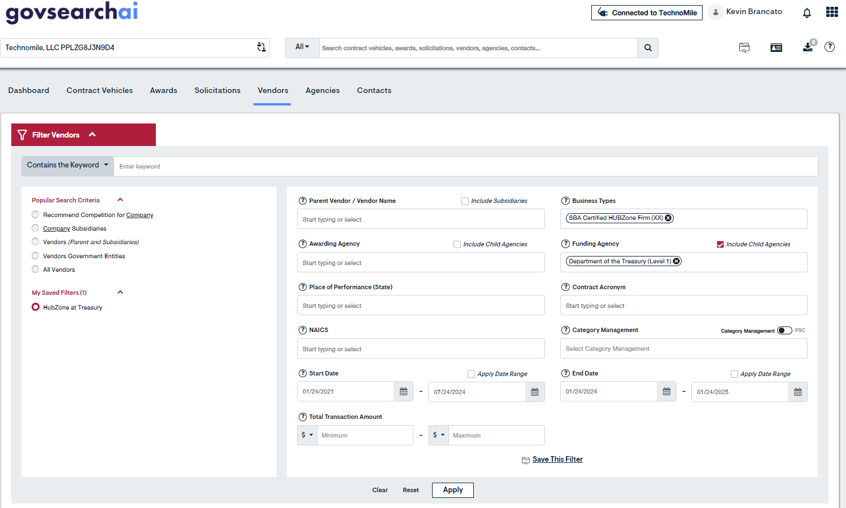
Identify Valuable Partners, Potential Competitors

Slide 18
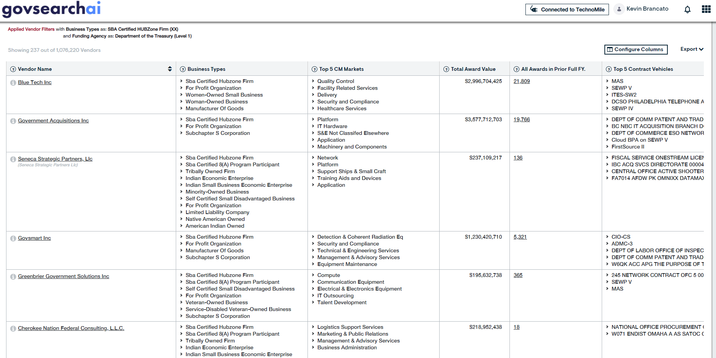
Identify Valuable Partners, Potential Competitors

Slide 19
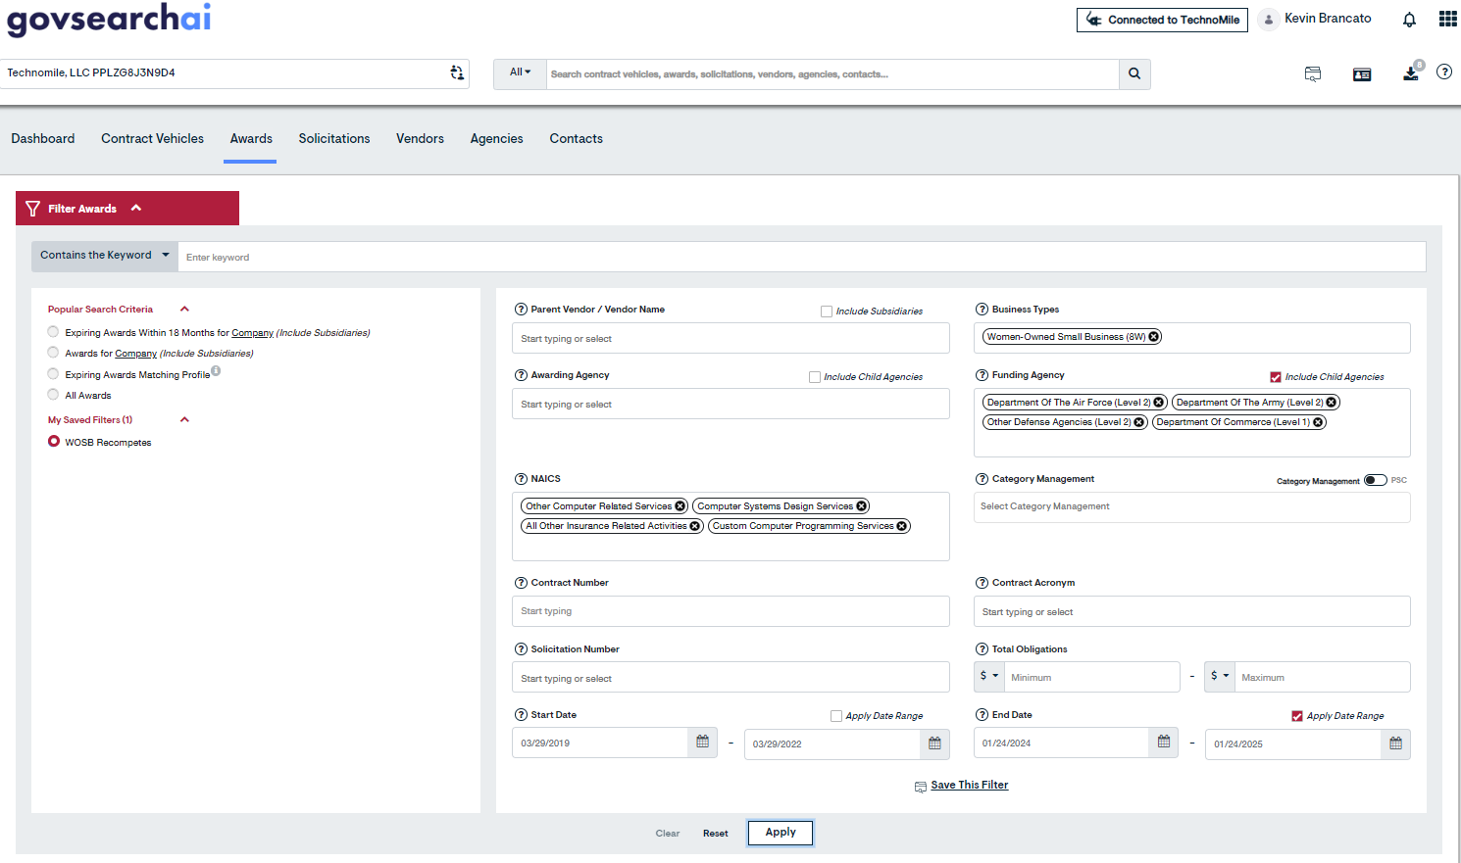
Create a Personalized View of Opportunities

Slide 20
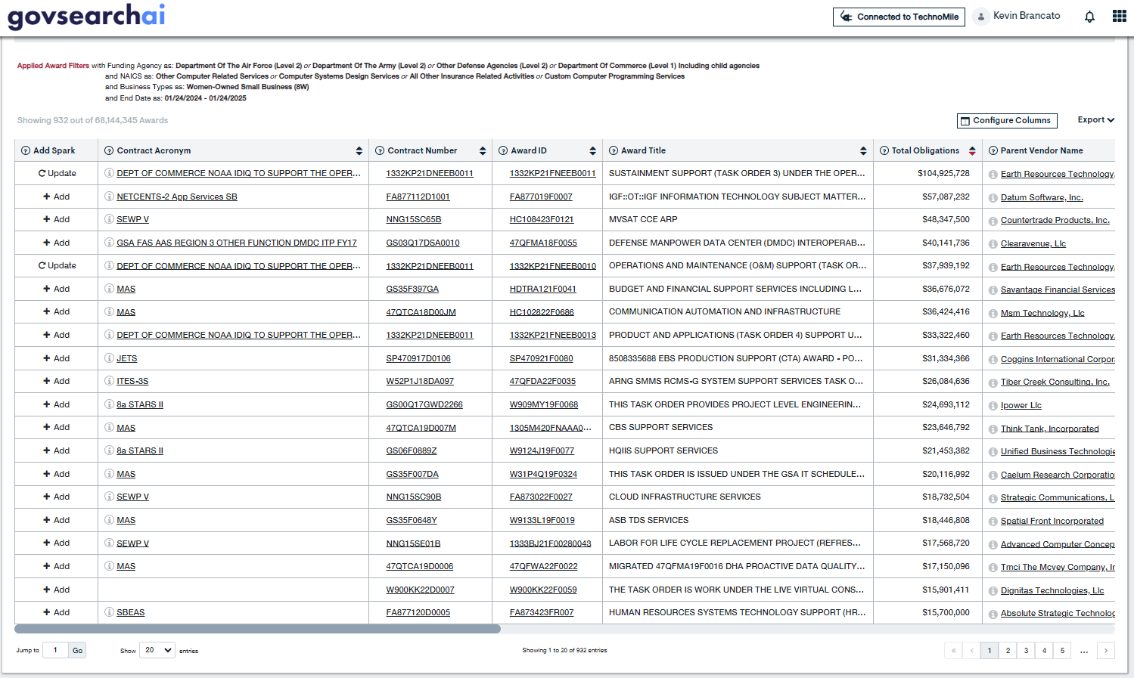
Create a Personalized View of Opportunities

Slide 21
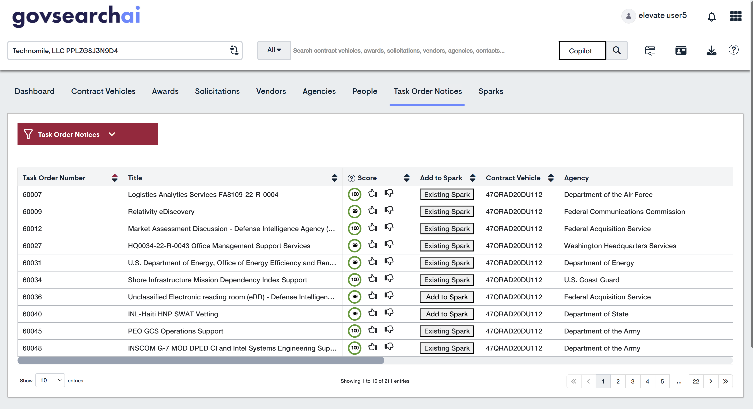
Let AI Help Identify Highly Relevant Opportunities
Notes:
CRM data used to analyze your company’s win/loss history, key capabilities, and other attributes
AI-powered recommendation engine continuously sifts through expiring awards, new solicitations, and newly-published task orders and recommends leads your organization is best positioned to win
Delivers highly-relevant leads for your team to evaluate, allowing you to focus resources on the strongest opportunities

Slide 22
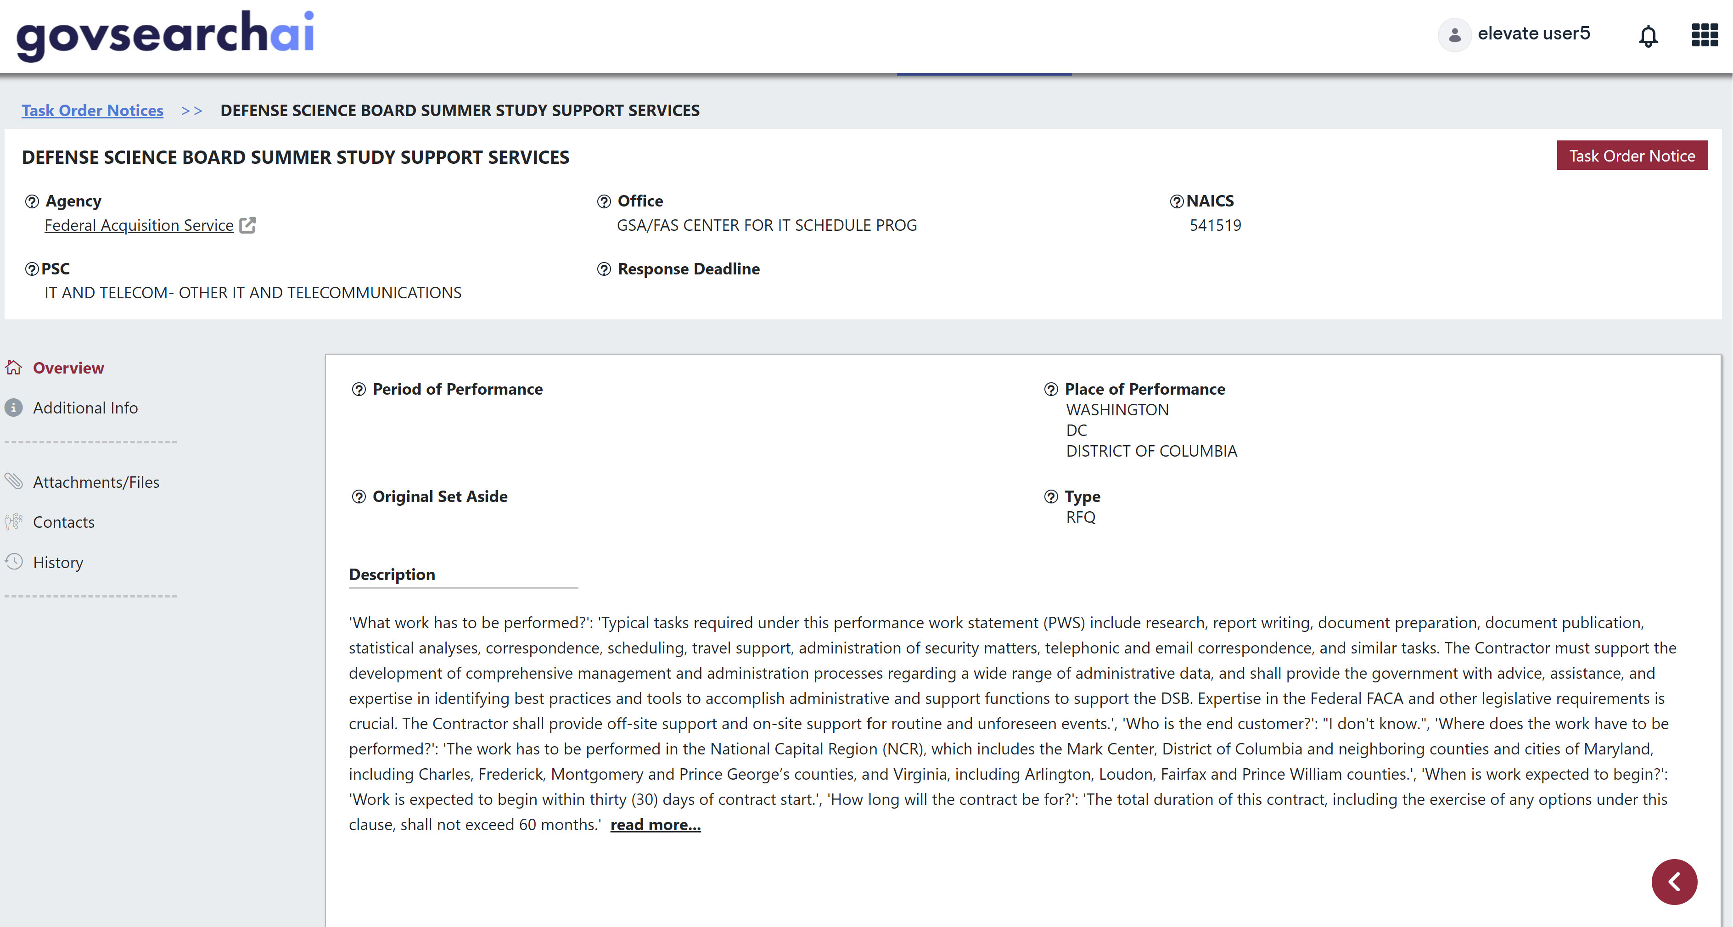
Instantly Understand Critical Details
Notes:
See an instant summary of critical details from solicitations, task/ delivery order notices, and all related documents

Slide 23
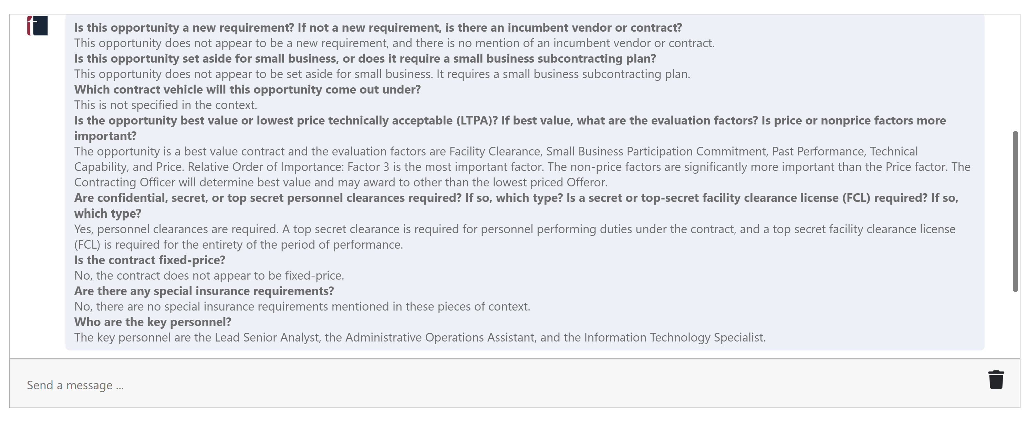
Instantly Understand Critical Details… and Get Answers
Notes:
Use the copilot’s assistive, generative, natural language capabilities to speed discovery and analysis in GovSearchAI
See an instant summary of critical details from solicitations, task/ delivery order notices, and all related documents
Leverage the copilot to ask and quickly get answers to your own questions as you evaluate leads

Slide 24
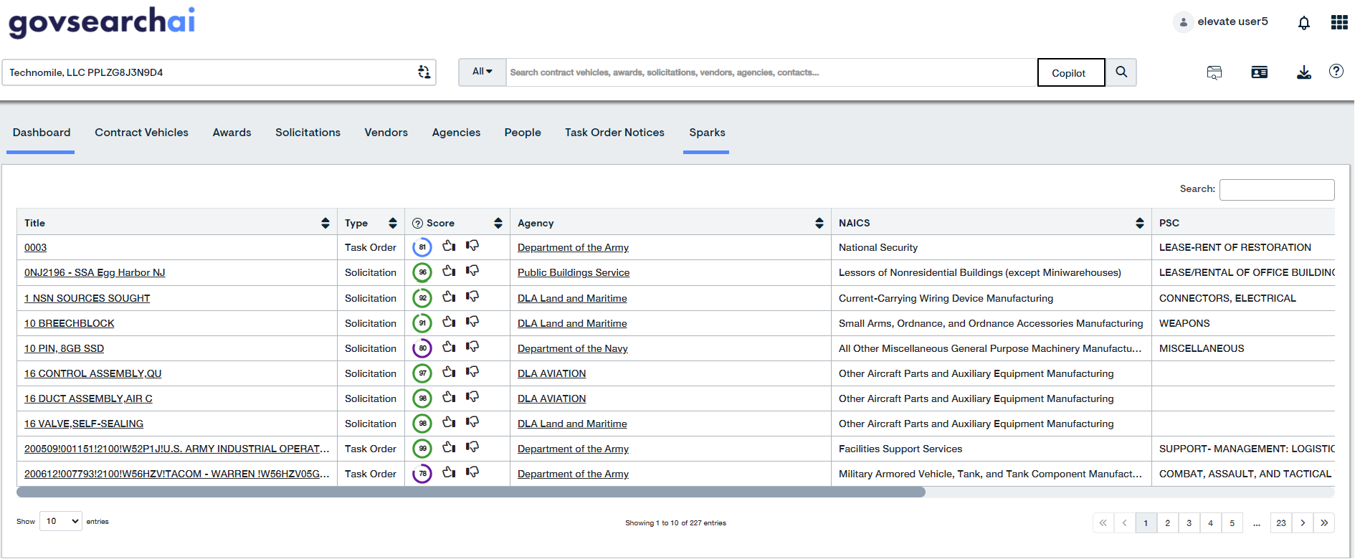
Focus on Highly Relevant Leads for Further Evaluation
Notes:
Delivers highly-relevant leads for your team to evaluate, allowing you to focus resources on the strongest opportunities

