Slide 1
Fringe Benefits: Will They Help or Hurt Your Small Business?
Taylor Boon
President and CEO | Boon

Slide 2
Taylor Boon
President and CEO
Boon

Slide 3
The McNamara-O’Hara Service Contract Act of 1965 (SCA)
Or Davis-Bacon Act of 1931 (DBA)
In general, service contractors under SCA or construction contractors under DBA contracts have minimum hourly requirements for wages & benefits.
Wage Determination dictates the wages under the contract as well as the amount available for benefits.
This hourly requirement for benefits is called a fringe rate
However, sometimes these are called prevailing wages and H&W.
Because benefits are required to be tracked on an hourly basis, complications can arise from trying to fit a traditionally priced monthly benefit plan into an hourly requirement on a government contract.
Let’s begin with an understanding of the laws on your contract, and what you are allowed to do with the Health & Welfare fringe.
FAR Subpart 22.10-Service Contract Labor Standards, https://www.acquisition.gov/sites/default/files/current/far/html/Subpart%2022_10.html

Slide 4
What must a contractor do to satisfy the fringe benefit obligation?
Fringes must be furnished separately from and in addition to specified wages
May be discharged by furnishing equivalent benefits or cash in lieu of benefits
Wages paid in excess of the Wage Determination minimum wage requirement cannot offset fringe requirement
Benefits must be “bona fide”
Payments must be segregated as benefits, not as wages
It is the Employer (not Employee) who can decide how the fringe is spent.
Bona Fide Fringe Benefits
Fringe benefits that meet the requirements of the SCA are defined in 29 CFR Part 4 Section 4.171. DBA are defined in 29 CFP Part 5 Section 5.20
Best Practices
Refer to the Field Operations Handbook
(Chapter 14; SCA) ; (Chapter 15; DBA)

Slide 5
How do Fringe Benefits Help or Hurt Your Business?
Affordable Care Act & Cost Containment
Low Price Environment - LPTA
How to protect future profits and success?

Slide 6
What are the biggest benefits challenges facing Small Businesses today?
The Common Theme:
What we hear:
The balancing act between benefits affordability and the need to pay the Health & Welfare fringe in cash.
“In a tough labor market, cash is king.”
“Benefits are no longer affordable to my employees.”
“How do I remain in compliance, offer benefits, and remain competitive?"
“Why do my rates go up every year!?”

Slide 7
State of the Union: Benefits Costs
The average annual premiums in 2022 were $7,911 ($659 per month) for single coverage per year and $22,463 ($1,872 per month) for family coverage. (KFF.org)
Take me somewhere expensive…
According to Mercer’s National Survey…
Health benefit cost rose 3.2% in 2022 and is expected to rise 5.4% in 2023.
Northeast pays the most, Southeast the least.
Transport/Communication/Utility Sector has the highest average total cost outside of the government.
For each FT working 30 hours a week, an SCA contractor has just $548.40 available, working a full 40 hours a week, an average of $792.12 for benefits.

Slide 8
Making the tough decision today will give you the competitive advantage tomorrow.
Employees want cheaper insurance,
but costs are primarily driven by demographics and location.

Slide 9
Best Practices for Small Business
The ideal scenario is to build a Fringe Benefit offering which matches the Fringe
Benefits
Provides the best Long-Term value to your employees (keeps costs low by avoiding adverse selection to your plan).
Protects profits (ensures you are spending no more or less than what is owed).
Allows you to more competitively bid on future work
Cost
Competitiveness
Compliance

Slide 10
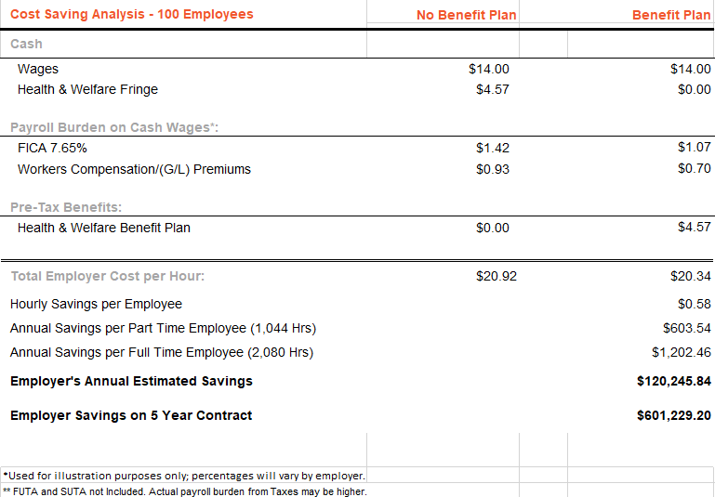
Cost Savings by Allocating the Fringe (as it was meant to be…)
On Average – Paying the H&W in cash costs a contractor $1,200 a year.
Remember “if it was meant to be paid in cash, it would have been called wages and not Health and Welfare!”

Slide 11
How does a contractor position themselves correctly,
but also keep up employee expectations?
Health insurance costs are rising faster than the fringe increases, which suggests that making tough decisions today may pay dividends in the future.
Spend no more than the fringe available.
Remember: Under SCA guidelines, contractors cannot force an employee to pay for fringe benefits from their wages. DBA you can dip into base wages.
Therefore, if a contractor requires an employee to participate in its benefit plan, costs must be contained within the fringe or risk becoming a liability to the contractor.
Without a proper strategy, hemorrhaging health plan related costs could reduce profits on a 3-, 5- or 7-year contract.

Slide 12
How does a contractor position themselves correctly,
but also keep up employee expectations? (cont.)
Work toward eliminating all remaining cash payments in lieu of benefits
By paying cash in lieu of benefits, contractors take on additional payroll tax burden
Consider retirement, supplemental health, or ancillary only plans for part-time employees
Reduce or eliminate contributions toward dependent coverage.
Dependent eligibility audits
Consider programs designed to encourage dependents to adopt spouse’s health program.
Reducing or eliminating any sick leave or excess vacation provided above what is required by the contract.
Taking steps today to make sure to correctly classify employees into distinct classes of full and part-time employees for planning purposes.
If employees vary in hours worked, it may be beneficial to choose a lower priced health option to ensure costs are contained to the fringe available each month.

Slide 13
Are you already at the point of no return? Additional ideas to contain Benefit Costs…
Dependent eligibility audits
Consider programs designed to encourage dependents to adopt their spouse's health programs.
Endorse Telemedicine
Diabetes tracking and support
Self Funding (Exercise Caution: However, done compliantly, this can allow you to restrict certain high-priced drugs and procedures.)
Consider Reference-Based Pricing
Benefit waiting periods for Major Medical
Look at Narrow Network Plans
Look at Consumer Driven Health Plans (About 40 percent of all health plans are HDHPs)
Increase Deductibles and add Critical Illness, Hospital Indemnity, or Gap Programs

Slide 15
Contact Boon today!
Taylor Boon President and CEO
tboon@boongroup.com
512 279 7116
Your link to benefits®
boongroup.com

