Slide 1
Strategic Alliances & Mastering Collaboration with Primes in the Federal Arena
Moderator: Rita Brooks
Panelists: Meredith Koons, Alex Agyemang, Tyler Brooks-Craft, Shawn Ralston, Gwen Johnson

Slide 2
Who is in the audience today?
I’m with a Small Business
I’m with a Large Business
I’m with a Non-Profit, PTAC,
or Educational Institution
I’m with the government
I’d rather not say.
I’m undercover!

Slide 3
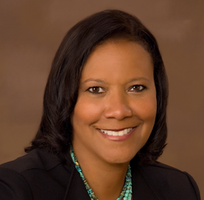
Rita Brooks
Did You Know…
Me and my family have spent Christmas in a warm place for the past 6 years now that my daughter is grown up (25).
Director of SB Programs
SAIC
Hobbies
I Love to read
Favorite Sports Team
Ravens. I have had a personal seat license (with season tickets) with my husband since they started in 1996.

Slide 4
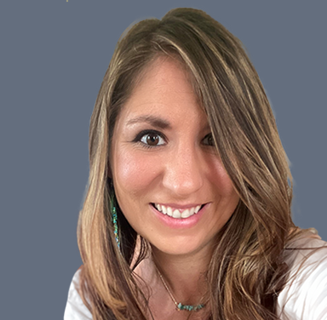
Meredith Koons
Did You Know…
I met Bryan Cranston 3 times – does this make us best friends?
Director of Marketing and
Small Business Programs
Hobbies
Kickboxing, Hiking, Biking, Paddleboarding
Favorite Sports Team
Notre Dame football
Conti Federal

Slide 5
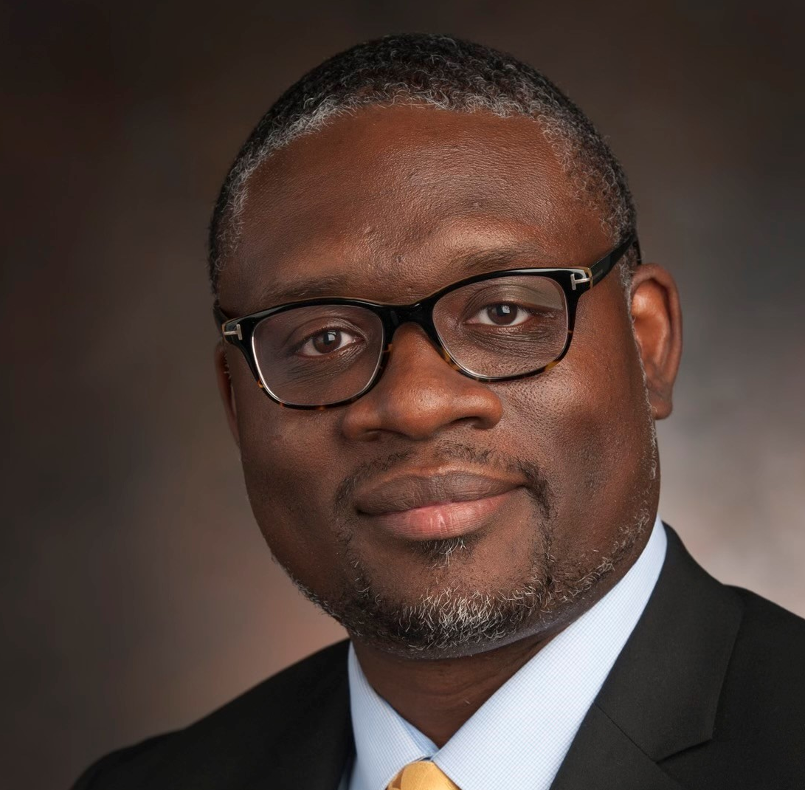
J. Alex Agyemang
Did You Know…
I am a licensed minister
Global Supplier Diversity Leader & SBLO
Hobbies
Singing, golf
Favorite Sports Team
The NY Yankees
Booz Allen Hamilton

Slide 6
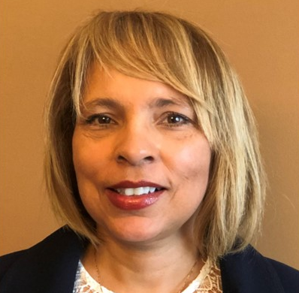
Tyler Brooks-Craft
Did You Know…
I am a collector of beanie babies and wheat pennies
Director, Small Business Engagement/
Supplier Diversity Advocate
Hobbies
Reading and traveling
Favorite Sports Team
James Madison University (JMU) football team GO DUKES!
CGI Federal

Slide 7
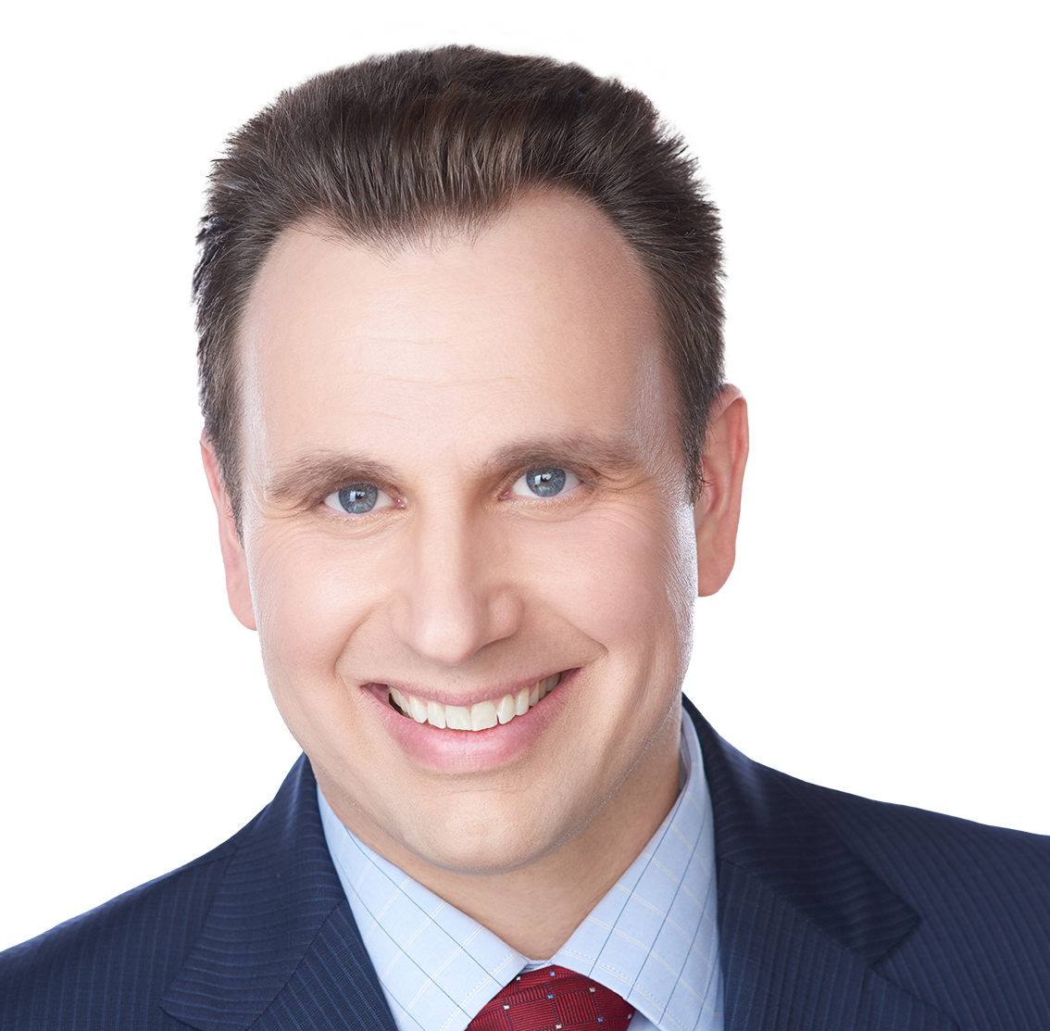
Shawn Ralston
Did You Know…
I’ve completed a marathon in every state.
SB Program Director & SBLO
AECOM
Hobbies
Running and Vacationing with my wife and five year old daughter
Favorite Sports Team
Any University of Virginia team

Slide 8
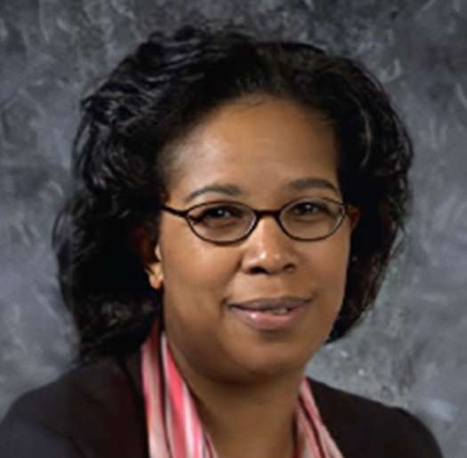
Gwen Johnson
Did You Know…
I am a licensed minister
Director, Supplier Diversity & SBLO
Parsons
Hobbies
Traveling, particularly historical sightseeing
Favorite Sports Team
N/A

Slide 9
Strategic Alliances & Mastering Collaboration with Primes in the Federal Arena
Rita Brooks | Meredith Koons | J. Alex Agyemang | Tyler Brooks-Craft | Shawn Ralston | Gwen Johnson
SAIC Director of SB Programs | Conti Federal Director of Marketing and Small Business Programs | Booz Allen Hamilton Global Supplier Diversity Leader& SBLO | CGI Federal Director, Small Business Engagement/ Supplier Diversity Advocate | AECOM SB Program Director & SBLO | Parsons Director, Supplier Diversity & SBLO
Rita.brooks@saic.com | 732.540.9478 mkoons@contifederal.com | 706.691.9742 Agyemang_joseph@bah.com | 703.227.7691 tyler.brooks-craft@cgifederal.com | 703.559.1338 shawn.ralston@aecom.com | 202.281.0368 gwen.johnson@parsons.com
SAIC is a premier technology integrator driving our nation’s technology transformation Our secure solutions include engineering, digital, artificial intelligence, and mission solutions. | Conti Federal Services is a global construction and engineering company with roots dating back to 1906. The company has delivered some of the most demanding projects for the U.S. federal government, specializing in military and secure construction, critical infrastructure, environmental remediation, and disaster response and recovery. | Booz Allen brings bold thinking and a desire to be the best in our work in consulting, analytics, digital solutions, engineering, and cyber, and with industries ranging from defense to health to energy to international development. | CGI is among the largest IT and business consulting services firms in the world and provides comprehensive, scalable and sustainable IT and business consulting services that are informed globally and delivered locally. | AECOM has partnered with federal agencies for 100+ years to deliver comprehensive infrastructure, facilities, energy, environment, disaster resilience and civil works services for our clients’ most challenging projects. | Parsons is a digitally enabled solutions provider focused on creating the future of the defense, intelligence and critical infrastructure markets. Key areas include cybersecurity, intelligence, missile defense, C5ISR, space, geospatial, mobility solutions and connected communities.

Slide 11
Rita Brooks, SAIC
Tyler Brooks-Craft, CGI
Rita.Brooks@saic.com
tyler.brooks-craft@cgifederal.com
703.227.7691
saic.com
cgi.com/us/en-us/federal
Meredith Koons, Conti Federal
Shawn Ralston, AECOM
mkoons@contifederal.com
shawn.ralston@aecom.com
732.540.9478
703.559.1338
contifederal.com
aecom.com
J. Alex Agyemang, Booz Allen Hamilton
Gwen Johnson, Parsons
Agyemang_joseph@bah.com
gwen.johnson@parsons.com
706.691.9742
202.281.0368
boozallen.com
parsons.com

