Slide 1
Harnessing the Power of Associations for Small Business Growth

Slide 2
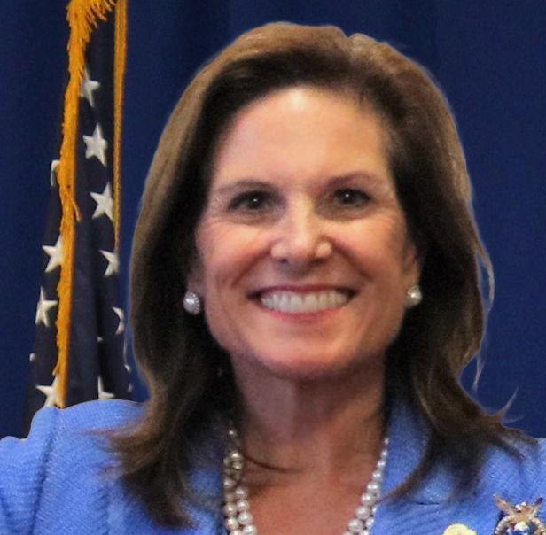
Barbara
Ashe
National Director
Veteran Institute for Procurement

Slide 3
Arming Vets to WIN!
The Veteran Institute for Procurement provides specialized training for owners, principals, and C-level executives from Veteran-owned small businesses looking to enter or grow in federal procurement.
8(a) Program - VIP Graduates
Total Companies: 270
Total Prime Awards: $9,920,181,190
Data Provided by: fedmine.us
START
GROW
ADVANCE
INTERNATIONAL
AEROSPACE
Designed for Veteran-owned small businesses looking to enter or expand in the federal market.
Created to increase the Veteran-owned small businesses’ ability to win and maintain federal contracts.
Tailored for Veteran entrepreneurs interested in taking their business to the next level of sustained growth.
Purpose-built for Veteran-owned small businesses considering entering or expanding their business overseas.
Developed to accelerate Veteran-owned small businesses’ success in the federal aerospace market.
[ February 13-15 ]
[ May 14-16 ]
[ June 11-13 ]
[ October 21-24 ]
[ TBD ]
[ April 23-25 ]
[ March 19-21 ]
[ TBD ]
Apply at: nationalvip.org

Slide 5
Barbara Ashe, VIP
bashe@nationalvip.org
301.738.0015 x215
nationalvip.org

