Slide 1
Compliance as a competitive differentiator
How Business System Status became a gate to solicitations, an elements in source selection criteria, and a potential competitive differentiator.

Slide 2
Rich Wilkinson
Senior Industry Director, GovCon
Unanet

Slide 3
Agenda – Compliance as a Differentiator
The Basics of Compliance
DCAA’s Waning Influence in GovCon
The focus on Business Systems
How the Business System criteria developed
How and why they became source selection criteria
Who determines adequacy
Business Systems as a Solicitation Requirement
Maximize Your Benefit from Your System Status

Slide 4
The Basics of Compliance

Slide 5
Compliance as a Function
How much compliance is enough?
Audits are a fact of life for government contractors…
Contract and proposal audits
Systems audits
Incurred Cost Proposal audits
CAS Disclosure Statement and compliance audits
DCAA “touched” about 5,800 contractor business units in FY2021
Notes:
The worst thing that could possibly happen happened. It happened at the worst possible time. But it generated the greatest compliance question ever. This is how it took place:
It happened at a time when the organization was particularly at risk for something like this to happen, and even though there were policies and procedures, and training, and documentation of transactions, and management approval of the transactions, and management monitoring of the process, it happened anyway. In the end, it required the intervention of upper-level management resolve the issue.
We called in the person who did the worst thing, and we asked him a series of questions that began with confirming his identity, and went on to include:
Have you received the company’s ethics training? (Our records showed he had received it eight times. Each time he signed the attendance roster and each time certified that he understood and agreed to comply with the ethics policy.)
Have you received training in the relevant company policies? (We had similar attendance rosters and certifications for that training too.)
Did you submit these expenses for reimbursement? (We provided him with copies of several of his expense reports.)
Tell us about the nature and purpose of the expenses.
What other similar expenses did you incur?
Are you aware of anyone else incurring these types of expenses?
Who approved the expenses?
What instructions from your management did you receive prior to and subsequent to incurring these expenses?
Did you have any concerns about the propriety of the behavior represented by these expenses?
Did you raise your concerns to your boss? Were you satisfied with his response? Did you raise your concerns with anyone else? Did you call the ethics hotline?
Finally, after we felt that we had heard the whole story, the attorney asked the greatest compliance question ever: “And what could possibly make you think that was the right thing to do?”
This was the greatest compliance question ever because prior to asking it we had demonstrated that the company had established a system of internal controls to prevent the thing he did from happening. The company had given him every reasonable opportunity to do the right thing: it told him what the right thing was, it trained him to do the right thing, it provided him with people to help him do the right thing, but ultimately he was responsible for actually doing the right thing. And he didn’t.
He was not the only one who was responsible for doing the right thing. His management told him to do the worst thing and approved it afterwards, overriding an otherwise good system of internal controls, and individuals in his management lost their careers as a result.

Slide 6
Compliance as a Function
How much compliance is enough?
Audits are a fact of life for government contractors…
Contract and proposal audits
Systems audits
Incurred Cost Proposal audits
CAS Disclosure Statement and compliance audits
DCAA “touched” about 5,800 contractor business units in FY2021
Notes:
The worst thing that could possibly happen happened. It happened at the worst possible time. But it generated the greatest compliance question ever. This is how it took place:
It happened at a time when the organization was particularly at risk for something like this to happen, and even though there were policies and procedures, and training, and documentation of transactions, and management approval of the transactions, and management monitoring of the process, it happened anyway. In the end, it required the intervention of upper-level management resolve the issue.
We called in the person who did the worst thing, and we asked him a series of questions that began with confirming his identity, and went on to include:
Have you received the company’s ethics training? (Our records showed he had received it eight times. Each time he signed the attendance roster and each time certified that he understood and agreed to comply with the ethics policy.)
Have you received training in the relevant company policies? (We had similar attendance rosters and certifications for that training too.)
Did you submit these expenses for reimbursement? (We provided him with copies of several of his expense reports.)
Tell us about the nature and purpose of the expenses.
What other similar expenses did you incur?
Are you aware of anyone else incurring these types of expenses?
Who approved the expenses?
What instructions from your management did you receive prior to and subsequent to incurring these expenses?
Did you have any concerns about the propriety of the behavior represented by these expenses?
Did you raise your concerns to your boss? Were you satisfied with his response? Did you raise your concerns with anyone else? Did you call the ethics hotline?
Finally, after we felt that we had heard the whole story, the attorney asked the greatest compliance question ever: “And what could possibly make you think that was the right thing to do?”
This was the greatest compliance question ever because prior to asking it we had demonstrated that the company had established a system of internal controls to prevent the thing he did from happening. The company had given him every reasonable opportunity to do the right thing: it told him what the right thing was, it trained him to do the right thing, it provided him with people to help him do the right thing, but ultimately he was responsible for actually doing the right thing. And he didn’t.
He was not the only one who was responsible for doing the right thing. His management told him to do the worst thing and approved it afterwards, overriding an otherwise good system of internal controls, and individuals in his management lost their careers as a result.

Slide 7
The Elements of Compliance

Slide 8
The Elements of Compliance
Do the Right Things
Adopt policies and procedures that are current and complete
Be sure they are designed to implement compliant processes
Document the policies and train the people
Do Things Right
Test your policies and procedures to be sure they work as designed
Be sure the procedures reflect your actual practice
Document the procedures and train the people
Use the Right People
Test your people for knowledge as well as experience
Train to eliminate gaps and reinforce both “how” and “why”
Document your training and expose P&P docs to users
Keep the Right Records
Design processes to be self-documenting if possible
Ensure adequate documentation at the point of the transaction
Notes:
Just as you would address many other business risks, you address Government contract compliance risks by establishing a system of internal controls. A well designed and maintained system of internal controls will give you the reasonable assurance you need to sleep at night. We have paraphrased the fundamental principles of internal controls on the slide. Let’s review them.
Your corporate culture should value competence and ethical behavior. (People, processes, and tools.) In my story, the culture of the division allowed management to override the system of controls, but the culture of the corporation investigated and resolved the issue. Management establishes the culture of the organization by what it says and what it does. “What it does” includes providing competent people with the proper authority, processes and tools to do their jobs well.
Your ERP system is critical to your business. Without it you can't make informed decisions that drive the direction and profitability of the organization. Picking the right system is critical. If you are a project based business that manages projects on behalf of the US Govt you should highly consider a purpose built project based ERP that has the government contractor in mind. One that builds in compliance through and through….one that audit agencies know and trust.
Risk assessment is a widely neglected aspect of having an effective compliance process. It was taught to me by one of the best bosses I ever had. He was the head of internal audit and did not have a background in Government compliance, but he hired good people and made them tell him what was important about the job they were about to do. The explanation of what was important came in the form of a risk memo. It was not perfect, but it was very good, and lead to good decisions based on relevant data. (slide content) How do you exercise oversight when you don’t understand what is important?
Communication - In “The Greatest Compliance Question Ever” the policies and training were great. People knew the policies and procedures. They were trained in matters important to their job. Training was documented (very important, as illustrated in the story).
Some comments and concerns not illustrated by the story:
Used – “Should the policies be in English or the employees’ native language?”
Record Keeping (control activities) - In “The Greatest Compliance Question Ever” the bad thing was caught in large part due to the quality of the organization’s documentation.
Travel expense form.
Support for professional services. (contract, work product, detailed invoice)
What metrics are important to evaluating compliance?
DSO
Every compliance function does a certain amount of internal audit, even if it is no more than an unallowable cost review when preparing the incurred cost submission. In addition to looking for unallowable costs there should also be verification of compliance with other significant policies e.g., timekeeping.
There are metrics that are important to your business that reflect on compliance e.g., DSO.
There are also metrics that relate only to compliance e.g., timely submission and acceptance of responses to data requests – a part of awarding the VP Finance’s bonus
Status of Activities
DCAA audits in process and last communication with the auditor
Responses to audits
Compliance projects
Maintenance activities
Accomplishments:
Projects completed
Lessons learned
Management systems’ approval status
Timekeeping errors
Cost allocation
Unallowable costs

Slide 9
The Regulations of Compliance

Slide 10
FAR versus CAS
The Federal Acquisition Regulation (FAR )
FAR is all about ALLOWABILITY
Defines when and to what extent costs can be recovered under a government contract
Relies heavily on the “prudent person” test – except when it doesn’t
The Cost Accounting Standards (CAS)
All about ALLOCABILITY
Dictates the way in which a contractor must maintain its accounting system
Instructs contractors how to account for types of costs
Controls how costs flow to cost objectives (projects and pools)

Slide 11
The DOD Business Systems Rule
Issued 18 May, 2011
Defined six business systems
Accounting
Estimating
Material Management and Accounting Systems(MMAS)
Purchasing
Government Property
Earned Value
Clearly established the ACO as the sole authority for determination of adequacy for ANY of the systems
Promulgated clauses to for DoD and limited withholding to CAS-covered contracts with the clause
Notes:
RSW

Slide 12
Business System Responsibilities
DCAA performs (audits):
Accounting
Estimating
Material Management and Accounting Systems (MMAS)
DCMA performs (reviews):
Purchasing
Government Property
EVM
Notes:
RSW

Slide 13
Focus on Business Systems

Slide 14
Result of the Final Business Systems Rule
Distinct shift in power from DCAA to DCMA
No authority vested in DCAA for any approval or disapproval – ONLY advisory to the ACO
DCAA audit (review) of systems limited to the first three business systems (accounting, estimating and MMAS)
No involvement by DCAA in review of purchasing, property or EVM systems except by DCMA request
Notes:
RSW

Slide 15
Unintended Consequences of the Rule
The shift from DCAA to DCMA for systems adequacy determinations AND final indirect rates ALSO shifted responsibility for approval of provisional rates
Procuring Contracting Officers (PCOs) began requiring contractors to furnish evidence of system adequacy as a pre-condition of solicitation participation OR offered “points” for adequate systems in the source selection scheme

Slide 16
Unintended Consequences of the Rule
The shift from DCAA to DCMA for systems adequacy determinations AND final indirect rates ALSO shifted responsibility for approval of provisional rates
Procuring Contracting Officers (PCOs) began requiring contractors to furnish evidence of system adequacy as a pre-condition of solicitation participation OR offered “points” for adequate systems in the source selection scheme

Slide 17
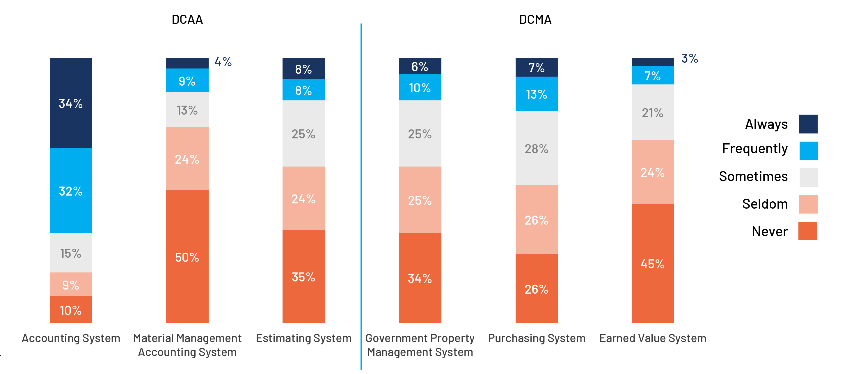
How Often Does it Happen?
20%
66%
Source: 2022 GAUGE Survey and Report

Slide 18
Unintended Consequences of the Rule
RED FLAG!
Contractors whose system ARE adequate often do not have a letter or other evidence
Contractor’s can’t get DCAA or DCMA to review a system on request – only an agency can do that (and even they have trouble with responsiveness)
There is no incentive for PCOs to increase the bidders’ pool!

Slide 19
Business Systems as a Solicitation Requirement

Slide 20
Typical Solicitation Provisions
What we see…
Offerors must provide a letter from DCAA stating that their [accounting, purchasing] system has been approved
Offerors must provide documentary evidence of system approval (by DCAA or other independent agency)
Offeror’s [accounting, purchasing] system must be approved for use on Government contracts
What PCO’s should be saying…
Offerors must provide an opinion on system adequacy from an independent auditor or authorized Government agency based on procedures performed under Generally Accepted Government Auditing Standards (GAGAS).
Until then we will continue to see…

Slide 21
Consequences of Unassessed Systems
Some contractors…
excluded from solicitations because of uncorrected system deficiencies,
some excluded because systems have not be reviewed,
some excluded because systems are in limbo between first review with corrections applied and waiting for second look, and
some excluded because system adequacy determinations have expired
Such solicitation provisions have been thoroughly tested via protest (GAO backs the agency every time!)

Slide 22
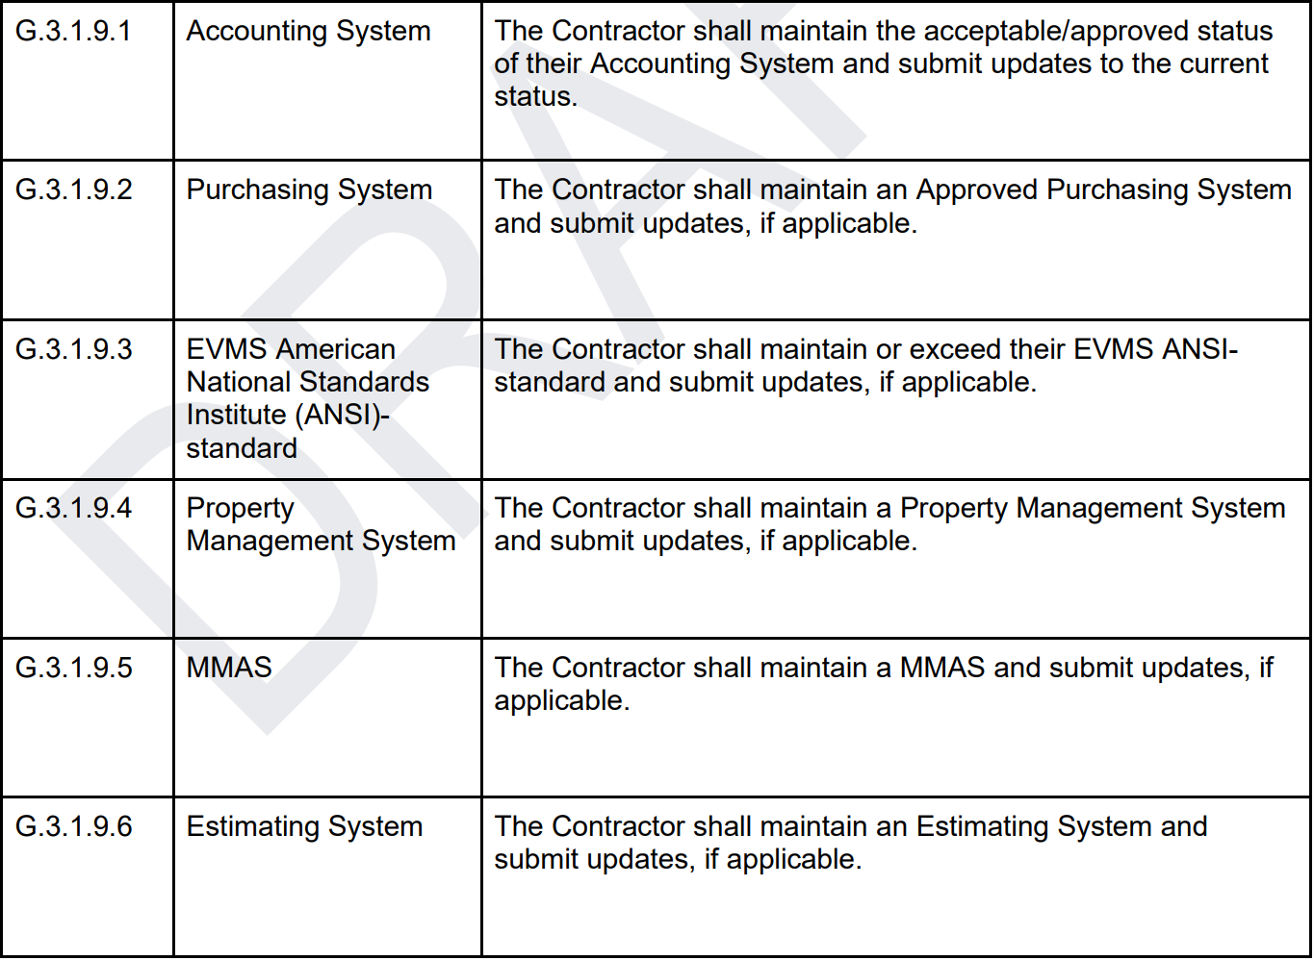
One Example…
GSA released a draft of the OASIS+ solicitation for comment in November 2022
Section F.4.2, Compliances, includes a mention of all six business systems
While it is not obvious from the wording, “if applicable” appears to apply to individual orders, not the contract award

Slide 23
An Expert Interpretation
A reading of the source selection criteria by experts led to this interpretation of the accounting system requirement:
“… contractors do not need an approved accounting system to bid, they simply cannot compete for cost reimbursement task orders.”
A similar interpretation of the other systems’ requirements is likely
Source: “Demystifying the Initial OASIS+ Draft Request for Proposal”, Feb 1, 2023, in Government Contracting Insights, Aprio https://www.aprio.com/demystifying-the-initial-oasis-draft-request-for-proposal/

Slide 24
Maximize Your Benefit from Your System Status

Slide 25
What to Do?
If your system has been examined and determined to be adequate, get a copy of the report and/or determination.
If your system was examined and deficiencies were identified, fix them and get a follow-up audit or review
If your system has never been reviewed, go to Plan B…

Slide 26
Plan B
Get your system reviewed by the government if you can
Neither DCAA nor DCMA will examine a system based on a contractor request
But they will respond to a request from a contracting officer
Get a friendly KO to request examination of your system
Be proactive and do it now
An SF1408 examination only takes a few days, but DCAA has a considerable backlog
An Estimating System examination is more complex and can take longer
A CPSR can take months and DCMA has an even greater backlog
If this doesn’t work, go to Plan C

Slide 27
Plan C
Pay a commercial firm to do an independent examination
FAR contemplates an SF1408 being performed by an independent audit organization (such as a CPA firm)
CAUTION: Not all solicitations will accept an SF1408 not executed by a government official
Also from the OASIS+ solicitation…
Acceptable documentation may include current and valid determination letters from the Contractor’s cognizant DCMA or CFA CO, DCAA audit reports, or Pre-Award Surveys of Prospective Contractor Accounting System (SF1408) completed by Government Officials.

Slide 28
Good News on the Horizon
The OASIS+ solicitation is a step in the right direction
OASIS+ follows the latest procurement trend: self-scoring
50 points are available in each Domain. The award threshold is currently 36 points for small businesses and 42 for large
While points are available for systems, clearances, and certifications, the lion’s share come from past performance
Rather than granting a finite number of awards, (all) bidders meeting the minimum points requirement will win an OASIS+ contract

Slide 29
Add Your Voice to the Chorus
The comment period on the 1st OASIS+ draft RFP closed 12/31
An OASIS+ 2nd draft will be released in 2023 Q2
Make a comment
Object to the restriction of SF1408 examinations to “government officials” – FAR permits examinations by commercial audit organizations
FAR does not address Purchasing, Estimating, EVM, Property or MMAS Systems, but many audit firms do such – request/suggest/demand that those examinations be recognized
Ask for clarifications of poorly worded compliance sections such as those in Section F.4.2 of the draft

Slide 31
THANK YOU
Rich Wilkinson
Senior Industry Director, GovCon
RWilkinson@Unanet.com

