Slide 1
PAST PERFORMANCE: AN ALWAYS-CHANGING MINEFIELD
Presented by Jon M. DeVore 202.659.5800
jdevore@bhb.com
© Birch Horton Bittner & Cherot, P.C. 2023| www.birchhorton.com

Slide 2
WHAT WILL WE TALK ABOUT TODAY?
Past Performance
What does Past Performance Mean
New Past Performance Regulations Related to Joint
Ventures
Important New Debriefing Regulations—What can you
learn
Some Interesting Past Performance GAO Cases
Questions and Group Discussion
© Birch Horton Bittner & Cherot, P.C. 2023| www.birchhorton.com

Slide 3
WHAT ARE PAST PERFORMANCE REGULATIONS
42.1501 General.
(a) Past performance information (including the ratings and supporting narratives) is relevant information, for future source selection purposes, regarding a contractor’s actions under previously awarded contracts or orders. It includes, for example, the contractor’s record of-
Conforming to requirements and to standards of good workmanship;
Forecasting and controlling costs;
Adherence to schedules, including the administrative aspects of performance;
Reasonable and cooperative behavior and commitment to customer satisfaction;
Complying with the requirements of the small business subcontracting plan (see 19.705-7(b));
Reporting into databases (see subpart 4.14, and reporting requirements in the solicitation provisions and clauses referenced in 9.104-7);
(7) Integrity and business ethics; and
(8) Business-like concern for the interest of the customer.
(b) Agencies shall monitor their compliance with the past performance evaluation requirements (see 42.1502), and use the Contractor Performance Assessment Reporting System (CPARS) metric tools to measure the quality and timely reporting of past performance information. CPARS is the official source for past performance information.
▪
▪
▪
▪
▪
▪
© Birch Horton Bittner & Cherot, P.C. 2023| www.birchhorton.com

Slide 4
PAST PERFORMANCE EVALUATION FACTORS
The evaluation should include a clear, non-technical description of the principal purpose of the contract or order. The evaluation should reflect how the contractor performed. The evaluation should include clear relevant information that accurately depicts the contractor’s performance, and be based on objective facts supported by program and contract or order performance data. The evaluations should be tailored to the contract type, size, content, and complexity of the contractual requirements.
Evaluation factors for each assessment shall include, at a minimum, the following:
Technical (quality of product or service).
Cost control (not applicable for firm-fixed-price or fixed-price with economic price adjustment arrangements).
Schedule/timeliness.
Management or business relations.
Small business subcontracting, including reduced or untimely payments to small business subcontractors when 19.702(a) requires a subcontracting plan (as applicable, see Table 42-3).
Other (as applicable) (e.g., trafficking violations, tax delinquency, failure to report in accordance with contract terms and conditions, defective cost or pricing data, terminations, suspension and debarments, and failure to comply with limitations on subcontracting).
▪
▪
▪
▪
▪
▪
▪
© Birch Horton Bittner & Cherot, P.C. 2022| www.birchhorton.com

Slide 5
RATING DEFINITIONS
Rating | Definition | Note
(a) Exceptional | Performance meets contractual requirements and exceeds many to the Government’s benefit. The contractual performance of the element or sub- element being evaluated was accomplished with few minor problems for which corrective actions taken by the contractor were highly effective. | To justify an Exceptional rating, identify multiple significant events and state how they were of benefit to the Government. A singular benefit, however, could be of such magnitude that it alone constitutes an Exceptional rating. Also, there should have been NO significant weaknesses identified.
(b) Very Good | Performance meets contractual requirements and exceeds some to the Government’s benefit. The contractual performance of the element or sub- element being evaluated was accomplished with some minor problems for which corrective actions taken by the contractor were effective. | To justify a Very Good rating, identify a significant event and state how it was a benefit to the Government. There should have been no significant weaknesses identified.
© Birch Horton Bittner & Cherot, P.C. 2022| www.birchhorton.com

Slide 6
RATING DEFINITIONS
(c) Satisfactory | Performance meets contractual requirements. The contractual performance of the element or sub-element contains some minor problems for which corrective actions taken by the contractor appear or were satisfactory. | To justify a Satisfactory rating, there should have been only minor problems, or major problems the contractor recovered from without impact to the contract/order. There should have been NO significant weaknesses identified. A fundamental principle of assigning ratings is that contractors will not be evaluated with a rating lower than Satisfactory solely for not performing beyond the requirements of the contract/order.
(d) Marginal | Performance does not meet some contractual requirements. The contractual performance of the element or sub-element being evaluated reflects a serious problem for which the contractor has not yet identified corrective actions. The contractor’s proposed actions appear only marginally effective or were not fully implemented. | To justify Marginal performance, identify a significant event in each category that the contractor had trouble overcoming and state how it impacted the Government. A Marginal rating should be supported by referencing the management tool that notified the contractor of the contractual deficiency (e.g., management, quality, safety, or environmental deficiency report or letter).
© Birch Horton Bittner & Cherot, P.C. 2023| www.birchhorton.com

Slide 7
RATING DEFINITIONS
(e) Unsatisfactory | Noncompliant with FAR 52.219-8 and 52.219-9, and any other small business participation requirements in the contract/order. Did not submit Individual Subcontract Reports and/or Summary Subcontract Reports in an accurate or timely manner. Showed little interest in bringing performance to a satisfactory level or is generally uncooperative. Required a corrective action plan. Had a history of three or more unjustified reduced or untimely payments to small business subcontractors within a 12-month period. | To justify an Unsatisfactory rating, identify multiple significant events that the contractor had trouble overcoming and state how it impacted small business utilization. A singular problem, however, could be of such serious magnitude that it alone constitutes an Unsatisfactory rating. An Unsatisfactory rating should be supported by referencing the actions taken by the Government to notify the contractor of the deficiencies. When an Unsatisfactory rating is justified, the contracting officer must consider whether the contractor made a good faith effort to comply with the requirements of the subcontracting plan required by FAR 52.219- 9 and follow the procedures outlined in 52.219-16, Liquidated Damages-Subcontracting Plan.
© Birch Horton Bittner & Cherot, P.C. 2023| www.birchhorton.com

Slide 8
PAST PERFORMANCE OF A PARENT OR SISTER SUBSIDIARY ?
A new subsidiary may also be able to benefit from a parent or affiliated company’s past performance. In T & S Products, Inc. v. United States, the Court of Federal Claims cautioned that a parent corporation and its subsidiary are separate and distinct entities, and that a contract with one is not a contract with both entities. 48 Fed. Cl. 100, 111 (2000). However, the Court also stated that the agency may properly consider the parent company’s resources in evaluating the offer, where an offeror represents in its offer that resources of its parent will be committed to the contract as long as there was not a prohibition in the RFP against subsidiaries relying on the resources of their corporate parents. 48 Fed. Cl. at 111.
This rule could also apply to a subsidiary benefiting from a parent company’s past performance. However, for the contracting officer to be at liberty to reasonably consider the past performance of parent and/or affiliated companies, the proposals should clearly show that the affiliate or other company will have meaningful involvement in the performance of the contract.
A Sister subsidiary past performance may also be used when the assistance provided is specific and identified .
© Birch Horton Bittner & Cherot, P.C. 2023| www.birchhorton.com

Slide 9
SISTER SUBSIDIARIES AS JOINT/VENTURES
Nothing in the Regulations Overtly Prohibits Sister Company Joint Ventures
Based on our understanding of SBA regulations and discussions with a limited number of SBA personnel, we are not aware of any regulations or statutes that specifically address or prohibit joint ventures between sister companies owned by ANCs, Tribes or NHO’s.
While there are no rules explicitly on sister company joint ventures, there are rules regarding related areas that may provide some insight to the relative risks associated with a sister company JV. We have reviewed the following relevant legal areas:
General affiliation exceptions for entity-owned small businesses and 8(a) firms
Affiliation exception for contractual relations between Entity-owned sister companies
New Joint Venture regulations
This is one of the safest manners in which to claim the past performance of a sister subsidiary, especially under the new SBA and DoD regulations
© Birch Horton Bittner & Cherot, P.C. 2023| www.birchhorton.com

Slide 10
NEW REGULATIONS RELATED TO JOINT/VENTURES
On November 18, 2021, the SBA published in the Federal Register changes to 13 CFR Part 125 to help small business contracts use past performance ratings for work performed as a member of a joint venture and for work performed as a first-tier subcontractor for a prime contract. These changes were required by the NDAA for Fiscal Year 2021 and this publication is perhaps one of the most expedited changes in regulations in quite some time.
© Birch Horton Bittner & Cherot, P.C. 2023| www.birchhorton.com

Slide 11
WHAT IS OFPF POLICY ON “LACK OF” PAST PERFORMANCE?
Given the number of mergers and acquisitions in today's American business environment, potential offerors may not have existed under their current name for very long. This creates an interesting wrinkle in the source selection process. Agencies must recognize this dynamic world marketplace and accommodate new prospective offerors by being more flexible in their procurement rules and practices.
The past performance of the offeror’s resources is a good indicator of future performance for new companies entering the marketplace that lack relevant experience, or mergers of previously established companies. If the key management personnel, subcontractors, or other resources, have experience on contracts similar to the pending requirement for another contractor; state and local government contracts; private contracts; or was a major subcontractor; then the source selection team can perform the appropriate evaluation and risk assessment. This reduces the chance of needing to "neither reward nor penalize" an offeror with no other relevant past performance information
© Birch Horton Bittner & Cherot, P.C. 2023| www.birchhorton.com

Slide 12
WHAT DO THE NEW REGULATIONS MEAN?
The new regulations provide a specific benefit to a small business in a joint venture where the small business does not have specific or relevant past performance but its partner does. SBA in the notice requested comments on whether small business subcontractors have been negatively impacted in competing for prime contracts due to not having a past performance rating. The SBA also sought comments on a specific time for the Prime contractor to respond to a request from a first-tier subcontractor. As we often note, making public comments on proposed regulations is important, especially in areas where a commenter might be supportive of a specific proposed change.
© Birch Horton Bittner & Cherot, P.C. 2023| www.birchhorton.com

Slide 13
MORE ABOUT DEBRIEFING REGULATIONS TO FIND OUT ABOUT PAST PERFORMANCE
The DoD rule implements new requirements for contracting officers when providing post-award debriefings, stipulating the requirements for information to be provided to successful and unsuccessful offerors. Specifically, it adds a paragraph that outlines the debriefing process, which provides the opportunity for offerors to submit written follow-up questions within two business days after receiving the debriefing, as well as requirements for the agency to respond in writing to the timely submitted follow-up questions within five business days after receipt of the questions. The proposed rule also adds a paragraph that ensures contracting officers do not consider the post-award debriefing to be concluded until the agency delivers its written response to an offeror.
© Birch Horton Bittner & Cherot, P.C. 2023| www.birchhorton.com

Slide 14
AN INTERESTING GAO CASE
The Government Accountability Office (GAO) on October 14, 2021 denied an interesting protest on the grounds that the agency reasonably rated the protester’s proposal unacceptable where the protester failed to provide any evidence of a relevant past performance as required. In the Matter of AnderCorp, LLC, (B-419984 Oct. 12, 2021) the protester asserted it was managed and operated by individuals with extensive experience from another company. AnderCorp, was a recently formed company. A key factor was the failure by AnderCorp to comply with the solicitation requirement to submit examples of prior experience. Of interesting note, the GAO pointed out that past performance and prior project experience were separate evaluation factors. The key language of the opinion is “Experience factors focus on the degree to which an offeror has actually performed similar work, whereas past performance factors focus on the quality of the fork performed.” Id, at Page 4. The FAR 15.30 (c)(2) recognizes the differences of past performances verse prior experience as two distinct factors.
© Birch Horton Bittner & Cherot, P.C. 2023| www.birchhorton.com

Slide 15
MICROTECH TECHNOLOGIES
B-420196.3 & B-420196.4 (1/6/23)
The GAO concluded the VA had not applied unstated criteria for Past Performance by limiting consideration of contracts at a $16.2 threshold. VA
was reasonable to restrict consideration to “similar in size.”
The GAO also held the VA did not have to consider a past contract that was not included in original offer. The VA could have found it but the burden is on
the Offeror and it wasn’t all that similar.
MicroTech made creative and good arguments, tried hard, but lost.
© Birch Horton Bittner & Cherot, P.C. 2023| www.birchhorton.com

Slide 16
SNODGRASS JV B-420376.2 (1/20/23)
The GAO rejected a protest where negative information in the CPARS system was used to judge past performance BUT the negative CPARS has been
mailed to the wrong address by the Navy. Snodgrass did not have a chance
to respond to the unknown review.
"While the facts of this protest present a novel situation concerning an apparently errantly-directed CPARS evaluation, our resolution presents a relatively straightforward application of our prior decisions addressing an agency's discretion and responsibilities
when evaluating past performance and conducting discussions," the GAO said.
In a catch-22, the Army could not have discussed the information with Snodgrass because it was not placed into CPARS until days later.
© Birch Horton Bittner & Cherot, P.C. 2023| www.birchhorton.com

Slide 17
INNOVATE NOW, LLC B-419546 SUMMARY
The GAO concluded that by requiring the protégé to meet the same experience requirements as the other offers, the RFP expressly violates the
prohibition in the regulation. The GAO recommended that the agency
amend the RFP to revise the work sample experience requirements as they relate to the protégé member of any mentor-protégé offeror. There is another issue discussed in the case but this decision is important because it is the first one released which I have found by the GAO that took into consideration the new regulations adopted in late 2019.
© Birch Horton Bittner & Cherot, P.C. 2023| www.birchhorton.com

Slide 18
STARLIGHT CORP
B-420267;3-4 (3/14/22)
The GAO sustained a protest on the basis of past performance where the agency, Dept. of the Air Force, failed to adequately document the relevancy of the offerors’ past performance information and improperly reduced the
protestor’s rating on a past performance rating questionnaire. They win!
Starlight also argued the AF past performance evaluation was not in accordance with the solicitation’s criteria and unreasonable. They win!
© Birch Horton Bittner & Cherot, P.C. 2023| www.birchhorton.com

Slide 19
ECCALON, LLC
B-420297 (01/24/22)
Eccalon, LLC protested a task order asserting the DoD had unreasonably evaluated price quotes resulting in an unreasonable selection decision.
A key issue in the case was the DoD consideration of the past performance of
a proposed subcontractor.
The GAO held that consideration of a subcontractor’s past performance where the solicitation neither prohibits nor mentioned the revaluation of such information is permissible. Quoting Enters, B-298576 (10/30/06)
© Birch Horton Bittner & Cherot, P.C. 2023| www.birchhorton.com

Slide 20
WHERE CAN YOU REACH ME?
Jon M. DeVore
1150 Connecticut Avenue, NW, Suite 350, Washington, D.C. 20036
(202) 659-5800 (office)/(202) 862-8362 (direct)
(443) 223-9466 (mobile)
jdevore@bhb.com
© Birch Horton Bittner & Cherot, P.C. 2023| www.birchhorton.com

Slide 22
Capturing Past Performance
Speakers: Gloria Larkin, President & CEO TargetGov

Slide 23
Gloria Larkin
President & CEO at TargetGov
FAST@TargetGov.com866-579-1346x 325
Creator of the FAST® Process and KickStart Program®
Invented the federal capability statement
Clients won $10+ billion in federal contracts
Nationally recognized federal contracting business development expert
Quoted in Wall Street Journal, Washington Post, INC Magazine, Bloomberg
Author of “The Basic Guide to Government Contracting”
Educational Foundation Board Chair Emeritus and Legacy Circle Inductee at WIPP.org

Slide 24
Use Past Performance to Win
Source selection officials rely on clear and timely evaluations of contractor performance to make informed business decisions when awarding government contracts and orders.
This information is critical to ensuring that the Federal government only does business with companies that provide quality products and services in support of the agency’s missions.
Mitigate all risk factors in doing business with you as a prime, sub or teaming partner

Slide 25
Difference Between Experience and Past Performance
Experience is often focused on technical abilities
Experience is often subjective, often based on personal opinions, interpretations, points of view, emotions and judgment. It is often considered ill-suited for decision making
Experience is often confused related to employees as opposed to the company
Experience is often presented as resumes
Experience is often not exactly related to the project needs at hand, but used to show depth of abilities
Experience is often confused within partners, teams, primes/sub relationships

Slide 26
Past Performance: Trackable and Verifiable
“Past performance information is relevant information, for future source selection purposes, regarding a contractor’s actions under previously awarded contracts or orders.
It includes the contractor’s record of conforming to requirements and to standards of good workmanship;
forecasting and controlling costs; adherence to schedules,
including the administrative aspects of performance;
reasonable and cooperative behavior and commitment to customer satisfaction;
reporting into databases; integrity and business ethics;
and business-like concern for the interest of the customer.”
[Federal Acquisition Regulation (FAR) 42.1501]

Slide 27
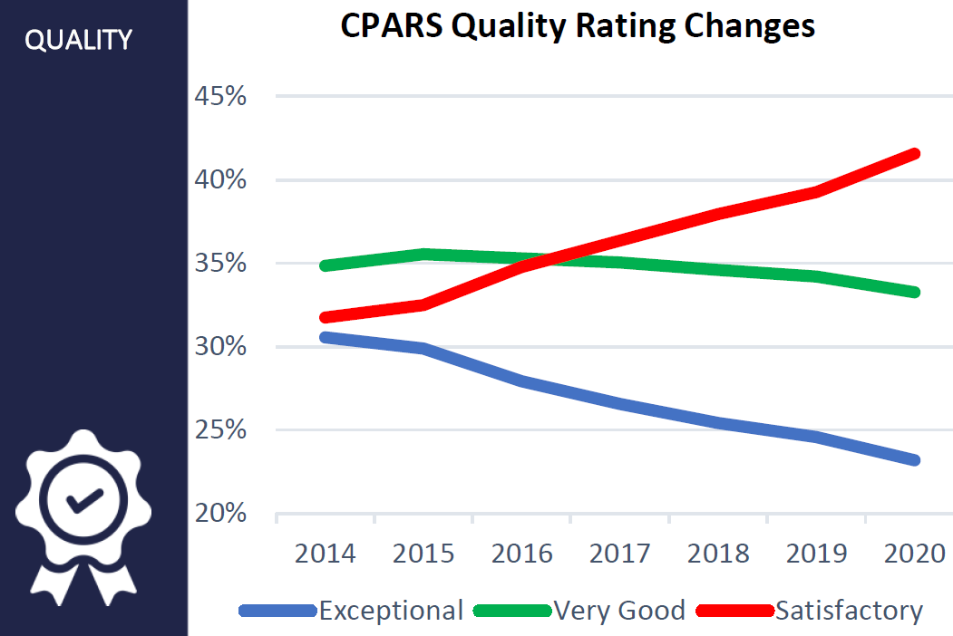
CPARS Limitations
Seven-year trend to reduce exceptional/very good
Has created a sea of satisfactory ratings
May not or will not include:
Classified work
Work under the simplified acquisition threshold
Subcontractor work at any tier
State, city, county or local government work
Private sector work
Work where the contracting official failed to complete the CPARS

Slide 28
Beat the CPARS Limitations
Create your own customer service tracking system internal to your company (Name/brand it!)
Use this system to document your entire customer service lifespan from award and kickoff through closeout (and hopefully recompete)
Seven areas must be continually rated:
Quality Assurance
Schedule/Timeliness of Performance
Customer Satisfaction
Management/Personnel/Labor
Cost/Financial Management
Safety/Security
General

Slide 29
Create an Internal Customer Experience Rating System
SAM.gov registrations, professional and socio-economic certifications, and CPARS
Other sources to determine financial resources and performance capability
Records and experience data, to include verifiable knowledge of personnel
Questionnaire responses, financial data, and personnel
Commercial sources
Pre-award surveys, in-progress (timing appropriate) meetings, close out meetings
Other sources; i.e., publicly available information, suppliers, subcontractors, current customers, financial institutions, Government agencies, include business and trade associations
Social media

Slide 30
During Every Contract & Task Order
Engage with acquisition and program entire lifespan
Always frame interactions as customer service communications
Have an agenda and purpose to each encounter
Document every participant, date, time, location
If virtual meetings, record if possible
Send all parties involved a recap with action items stated
Use the lifespan of this contract to explore other upcoming needs

Slide 31
Frame All Ratings as Exceptional or Very Good
Know what you must do get EXCEPTIONAL before you begin work on the contract
Set deliberate goals to achieve the EXCEPTIONAL criteria
Track and report these successes to the reporting official
Provide the supporting verbiage to the reporting official BEFORE they complete the initial CPARS, or as you document in your own internal customer service process.
Note: ALWAYS provide a response to your CPARS evaluation, even if they gave you the best possible rating; it’s your opportunity to “speak” to your future customers; do not squander the opportunity

Slide 32
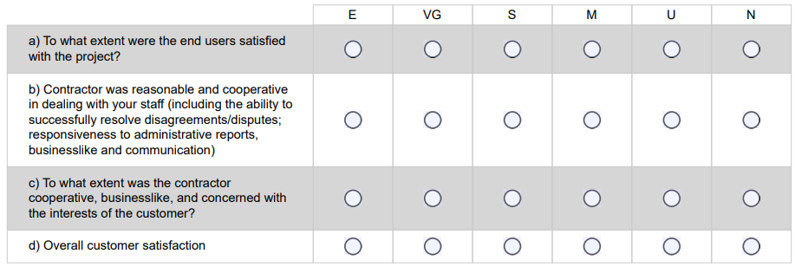
Sample: Customer Satisfaction

Slide 33
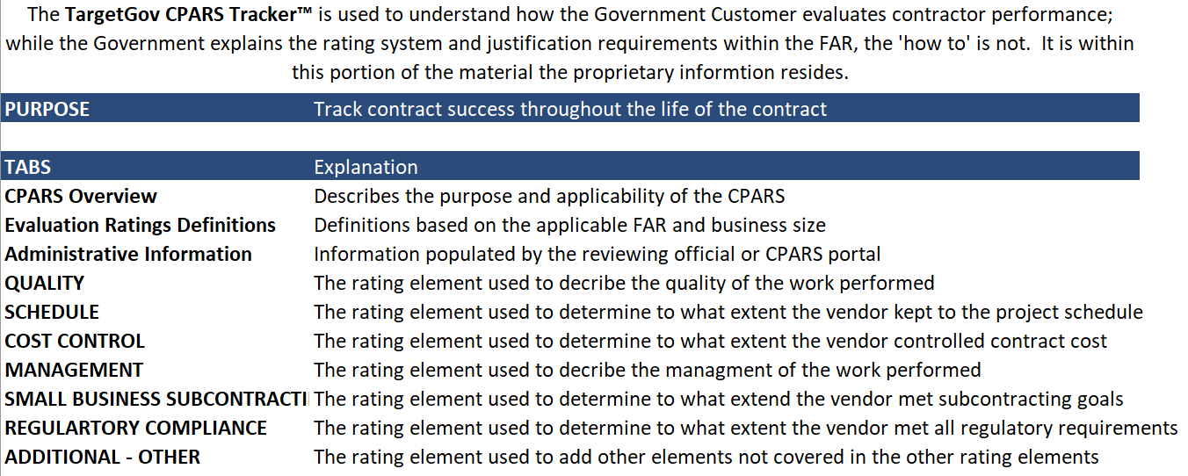
Tool: TargetGov CPARS Tracker™
Available to all session attendees—complimentary!
Email FAST@TargetGov.com --Indicate National8(a) Capturing Past Performance Panel Handouts in subject line

Slide 34
Session Slides
TargetGov CPARS Tracker™ Tool: use this as a basis of your internal customer service process
Email FAST@TargetGov.com --Indicate National8(a) Capturing Past Performance Panel Handouts in subject line

Slide 36
Gloria Larkin, President & CEO at TargetGov
FAST@targetgov.com
866-579-1346 x325
https://www.targetgov.com

