Slide 1
Contract Opportunities Direct from Agencies

Slide 2
Office of Small Business
Programs
Ronald Saville
SAF/SB
13-15 Feb 23
Version #2

Slide 3
SAF/SB Organization Chart
Treva Pettis
Executive Assistant
Scott Kiser
Director
SAF/SB
1060 Air Force Pentagon
Room 4D944 Washington, DC 20330-1060
Jamie Adams
Deputy Director
Max Kidalov
Legal Counsel
Paul Aldrich
(USSF)
Contractor Support (CTR)
Benjamin Nwadibia (Lead & Data)
Denise Lebel (Office Manager)
Brian Norman (Manpower & Resources)
Haile Taddele (Data Analytics)
Sheriff Ayoob (Data Analytics)
Calvin Boyce, Jr (IT)
Jonathan Metts (MPP)
Lorenzo Parnell (Public Relations)
Personnel, Acquisition, and Analytics
Mike McWilliams (Director of Staff)
Ronald Saville (Policy)
David Sikora (SBIR/MPP)
Heather Kuba (Data Analytics)
Nicole Perry (Subcontracting)
Dave Morgan (Acquisition Program Manager)
Small Team, Big Impact: Light, Lean 2-Letter
17 Jan 23

Slide 4
SAF/SB & USSF
SAF/SB supports senior DAF leadership’s SB roles & functions
Interacts with and supports senior leaders and two SAEs (Air and Space)
Provides SB policy and guidance for DAF, USAF, & USSF
Directs, oversees, & provides reach-back for DAF, USAF, & USSF programs
17 Jan 23

Slide 5
What We Do: SAF/SB Missions & Functions
Small Business Act Compliance
Policy
Program Management
Outreach, Counseling &
Training
Complaints & Appeals Resolution
Strategies & Goals
Acquisition Strategies/Planning
Reviews
Gives Advice
Market Research
Business Intelligence
Subcontracting
Regulatory Compliance Assistance & Relief
Small Business Liaison & Advocate
Functional Workforce Leadership
Appointments
Facilitates Training
SBIR/STTR Oversight & Assistance
Mentor Protégé
Program
Organizational Climate & Leadership
Sources: 10 U.S.C. 9024, 15 U.S.C. § 644(k) (3) through (21), FAR Part 19, DFARS 219 and App I, AFFARS 5319, DoDI 4205.01, HAFMD 1-30, etc.
17 Jan 23

Slide 6
Small Business Program Support
Consists of:
• 170+ SB professionals
• 2 Military Services
• 9 Major Commands
• 3 Field Commands
• 5 Direct Reporting Units
Assists with:
• Market Research
• Source Selections
• Request for Information (RFIs)
• Request for Proposal (RFPs)
• Hosts industry events
Matches industry
capabilities
with Air Force
requirements
Delivers advice & consultation
to ensure Air Force
acquisitions
Guides you to
opportunities
& resources
17 Jan 23

Slide 7
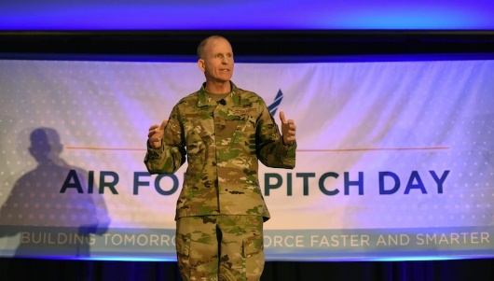
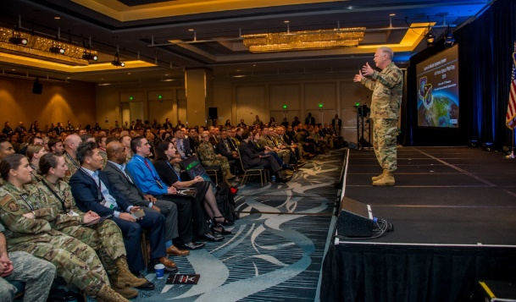
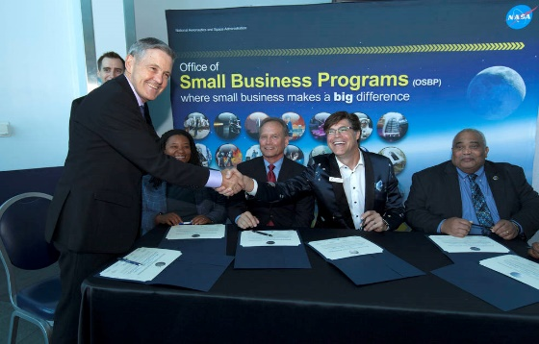
SAF/SB Program Topics of Interest
Small Business Innovation Research (SBIR)
Small Business Technology Transfer (STTR)
Mentor-Protégé Program (MPP)
First Look
Outreach
17 Jan 23

Slide 8
SBIR / STTR
Release
11 Jan 2023
Open
08 Feb 2023
Due/Close
08 Mar 2023
DoD SBIR 23.1
DoD STTR 23.A
Release
19 Apr 2023
Open
17 May 2023
Due/Close
14 Jun 2023
DoD SBIR 23.2
DoD STTR 23.B
Release
23 Aug 2023
Open
20 Sep 2023
Due/Close
18 Oct 2023
DoD SBIR 23.3
DoD STTR 23.C
SBIR/STTR programs harness the talent of U.S. technology companies
SBIR focuses on small tech companies & entrepreneurs
STTR funds R&D projects between SBs & research institutions
SBIR/STTR programs utilize DoD Broad Agency Announcements
DoD schedules 3 main solicitation times per year
https://www.dodsbirsttr.mil/submissions/baa-schedule/active-baa-announcements
23 Jan 23

Slide 9
Mentor-Protégé Program (MPP)
Assists eligible SBs (Protégés) in developing capabilities to perform as suppliers under DoD contracts and other contracts and subcontracts.
DAF currently has 13 active agreements:
5 – Part and Equipment Manufacturing
6 – Information Technology / Cybersecurity
1 – Medical / Medical Product Manufacturing
1 – Technical and Engineering Services
Mentor-Protégé Contact: David.Sikora.2@us.af.mil
For more information, visit the link below:
https://www.airforcesmallbiz.af.mil/Support-Programs/MENTOR-PROTEGE-Program/
25 Jan 23

Slide 10
First LOOK: SAF/AQC-led Initiative
Align DAF Installation micro-purchase spend w/ NDAA reform efforts and SECAF vision for smarter business practices
SAF/AQC Solution: FIRST LOOK Program
Give local and small businesses to the base’s mission requirements the “FIRST LOOK” for micro-purchase requirements
Installation/CC-driven initiative for employing purchasing power
Not a mandatory procedure
Encourages GPC ($2B) cardholders and CONS to purchase local when it make smart business sense
24 Oct 22

Slide 11
SBA Veteran Small Business Certification Program (Effective 10 Jan 23)
New
The program will be the Agency’s primary certification vehicle for all Veteran-owned small businesses (VOSBs) and SDVOSBs, important classifications that enable those businesses to qualify for sole-source and set-aside federal contracting awards.
Certified VOSBs are eligible to compete for sole-source and set-aside contracts at the Department of Veterans Affairs, while certified SDVOSBs can compete for sole-source and set-aside contracts government-wide.
The 2021 National Defense Authorization Act grants a one-year grace period for self-certified SDVOSBs until January 1, 2024.
Beginning January 1, 2024, both Veteran and service-disabled Veteran small business owners will need to be certified to compete for federal contracting set-asides unless an application from a self-certified firm is pending an SBA decision.
Want more info: visit www.sba.gov/vetcert or email vetcert@sba.gov
Source: SBA.GOV press release #23-01,10 Jan 23
Notes:
To be eligible to apply for the Veteran Small Business Certification Program, an applicant must:
Be considered a small business, as defined by the size standardcorresponding to any NAICS code listed in the business’s SAM profile.
Have no less than 51% of the business owned and controlled by one or more Veterans.
For certification as a SDVOSB, have no less than 51% of the business owned and controlled by one or more Veterans rated as service-disabled by VA.
For those Veterans who are permanently and totally disabled and unable to manage the daily business operations of their business, their business may still qualify if their spouse or appointed, permanent caregiver is assisting in that management.
Eligible new applicants certified by the SBA after January 1, 2023, will receive the standard three-year certification period.

Slide 12
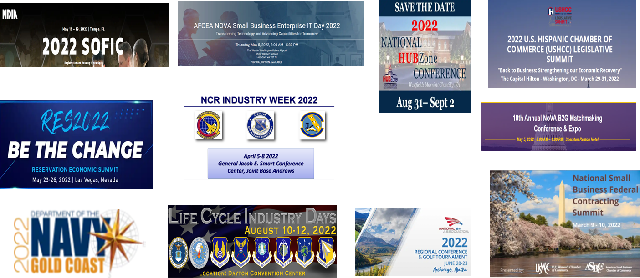
FY22 Recap: SAF/SB and DAF SBPs’ Outreach Activities
42 events and 23,285K audiences reached (54% increase in participation above FY21!)
14 virtual with 3,618K attendees (48% increase in participation above FY21!)
28 in person with 19,667K attendees (45% increase above FY21!)
Strategic Communications and Public Relations focus + counseling + training
Data provided by SAF/SB Data Team As of 23 Jan 23
Notes:
One way to help get more targeted SB participation is by making more time for targeted outreach and instruction to our eligible Small Businesses
At Air Staff, we get far more invitations that we have time to participate, but we look 3 months to 12 months out to deliver strategic outreach and engagement
You can see by the stats that we try to get the best bang for the buck in where we go out there, either virtually or in-person to participate or speak
We need to be strategic at every level to ensure we get out there and support or even lead outreach to the Smalls and even larger primes who can offer Sub opportunities to smalls.

Slide 13
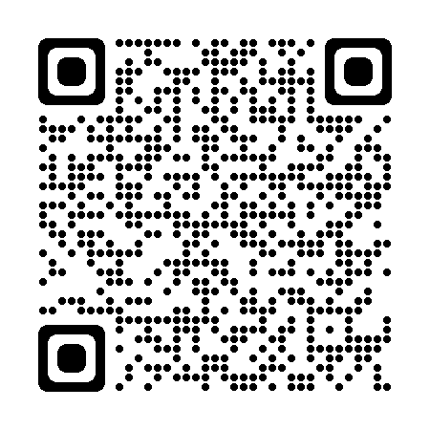
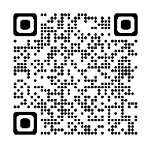
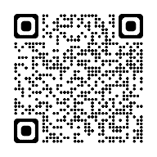
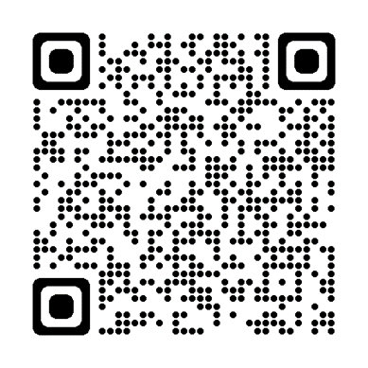
Stay Connected With Us
Linkedin.com/company/
airforcesmallbiz
Twitter.com/
AFSmallBiz
Facebook.com/
airforcesmallbiz
DAF SB Website: www.airforcesmallbiz.af.mil
Email: SAF.SB.workflow@us.af.mil
SBIR/STTR: www.sbir.gov/about
17 Jan 23

Slide 14
Use Available Resources
17 Jan 23

Slide 15
Questions?
Notes:
This slide fuses all hi-res photos into a simplified picture to save slide file size.
MIDDLE: B-21 Raider (Rendering) https://www.af.mil/News/Tag/62756/b-21/
TOP LEFT TO RIGHT:
Encapsulated X-37B Orbital Test Vehicle @ https://www.spaceforce.mil/Multimedia/Photos/igphoto/2002295317/
F-22 Raptor @ https://www.acc.af.mil/News/Photos/igphoto/2002635372/
Cyberwarfare Specialists of 175th Cyberspace Ops Gp of Maryland ANG @ https://www.108thwing.ang.af.mil/News/Photos/igphoto/2002449914/
Space Based Infrared System (SBIRS) @ https://www.spaceforce.mil/Multimedia/Photos/igphoto/2002305616/
KC-46 Pegasus Flies over 97th AMW at Altus 8 Feb 2019 @ https://www.af.mil/News/Photos/igphoto/2002090130/
BOTTOM LEFT TO RIGHT:
B-2A Spirit Bomber @ https://www.af.mil/News/Photos/igphoto/2001051188/
XQ-58A Valkyrie deploys Altius-600 small unmanned Aircraft system 26 Mar 2021 @ https://www.af.mil/News/Photos/igphoto/2002617611/
AC-130H Gunship from 16th SOS Hurlburt @ https://www.af.mil/News/Photos/igphoto/2000454801/
MQ-9 Reaper from 124th Attack Squadron @ https://www.acc.af.mil/News/Photos/igphoto/2002720790/
F-35A Lightning II at Hill @ https://www.af.mil/News/Photos/igphoto/2002318532/
First F-15EX Arrives at Eglin 11 Mar 2021 @ https://www.af.mil/News/Photos/igphoto/2002599657/ (REMOVED)

Slide 16
Backup Slides

Slide 17
SAF/SB Missions & Functions in Focus
Program Management
Program Execution
Policy
Training
Outreach/Reg Relief/Entry Barriers
Independent Function, Appointed by SecAF
Directly Reports to USecAF
SB BoD Strategy
Supervisory authority & functional leadership over DAF Small Business Professionals (SBPs)
Delegated SecAF’s appellate authority in SBA appeals
Federal Procurement Data System reports
SBIR/STTR Policy Oversight, Outreach, and Phase III Assistance
Gov’t Purchase Card Compliance
Assists small business concerns
Obtains payments, late payment interest penalties, & other information
Assigns SB Technical Advisors
Check Subcontracting Plans
Provides advice to AQ, SQ, acquisition planners, and Contracting Officers on acquisition strategies and market research
Manages DAF MPP
Review, Develop, Submit, Share
Statutory
Federal
OSD
DAF
Mandatory Procedures
Advise, Respond to Policy Questions
Oversee SB Credential Training
Assess, Report on SB Workforce and Industry Training
Develop Programs
Provide Training Tools & Resources for SBs and others
Host, Sponsor, Guide Strategic Outreach Programs
Participate in Events
Receive Unsolicited Proposals
Liaison, Partnering and Information Sharing
Share Industry Forecasts, NAICS
Support/facilitate with SBA, Apex Accelerators (PTACs), SBDCs, and PIAs
SBREFA & SBPRA DAF lead
Sources: 10 U.S.C. 9024, 15 U.S.C. § 644(k) (3) through (21), FAR Part 19, DFARS Part 219 and App I, AFFARS Part 5319, DoDI 4205.01, HAFMD 1-30, etc.
17 Jan 23

Slide 18
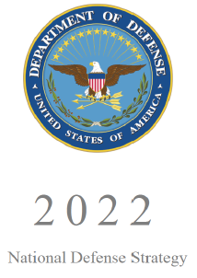
National Defense Strategy
“ADAPT AND FORTIFY OUR DEFENSE ECOSYSTEM”
“The Department will strengthen our defense industrial base to ensure that we produce and sustain the full range of capabilities needed to give U.S., allied, and partners forces a competitive advantage. We will bolster support for our unparalleled network of research institutions, both university affiliated and federally funded research and development centers, as well as small businesses and innovative technology firms…We will increase collaboration with the private sector in priority areas…We will prioritize joint efforts with the full range of domestic and international partners in the defense ecosystems to fortify the defense industrial base, our logistical systems, and relevant global supply chains…”
Source: 2022 National Defense Strategy, page 20
3 Jan 23
Notes:
National Defense Strategy

Slide 19
SAF/SB Linkages
National Defense Strategy - 2022 1. Defending the Homeland
2. Deterring Strategic Attacks Against US, Allies, Partners
Deterring Aggression, While Prepared to Prevail in Conflict, Prioritizing the PRC challenges…then…Russia
Building Resilient Joint Force & Defense Ecosystem
DoD Small Business Strategy – Draft for FY23+
Implement a Unified Management Approach
Align SB Programs w/NDS & Other Guidance
Strengthen Engagement and Support of SBs
SAF/SB Lines of Effort
1. Build Mission-Focused SB Leaders
Provide Relevant Tools and Rules
Strengthen Department’s Engagement
and Support of Small Businesses
24 Oct 22

Slide 20
National Security Imperative
“The United States is pursuing a modern industrial and innovation strategy…We are securing our supply chains, including through new forms of public-private collaboration, and using public procurement in critical markets to stimulate demand for innovation.”
“We are incubating and deploying new technologies and solutions, allowing us to lead the world while creating new markets and scalable approaches. Together, these investments will keep the United States at the leading edge, increase economic capacity, and support millions of jobs and trillions of dollars in economic activity over the next decade…mobilizing the talent, grit, and innovation of American workers, who can out-compete anyone. We are also prioritizing equity and investing in regional economic development to ensure the future is made across all of America, by all Americans.”
Source: White House, National Security Strategy, October 2022
17 Jan 23

Slide 21
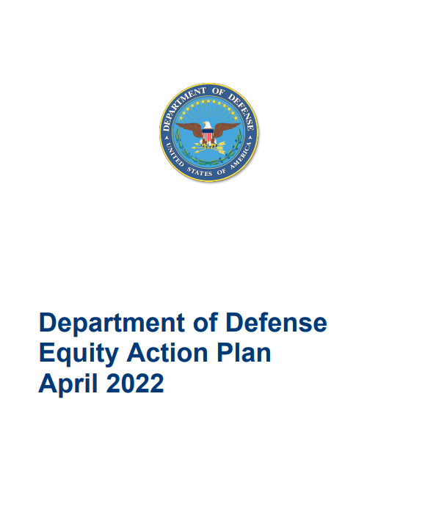
DoD Equity Action Plan
ID’s THREE ACTIONS to Reduce Barriers:
Set, resource, and implement a galvanizing goal around advancing opportunities for prime and subcontractors who are members of underserved communities
Advance equity through requirements on wage setting and labor practices in the DoD contractor workforce and supply chain.
Empower small business programs and initiatives to lead policy and management practices across the Department.
RELEASED 15 APR 22
ACTION ONE of 5 Major Areas relates to SBs:
Procurement/Contracting:
Close gaps in small business participation, participation by other underserved communities, and improve workforce equity through an ambitious equitable procurement and contracting agenda that includes advancing equity throughout the supply chain, such as advancing opportunities for prime and subcontractors who are members of underserved communities.
SAF/SB team swiftly engaged OSD Office of Diversity, Equity, & Inclusion (DEI) and OSD OSBP
Made significant improvements in crafting the Procurement and Contracting details involving SB Programs and Engagement
Orchestrated cascade/integration of key points into OSD SB Strategy soon to be released & ongoing DAF BoD LOE “reset”
SOURCE: https://media.defense.gov/2022/Apr/13/2002976515/-1/-1/0/DOD-EQUITY-ACTION-PLAN.PDF

Slide 22
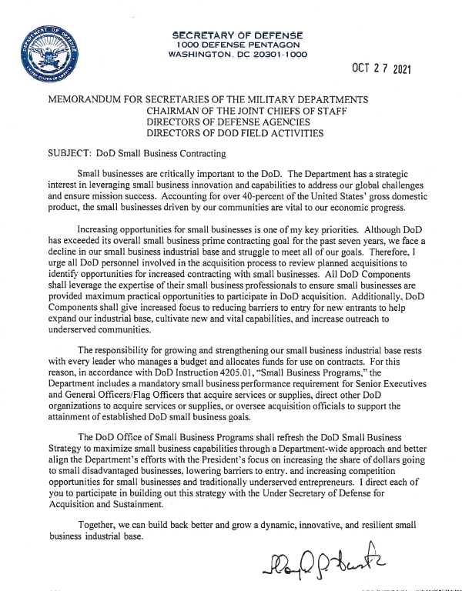
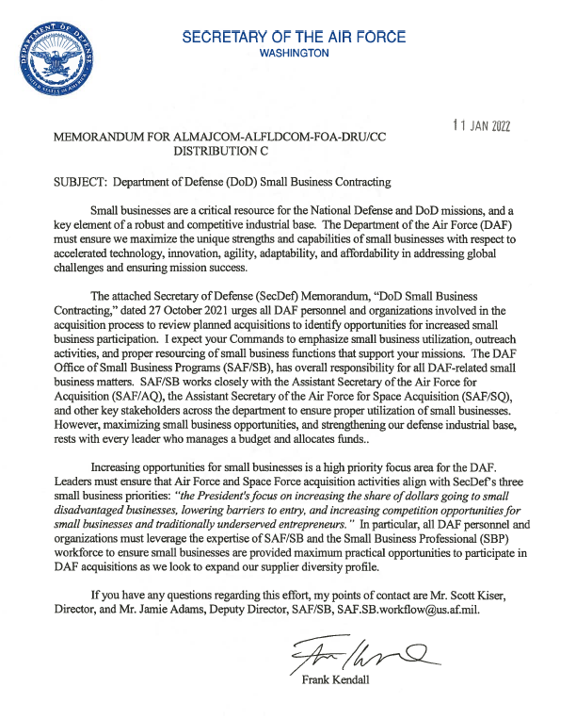
Advancing Equity in Federal Procurement (SECDEF and SECAF SB Contracting Memos)
SAF/SB Action – Signed SecDef & SecAF 11 Jan 2022 memo on “Small Business Contracting”
Highlight commitment/priority to increase SB utilization
Emphasize a review of all planned acquisitions to identify SB opportunities
Take steps to reduce barriers to entry for SBs & expand SB diversity profile
Reemphasize holding Senior Leaders who acquire services and supplies accountable
17 Jan 23

Slide 23
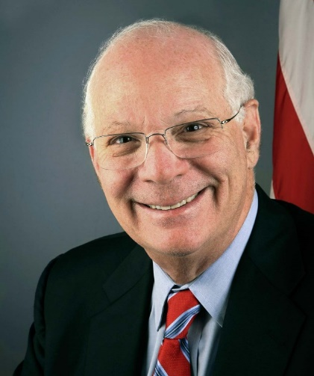
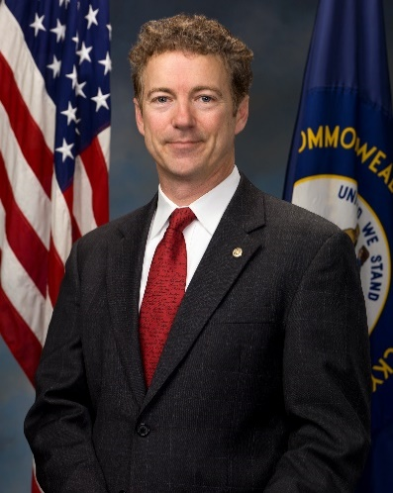
U.S. Senate Committee on Small Business & Entrepreneurship
Ben Cardin
MD
Chair
Rand Paul
KY
Ranking Member
Changing Due to Recent Election
Majority Members (10 including Chair):
Maria Cantwell (WA)
Jeanne Shaheen (NH)
Ed Markey (MA)
Cory Booker (NJ)
Chris Coons (DE)
Mazie Hirono (HI)
Tammy Duckworth (IL)
Jack Rosen (NV)
John Hickenlooper (CO)
Minority Members (10 including Ranking Member):
Marco Rubio (FL)
James Risch (ID)
Tim Scott (SC)
Joni Ernst (IA)
James Inhofe (OK)
Todd Young (IN)
John Kennedy (MO)
Josh Hawley (MO)
Roger Marshall (KS)
*Majority and Minority memberships are equal due to 50-50 Senate split + VPOTUS as President of the Senate
17 Jan 23

Slide 24
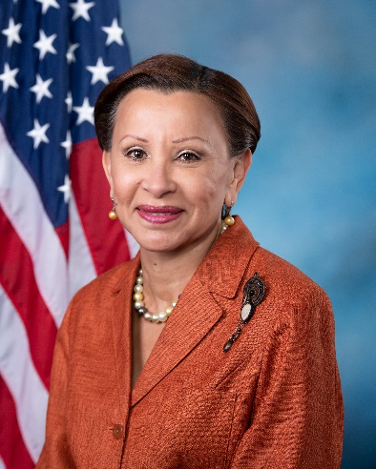
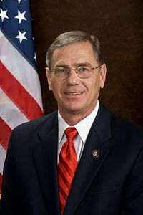
House of Representatives Committee on Small Business
Nydia Velázquez
(NY-07)
Chair
Blaine Luetkemeyer (MN-03)
Ranking Member
Changing Due to Recent Election
Majority Members (15 including Chair):
Vice Chair Rep. Kweisi Mfume (MD-7)
Jared Golden (ME-2)
Jason Crowe (CO-6)
Sharice Davids (KS-3)
Dean Phillips (MN-3
Marie Newman (IL-3)
Carolyn Bourdeaux (GA-7)
Troy Carter (LA-2)
Minority Members (12 including Ranking Member):
Vice Ranking Member, Roger Williams (TX-25)
Jim Hagedorn (MN-1)
Pete Stauber (MN-8)
Dan Meuser (PA-9)
Claudia Tenney (NY-22)
Andrew Garbarino (NY-2)
Young Kim (CA-39)
Beth Van Duyne (TX-24)
Byron Donalds (FL-19)
Maria Salazar (FL-27)
Scott Fitzgerald (WI-5)
Judy Chu (CA-27)
Dwight Evans (PA-03)
Antonio Delgado (NY-19)
Chrissy Houlahan (PA-06)
Andy Kim (NJ-03)
Angie Craig (MN-02)
17 Jan 23

Slide 25
How to do Business with the Air Force
1
3
Prepare to Market Your Business to the Air Force
www.airforcesmallbiz.af.mil/Small-Business/Majcoms-Others-NAICS-Codes/
Review the Air Force Long Range Acquisition Forecast
www.airforcesmallbiz.af.mil/Small-Business/Acquisition-Forecasts/
Review our Web Site
www.airforcesmallbiz.af.mil/
Contact a Small Business Professional
www.airforcesmallbiz.af.mil/Small-Business/Locate-Specialist/
Explore Subcontracting Opportunities
Understand Government Contracting
Identify Your Product or Service
Federal Supply Class or Service codes https://psctool.us/
North American Industry Classification System (NAICS) codes http://www.census.gov/naics
Prepare a printed and electronic Capability Statement
2
Register Your Business
Obtain a Unique Entity ID (UEI) . UEI is now assigned to entities when they register with SAM
Register with the System for Award Management (SAM) www.sam.gov OR call 1-866-606-8220
17 Jan 23

Slide 26
Finding New Ways to Engage SBs and Infuse Innovation
17 Jan 23

Slide 27
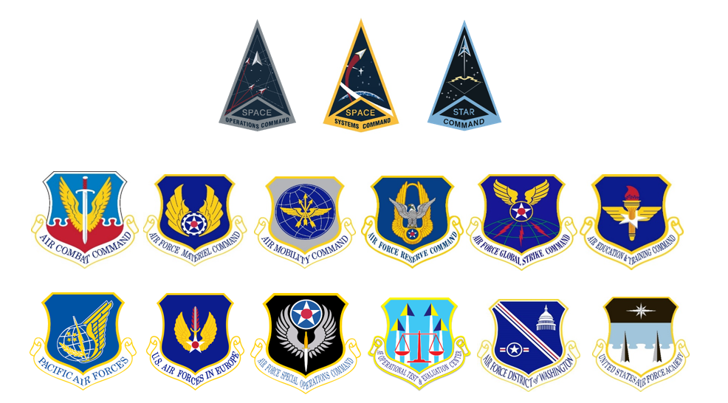
Know Your Target Market
17 Jan 23

