Slide 1
Data Security: The Intersection of Physical Security & Cybersecurity

Slide 2
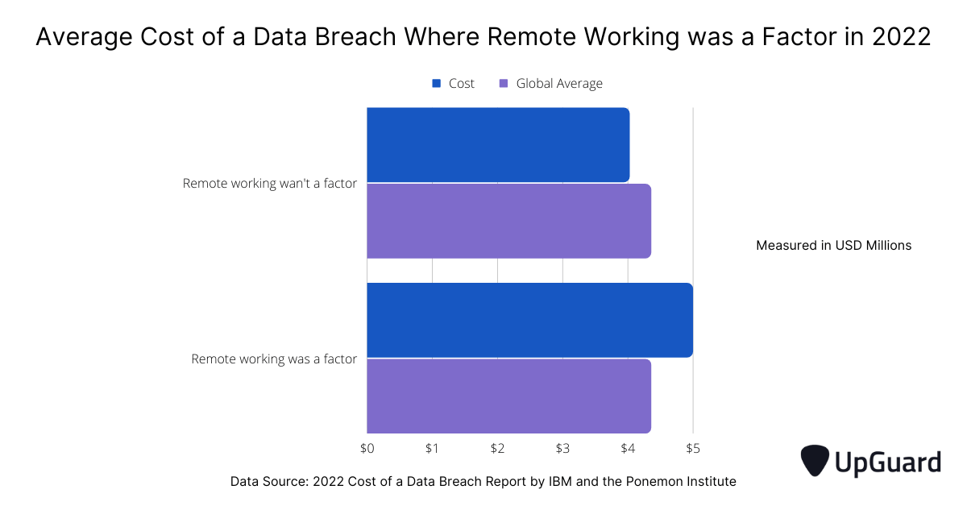

Slide 3
Security AI and Automation Controls Reduced Data Breach Costs by 70%
Security AI and automation controls helped businesses detect and contain data breaches much faster, pushing damage costs down. Organizations with fully deployed security and AI automation paid an average of US$ 3.05 million for data breach damages, US$ 1.3 million less than the global average across all security environments, and they detected breaches faster - 249 days compared to 323 days with no AI and automation solutions.
https://www.upguard.com/blog/cost-of-data-breach

Slide 4
What was the Biggest Contributor to Data Breach Costs in 2022?
Time was found to be the biggest contributor to data breach costs. This makes sense, the longer a breach remains undetected the more sensitive data can be exfiltrated by cybercriminals.
https://www.upguard.com/blog/cost-of-data-breach

Slide 5
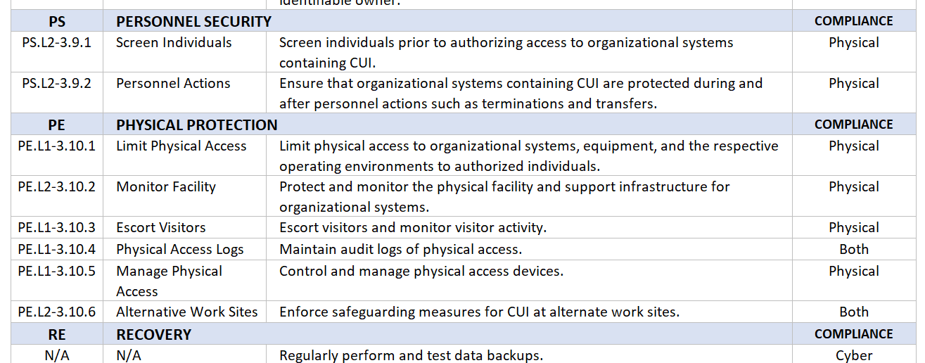
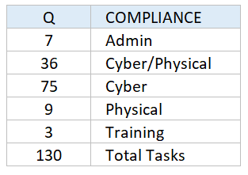
What Is the NIST SP 800-171 and Who Needs to Follow It?

Slide 6
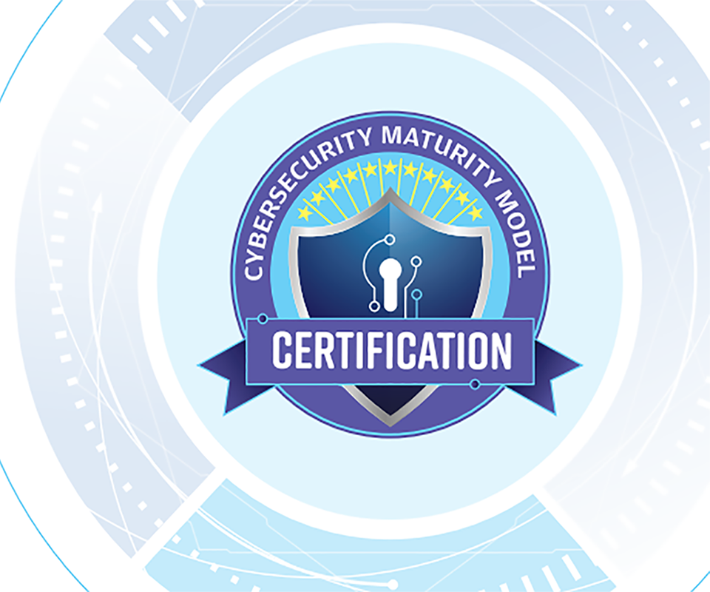

Slide 7
Zero trust (ZT) is the term for an evolving set of cybersecurity paradigms that move defenses from static, network-based perimeters to focus on users, assets, and resources. A zero-trust architecture (ZTA) uses zero trust principles to plan industrial and enterprise infrastructure and workflows. Zero trust assumes there is no implicit trust granted to assets or user accounts based solely on their physical or network location (i.e., local area networks versus the internet) or based on asset ownership (enterprise or personally owned).

Slide 8
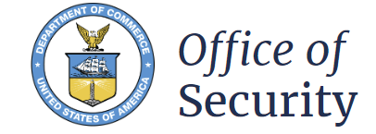
Description of work: The objective of this Multiple Award Task Order Contract (MATOC) is to procure, install, and maintain ESS and physical security; and/or force protection measures. An ESS shall be considered to encompass five (5) sub-systems: a) Intrusion Detection System (IDC), b) Electronic Entry Control System (EECS or Automated Entry Control System (ACES)), c) Video Systems which include Closed Circuit Television (CCTV) systems, d) Data Transmission Systems (DTS), including information assurance, data processing and data storage, and e) Command and Control Systems. The ESS encompasses a wide array of physical security equipment and building automation systems, including security and/or force protection measures such as mass notification systems, fire alarm systems, life safety systems, barriers, fencing, gates, window treatments, hardening, and lighting.

Slide 9
Most Common Applications

Slide 10
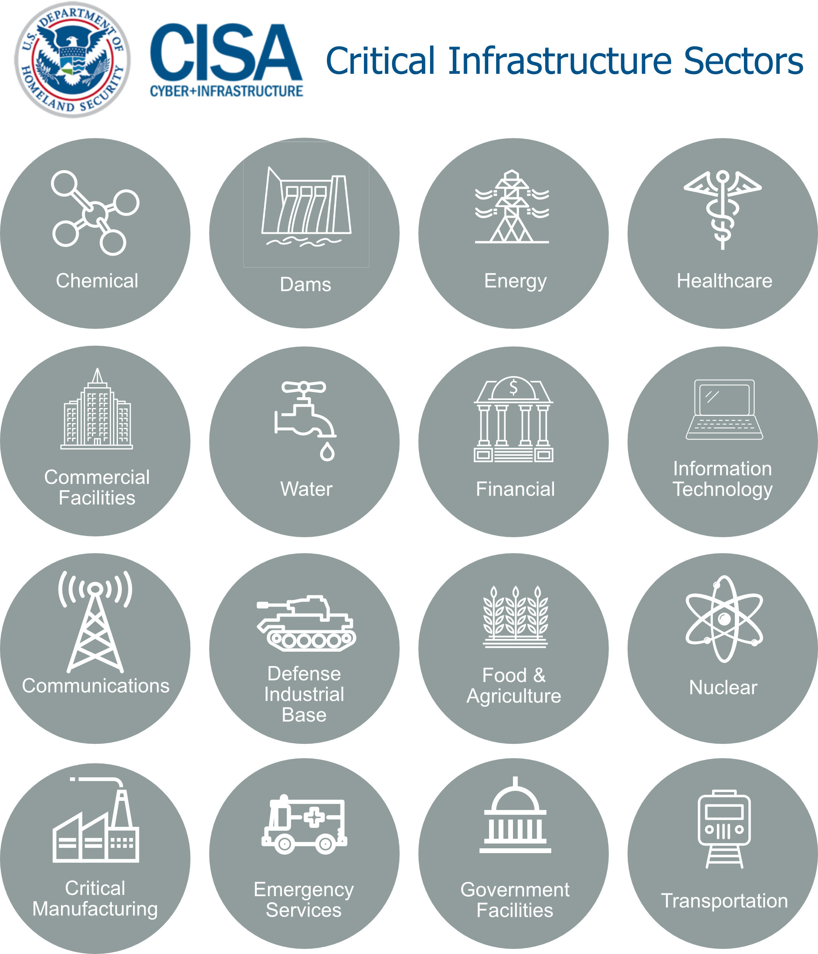

Slide 11
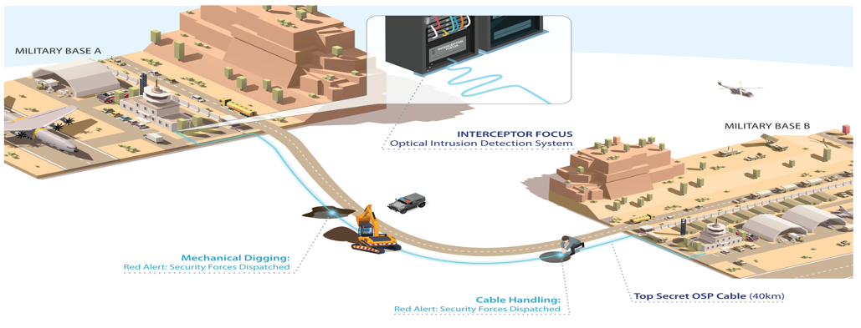

Slide 12
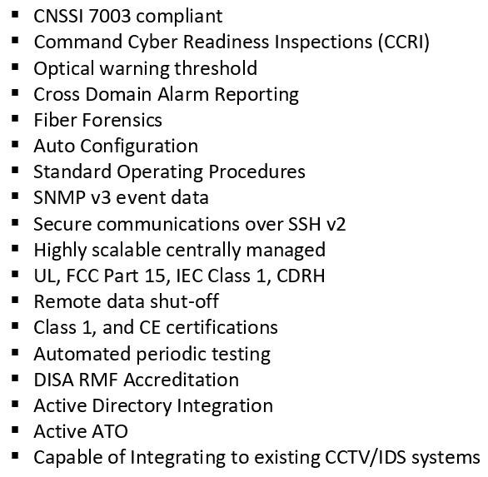
Something to Think about…

Slide 13
Converged Cyber and Physical Security

Slide 14
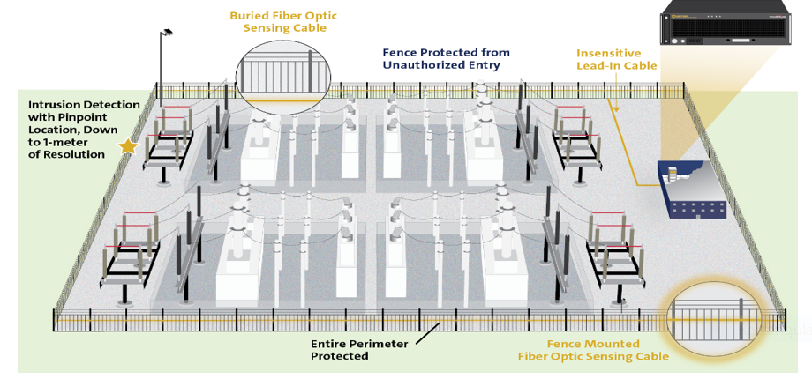
Perimeter Intrusion Detection System

Slide 15
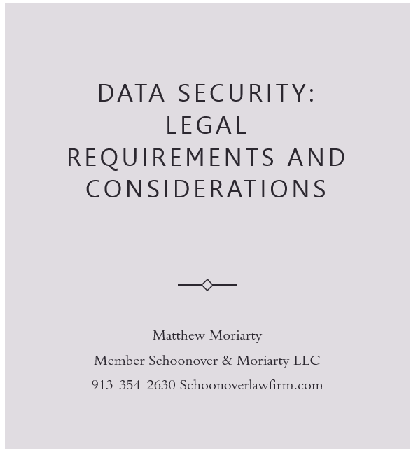

Slide 17
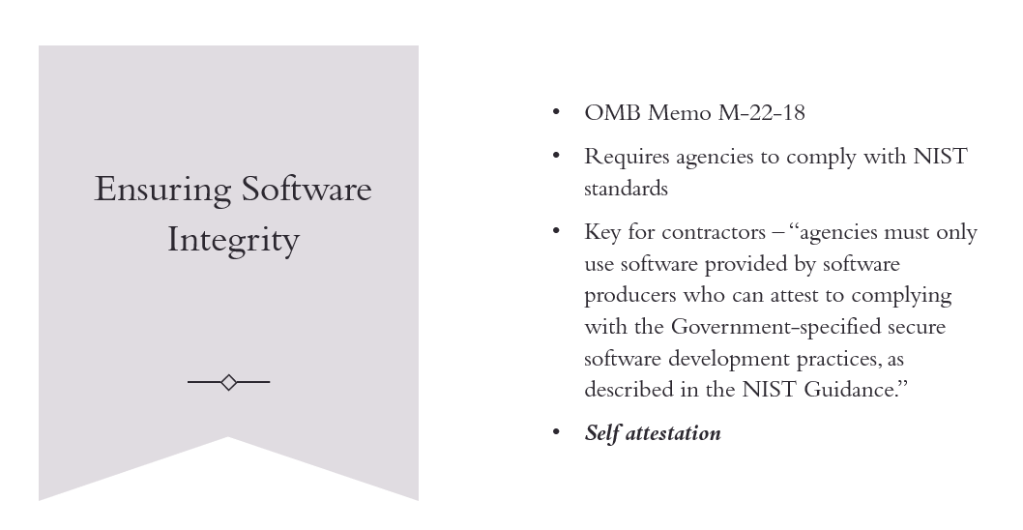

Slide 18
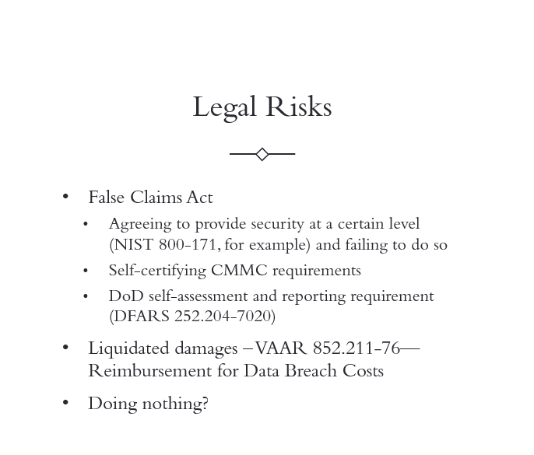

Slide 19
