Slide 1
Get to Know Your Resources
Marie Myszkier, Florida PTAC; Candace Waterman, WIPP; Barbara Ashe, VIP & Michelle Burnett, HUBZone Council

Slide 2
Marie A. Myszkier, MBA, CSDP
Florida PTAC/APEX Accelerator

Slide 3
Marie A. Myszkier, MBA, CSDP
Procurement Specialist
University of North Florida
APEX Accelerator/PTAC

Slide 4
Get to Know Your Resources
Relationships
Partnerships, Clients, Competitors
Small Business Administration (SBA)
Small Business Development Centers (SBDC)
APEX Accelerators formerly Procurement Technical Assistance Centers (PTAC)
Manufacturing Extension Partnership (MEP)
Minority Business Development Agency (MBDA)
Small Business Program Offices
Federal, Prime, Local, Educational, Utilities, Port/Air Authorities
SBIR/STTR Program Offices
Technology Transfer Offices
Federally Funded R&D Centers

Slide 5
Get to Know Your Resources
One-on-One Consulting Services: Serve as a resource for large and small businesses, to obtain procurement technical assistance; to identify potential contractual opportunities and obtain or perform under contracts, innovation and technology grants or contracts, and other Federally funded instruments, with DoD, other Federal agencies, State and/or Local governments, and/or with Federal, State and/or Local government contractors. Regardless of where you are in the process, we will help you identify and prioritize your actions steps and hold you accountable to get them completed. Note: Innovation and technology grants or contracts refer to awards issued pursuant to the SBIR and/or STTR programs or other prototyping agreements.
Marketing and Business Development Support: Help our clients develop marketing collateral (i.e. custom capability statements, DSBS, website strategy, etc.), develop an ongoing networking and relationship strategy, and support your opportunity capture and proposal development efforts.
Research Support: Help our clients develop sustainable research strategies using both publicly available tools such as Contract Opportunities, beta.sam.gov and USAspending but also PTAC-specific tools such as FedMine, Gov$pend, and Bid-Match.
Professional Development: Through our partners at the SBDC, SBA and other agencies, we offer a training calendar throughout the year designed to help business owners, and their staff, better understand key aspects of government contracting. PTAC clients also have access to ‘Govology’ a live and on-demand training resource at no-cost.

Slide 6
Get to Know Your Resources
SIX STEP GATEWAY
EVALUATE Is government contracting the right path for your business?
PLAN Develop your plan for entering the government marketplace.
REGISTER Complete the required business registrations.
PREPARE Develop marketing tools and secure certifications.
PURSUE Find, select, and pursue government opportunities.
ACHIEVE Win, support, and operate contracts—and win more business

Slide 7
Get to Know Your Resources
Leveraging Tools & Resources – Federal
NAICS https://www.census.gov/naics/
SAM https://sam.gov/content/home
Dynamic Small Business Search (DSBS) https://web.sba.gov/pro-net/search/dsp_dsbs.cfm
SBA https://www.sba.gov/
SBIR/STTR https://www.sbir.gov/
Federally Funded R&D Centers https://www.nsf.gov/statistics/ffrdclist/
National Technical Information Service https://www.ntis.gov/
SAM – Contract Data https://sam.gov/content/contract-data
USA Spending https://www.usaspending.gov/
Acquisition Gov https://www.acquisition.gov/procurement-forecasts
– Agency Recurring Procurement Forecasts
Disaster Assistance https://www.disasterassistance.gov/
USA Gov https://www.usa.gov/
Benefits Gov https://www.benefits.gov/

Slide 8
Get to Know Your Resources
Professional and Business Development Associations
National Contract Management Association (NCMA) https://www.ncmahq.org/
Society of American Military Engineers (SAME) https://www.same.org/
National Defense Industrial Association (NDIA) https://www.ndia.org/
National Defense Transportation Association (NDTA) https://www.ndtahq.com/
National 8(a) Small Business Association https://www.national8aassociation.org/
Women’s Business Enterprise National Council (WBENC) https://www.wbenc.org/
National Association of Women Business Owners (NAWBO) https://www.nawbo.org/
Women Impacting Public Policy (WIPP) https://www.wipp.org
HUBZone Council https://www.hubzonecouncil.org/
National Veteran Small Business Coalition (NVSBC) https://nvsbc.org/

Slide 9
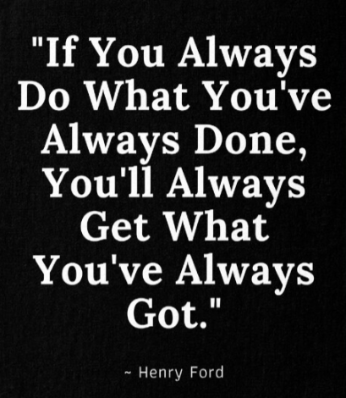
Key Takeaways
Relationships Still Matter
Leverage Your Resources
Be Open to New Avenues

Slide 10
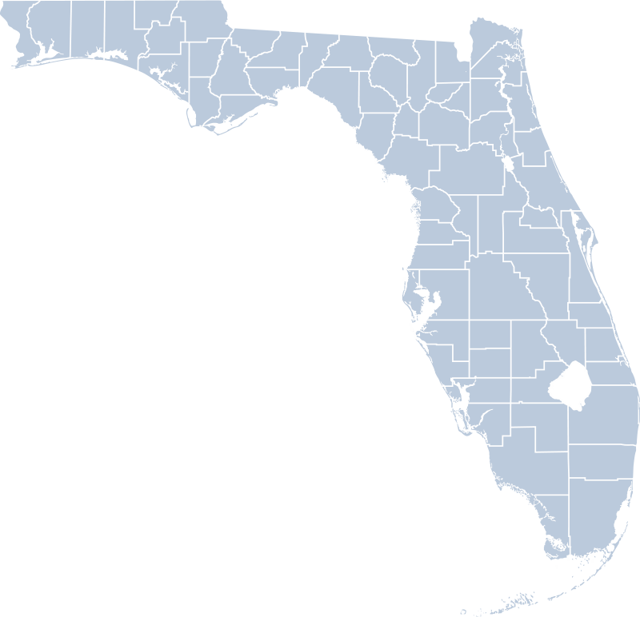
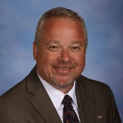
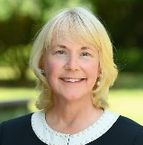
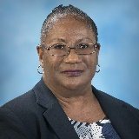
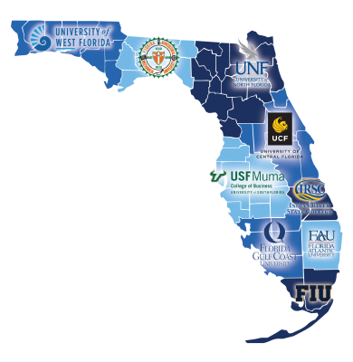
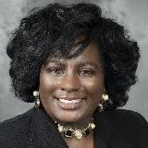
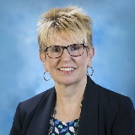
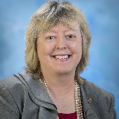
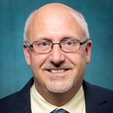
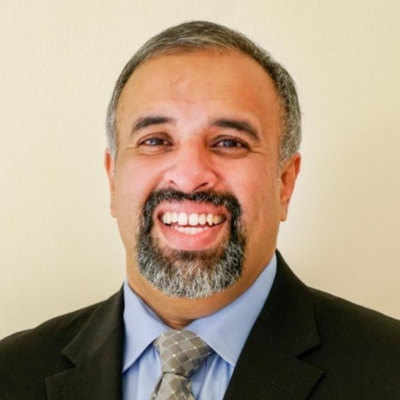
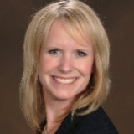
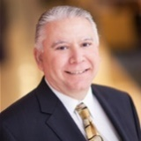
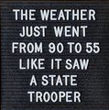
FPTAC.ORG
Marie A. Myszkier, MBA, CSDP
PTAC Specialist
Marie.Myszkier@unf.edu
TBD
Greg Grant
Marie Myszkier
Don Zavesky PTAC HQ
Emery Parker
Steve South
Gregory Grant, MBA
PTAC Specialist
Gregory.Grant@unf.edu
Kara Vernon
Yolanda Cowart
Scotty Wilson
Karen Krymski
Carole Hart
Complexities
For Appointment call:
904-620-2476
800-450-4624
Request for Consulting at UNF
Register (floridasbdc.org)
Mark Odell
Knowledge
Kristy Pittman
Jasion Raju
Credentialed
Experienced
Luis Batista
Notes:
The Florida PTAC has a network across Florida and is a proud member of APTAC, which stands for Association of Procurement Technical Assistance Center.

Slide 11
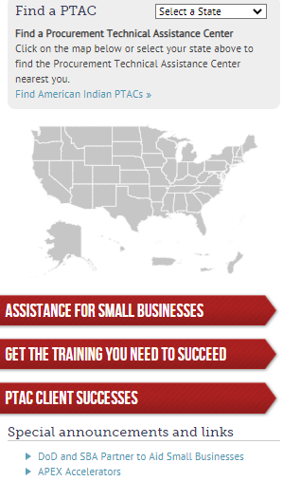
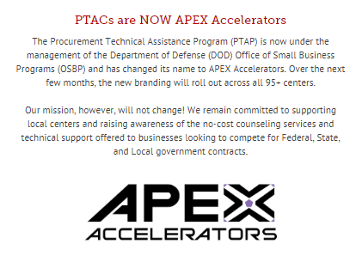
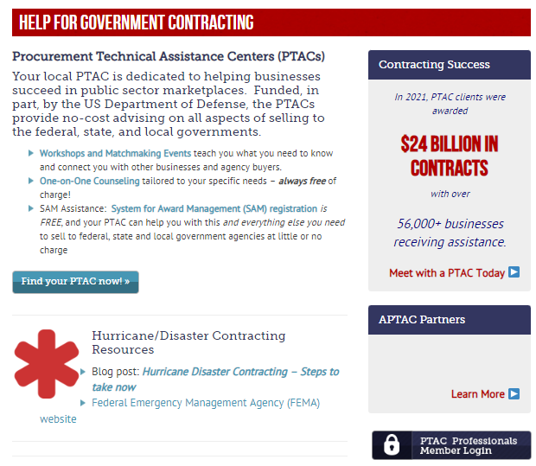
https://www.aptac-us.org/

Slide 13
Get to Know Your Resources
Barbara Ashe, Veteran Institute for Procurement

Slide 14
Barbara Ashe
National Director
Veteran Institute for Procurement (VIP)

Slide 15
Accelerating Growth: What is VIP?
We train “companies,” not individuals​
and make them procurement ready!​
A 27-hour comprehensive certification program ​
Hands-on, market-based instruction that helps establish best business practices for Federal gov’t​
Owner, principal or C-level exec for VOSB/SDVOSB​
Offered nationwide at no cost to participants​ (includes hotel, meals, and training)
2,000+ graduate companies from all 50 states, Washington D.C., Puerto Rico, and Guam

Slide 16
Accelerating Growth: What is VIP?
VIP Programs Reduce Risk​
Business Mistakes are Expensive and Often Times Fatal to a Small Business​
Reduce risk to companies, teaming partners, and gov’t​
Learn from highly experienced industry and government professionals across 20+ topics​
Accelerate growth through best business practices​
Helps businesses get procurement ready

Slide 19
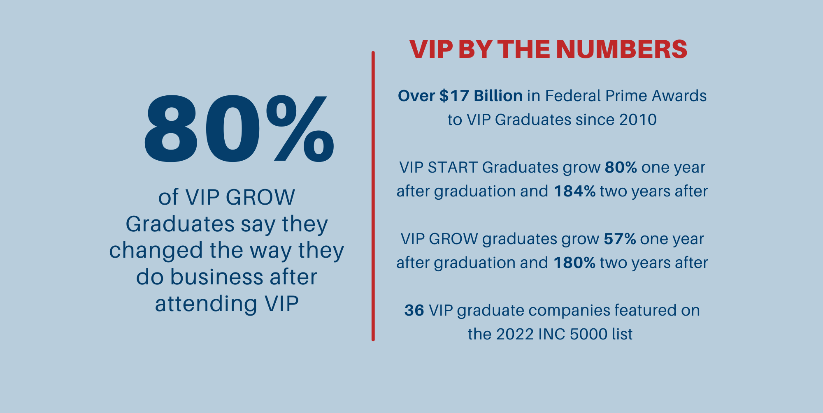

Slide 21
VIP Upcoming 2023 Programs
VIP Programs Reduce Risk​
Business Mistakes are Expensive and Often Times Fatal to a Small Business​
Apply NOW at NationalVIP.org​​
Qualified applicants are accepted on a first come basis​
Apr 18-20
Oct 24-26
Dec 5-7
May 16-18
Mar 28-30
June 13-15

Slide 22
Resources
VIP Resource Page: www.nationalvip.org/resources
U.S. Small Business Administration: www.sba.gov
Veteran Business Outreach Center (VBOC)
SBA District Offices
APEX Accelerators (Formerly known as PTACs): www.aptac-us.org

Slide 23
Thank You VIP Sponsors

Slide 25
Barbara Ashe
bashe@nationalvip.org
301-738-0015 x215
NationalVIP.org

