Slide 1
The GovCon Guide to Collaborating with Non-Civilian Agencies
Laura Anderson, Missile Defense Agency
Carlen Capenos, Defense Information Systems Agency
Roberto Acosta, Air Force Nuclear Weapons Center
Jeffrey Mellott, Air Force Materiel Command

Slide 2
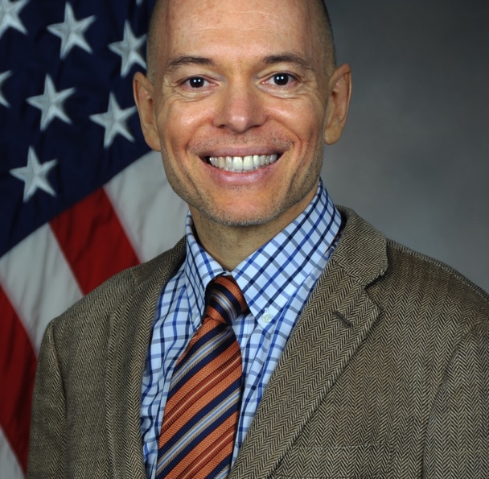
Jeff Mellott
Director, Small Business Programs
Air Force Materiel Command

Slide 3
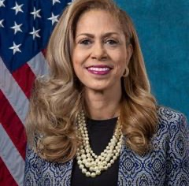
Laura Anderson
Deputy Director, Small Business Programs
Missile Defense Agency

Slide 4
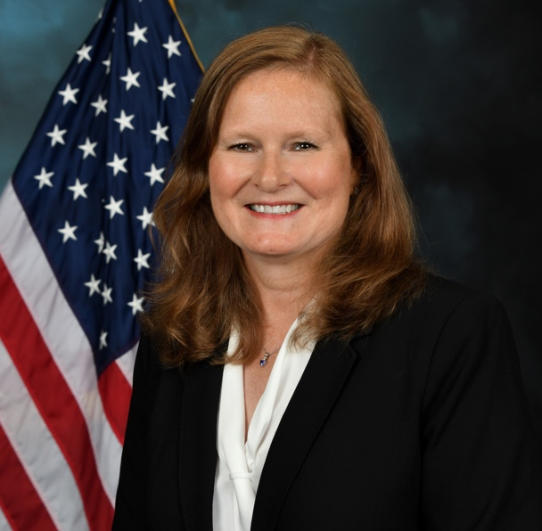
Carlen Capenos
Director, Office of Small Business Programs
Defense Information Systems Agency

Slide 5
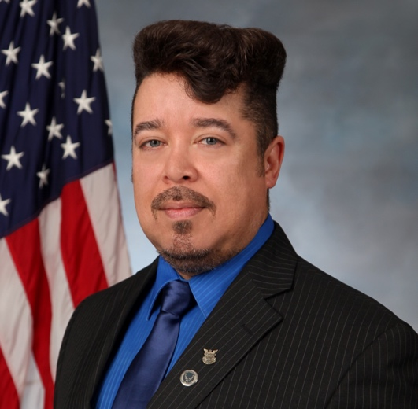


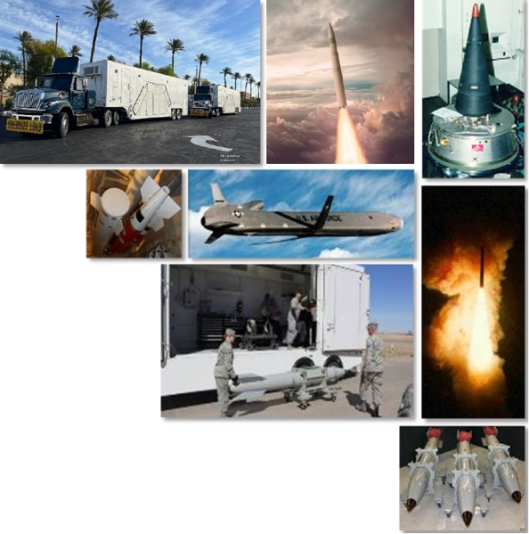
Rob Acosta
Director, Small Business Programs
Air Force Nuclear Weapons Center
Kirtland AFB
$66B ($4B Product | $62B Services)
37 Programs
  5 Acquisition Category I
    Sentinel
    ICBM Fuze Modernization
    Mk21A Re-entry Vehicle
    Long Range Stand-Off Cruise Missile
    B61-12 Life Extension Program Tail Kit Assembly
  2 Acquisition Category II
    ICBM Crypto Upgrade – Phase II
    Flight Test Telemetry & Termination
30 Acquisition Category III
  ALCM SLEP
  MMIII SLEP
  WS3
  DMS Mod

Slide 6

Defense Information Systems Agency (DISA)

Slide 7
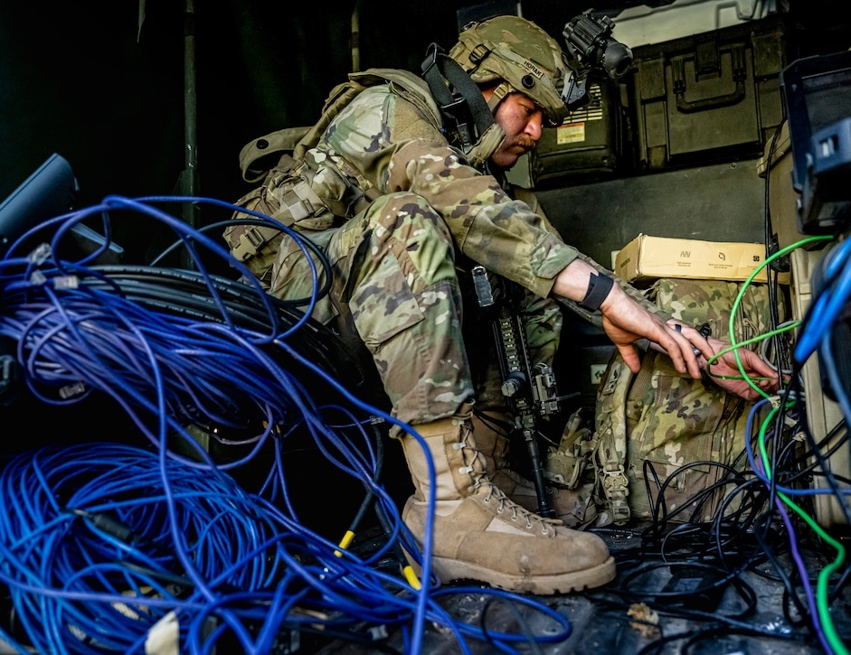
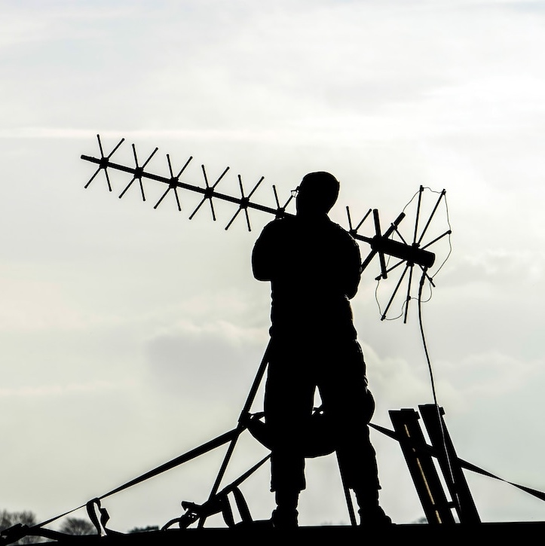
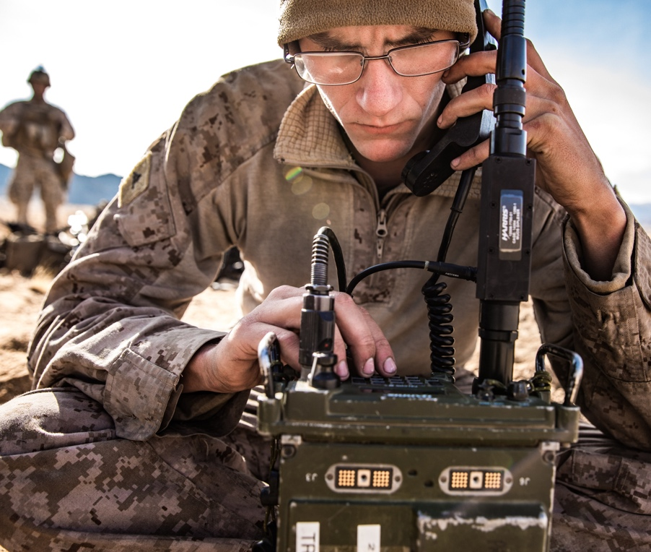
DISA: We Are The
IT Combat Support Agency for the DoD
OUR MISSION: To be the trusted provider to connect and protect the warfighter in cyberspace
OUR VISION: To conduct Department of Defense Information Network operations for the joint warfighter to enable lethality across all warfighting domains in defense of our nation
OUR MANTRA: DISA: Trusted to Connect, Protect, and Serve

Slide 8

DISA Office of Small Business Programs
DISA’s Small Business First Policy: Every requirement that comes through DISA for execution is automatically included in the Small Business Program unless and until market research demonstrates that small business cannot execute the requirement.
DISA is Small Business Friendly: $18B+ in last decade, average = 28.32%
DISA’s OSBP is the entry point for small businesses
Step 1: Email: DISASmallBusiness@mail.mil for invite to
“DISA 101 Small Business Orientation”
Step 2: Do Your Homework – Review the forecast and www.disa.mil
Step 3: Ask for a One-on-One Meeting with OSBP
Step 4: Create a Plan to Work with/for DISA
Step 5: Submit Responses to Sources Sought Notices
Step 6: Submit Proposals
DISASmallBusiness@mail.mil

Slide 9

Missile Defense Agency (MDA)

Slide 10

Air Force Materiel Command (AFMC)

Slide 11

MISSION & VISION
OUR MISSION
OUR VISION
Powering the world’s greatest Air Force…We develop, deliver, support, and sustain war-winning capabilities
One AFMC—Collaborative, innovative, trusted, and empowered…indispensable to our nation, disruptive to our adversaries

Slide 12

OUR BUDGET
BASED ON FY23 PRESIDENT’S BUDGET
45%
$80.2 Billion
TOTAL AFMC BUDGET
of the Air Force budget is executed and managed by AFMC

Slide 13



WHAT WE DO
EVERY DAY, MORE THAN 86,000
AFMC AIRMEN EXECUTE OUR WARTIME MISSION
We buy, test, and maintain the Air Force’s conventional and nuclear
weapon systems.
We build, maintain, secure, and provide critical services to our Air and Space Force installations.
We research and develop new technology to expand our competitive edge.

Slide 14






OUR CENTERS
Current as of July 2023
RESEARCH LABORATORY
Wright-Patterson Air Force Base, Ohio
LIFE CYCLE MANAGEMENT CENTER
Wright-Patterson Air Force Base, Ohio
TEST CENTER
Edwards Air Force Base, California
SUBORDINATE UNITS
711th Human Performance Wing, Wright-Patterson AFB, Ohio Aerospace Systems, Wright-Patterson AFB, Ohio/Edwards AFB, Calif. Air Force Office of Scientific Research, Arlington, Va.
Directed Energy, Kirtland AFB, N.M.
Information, Rome, N.Y.
Materials & Manufacturing, Wright-Patterson AFB, Ohio
Munitions, Eglin AFB, Fla.
Sensors, Wright-Patterson AFB, Ohio
Space Vehicles, Kirtland AFB, N.M.
Systems Technology, Wright-Patterson AFB, Ohio
SUBORDINATE UNITS
66th Air Base Group, Hanscom AFB, Mass
88th Air Base Wing, Wright-Patterson AFB, Ohio
Air Force Security & Cooperation, Wright-Patterson AFB, Ohio Agile Combat Support, Wright-Patterson AFB, Ohio Armament, Eglin AFB, Fla.
Bombers, Wright-Patterson AFB, Ohio
Business & Enterprise, Gunter Annex-Maxwell AFB, Ala.
C3I/Networks, Hanscom AFB, Mass.
Digital, Hanscom AFB, Mass.
Fighter & Advanced Aircraft, Wright-Patterson AFB, Ohio
ISR/SOF, Wright-Patterson AFB, Ohio
Mobility & Training Aircraft, Wright-Patterson AFB, Ohio Presidential & Executive Airlift, Wright-Patterson AFB, Ohio Propulsion, Tinker AFB, Okla.
Rapid Sustainment Office, Wright-Patterson AFB, Ohio
SUBORDINATE UNITS
96th Test Wing, Eglin AFB, Fla.
412th Test Wing, Edwards AFB, Calif.
Arnold Engineering and Development Complex, Arnold AFB, Tenn.
Platforms Tested 96th Test Wing:
A-10, B-1, B-2, B-52, E-3, E-4, E-8, EC-130, F-15C/E,
F-16, F-22, F-35, HH-60, HC-130, MH-139, MQ-1/9, RC-135, RQ-4, U-2ATD
412th Test Wing:
B-1, B-2, CV-22, RQ-4, RQ-4E, F-18, F/A-22, F-35, C-130J, F-16, F/A-18, F-117A
BUDGET: $5.3B PERSONNEL: 6,003
Arnold Engineering and Development Complex:
F-35, F-22A, A-10, F-14, F-15, F-16, F/A-18, C-5, C-17, B-1B, B-2, B-52
SUSTAINMENT CENTER
Tinker Air Force Base, Oklahoma
BUDGET: $37.8B PERSONNEL: 21,982
BUDGET: $1.5B PERSONNEL: 13,282
SUBORDINATE UNITS
Ogden Air Logistics Complex, Hill AFB, Utah
Oklahoma City Air Logistics Complex, Tinker AFB, Okla. Warner Robins Air Logistics Complex, Robins AFB, Ga. 448th Supply Chain Management Wing, Tinker AFB, Okla. 635th Supply Chain Operations Wing, Scott AFB, Ill.
72nd Air Base Wing, Tinker AFB, Okla. 75th Air Base Wing, Hill AFB, Utah 78th Air Base Wing, Robins AFB, Ga.
NUCLEAR WEAPONS CENTER
Kirtland Air Force Base, New Mexico
INSTALLATION & MISSION SUPPORT CENTER
Joint Base San Antonio- Lackland, Texas
SUBORDINATE UNITS
Air Delivered Capabilities, Kirtland AFB, N.M. Intercontinental Ballistic Missile Systems, Hill AFB, Utah NC3 Integration, Hanscom AFB, Mass.
Nuclear Command, Control, and Communications Integration, Hanscom AFB, Mass., and Kirtland AFB, N.M.
Nuclear Technology and Integration, Kirtland AFB, N.M.
Strategic Systems, Kirtland AFB, N.M.
PLATFORMS MAINTAINED
Ogden Air Logistics Complex:
A-10, F-16, F-22, F-35, T-38, Minuteman III & landing gear
Oklahoma City Air Logistics Complex:
B-1, B-52, KC-135, E-3, ALCM, Engines & KC-46
Warner Robins Air Logistics Complex:
C-5, C-17, F-15, C-130, propellers & RQ-4
SUBORDINATE UNITS
Air Force Civil Engineer Center, Joint Base San Antonio-Lackland, Texas Air Force Installation Contracting Center, Wright-Patterson AFB, Ohio Air Force Security Forces Center, JBSA-Lackland, Texas
Air Force Services Center, JBSA-Lackland, Texas
BUDGET: $1.1B PERSONNEL 38,040
BUDGET: $4.0B PERSONNEL: 1,844
BUDGET: $9.3B PERSONNEL: 3,403

Slide 15
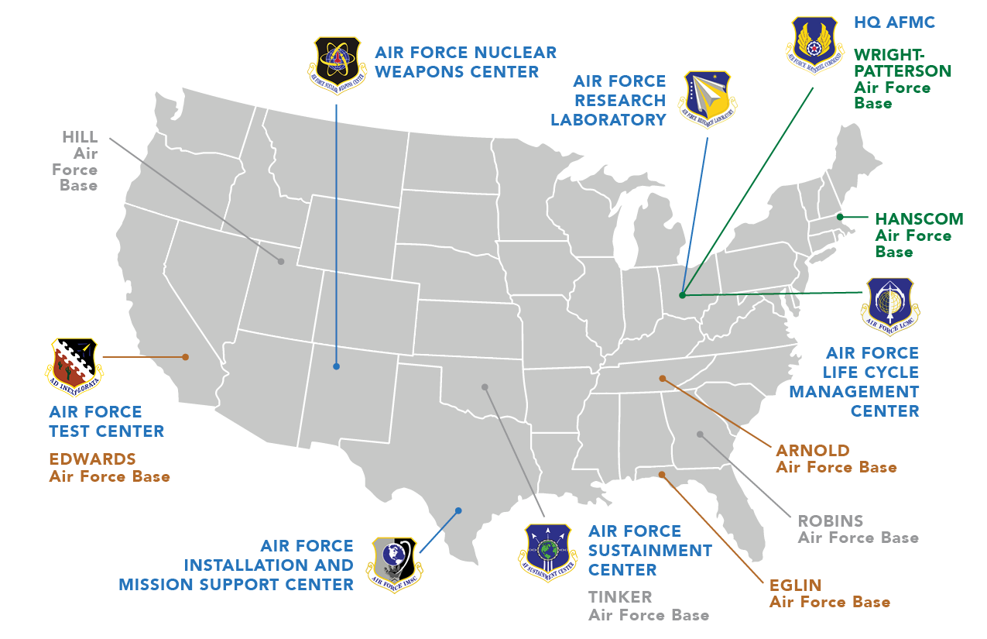
WHERE WE ARE
171
LOCATIONS around the globe where AFMC personnel are located
COUNTRIES where AFMC personnel are stationed
19
55
Military BASES where AFMC personnel
are assigned

Slide 16
Air Force Materiel Command (AFMC)
Small Business Program
AFMC’s FY23 SB program: $9.8B, or 16.62% of $58B in eligible spend
  Eligible spend is contract awards available for small business consideration
  Exclusions include statutorily mandated sources and foreign military sales (FMS)
All socio-economic categories experienced substantial spend
      Small Disadvantaged Business (SDB): $3.5B (6.01%). A New Record
      Service-Disabled Veteran-Owned Small Business (SDVOSB): $1.1B (1.92%)
      Woman-Owned Small Business (WOSB): $1.33B (2.28%)
      Historically Underutilized Business Zone (HUBZone): $600M (1.03%) A New Record
    Expect FY24 to be another record SB program!

Slide 17
Air Force Materiel Command (AFMC)
Small Business Program Directors
AFRL: Brian McJilton, Director
  afrl.sb.workflow@us.af.mil
AFLCMC: Luke Schultz, Director
  aflcmc.sb.org.mailbox@us.af.mil
AFTC: Cindy Randall, Director
  s53272@us.af.mil
AFSC: Ronnie Hobbs, Director
  afsc.sb.workflow@us.af.mil
AFNWC: Rob Acosta, Director
  AFNWC.SB.Workflow@us.af.mil
AFIMSC, including AFCEC: Greg Santiago, Director
  AFIMSC.SB.workflow@us.af.mil
HQ AFMC/SB:
afmc.sb.workflow@us.af.mil

Slide 18





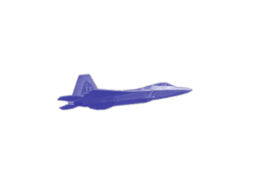


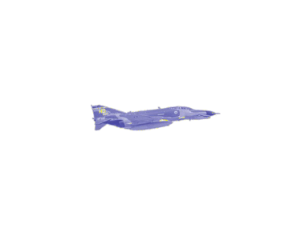
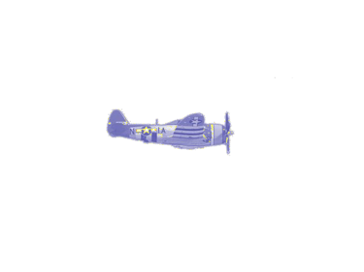

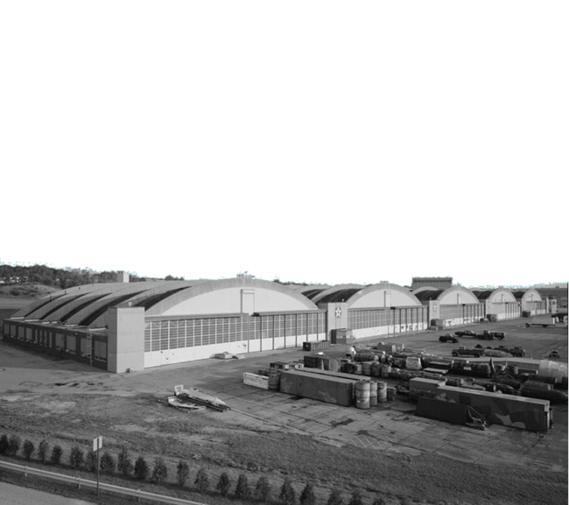
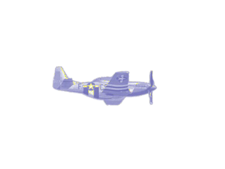





A I R F O R C E
S M A L L B U S I N E S S
WELCOME TO THE
AIR FORCE MATERIEL COMMAND
Have you contacted your APEX Accelerator Rep formally PTAC? If not, click here: https://www.aptac-us.org/find-a-ptac/
They can help you with the steps below.
M A T E R I E L C O M M A N D
WHO WE ARE
Air Force Materiel Command (AFMC) is the world’s leader in developing and sustaining war-winning expeditionary capabilities. To achieve this mission, AFMC leverages the innovation & expertise of thousands of Small Businesses such as YOU. The AFMC mission is executed across six Centers, with each Center focused on a particular mission; e.g., R&D, weapon system life cycle management, sustainment, test and evaluation, nuclear, and installation support.
Utilizing the contacts in this brochure, you can make contact with the Center your company is best suited to support. We look forward to working with you in the defense of our nation!
GUIDE TO FINDING CONTRACT OPPORTUNITIES
SIX EASY STEPS TO DO BUSINESS WITH AFMC
Obtain a DUNS Number and register in the System for Award
Management. (www.fedgov.dnb.com and SAM.gov)
If you would like to compete for special small business set- aside contracts, contact and register with your local SBA Office. Examples of Small Business Set-asides include:
DELIVERING
INNOVATION,
EFFICIENCY, AND
AGILITY TO THE BATTLEFIELD...
8(a) Business Development
HUBZone
Economically Disadvantaged/Women-Owned Small Business Programs
Service-Disabled Veteran-Owned Small Business Concerns
...THROUGH THE POWER OF SMALL BUSINESS!
Determine your Federal Supply Classification (FSC) & North American Industry Classification System Codes (NAICS). Once you have determined your codes, add them to your SAM.gov company profile to be informed about future contract opportunities. If you need help with this contact your local Procurement Technical Assistance Center, https://www.aptac- us.org.
Browse SAM.gov for contract opportunities at the Bases you would like to do business with.
For additional information about AFMC Small Business opportunities, directly reach out to the appropriate AFMC Small Business Office located at the Center/Base as indicated in this brochure.
Once you have found a requirement that you can support, submit a proposal in accordance with the Request for Proposal (RFP) “Instructions to Offerors”.
HOW CAN AFMC/SB HELP YOU?
Think of us like the front door. We can be your initial entry to AFMC requirement owners and contracting units, pointing you to the base or mission that best fits your capabilities. If you understand the AFMC organization outlined in this pamphlet, recommend reaching out directly to the Center small business office most relevant to the product or service you offer. Also, feel free to contact HQ AFMC/SB and we will point in the right direction.
If at any point you would like assistance with locating or responding to AFMC Requirements, please contact the appropriate Center Small Business Office (see POC Listing).
Check out links for potential opportunities
AF Expiring Contracts: https://www.airforcesmallbiz.af.mil/Small- Business/Business-Opportunites/
AFCEC Construction Task Order list: https://www.afcec.af.mil/Home/ Business/

Slide 19



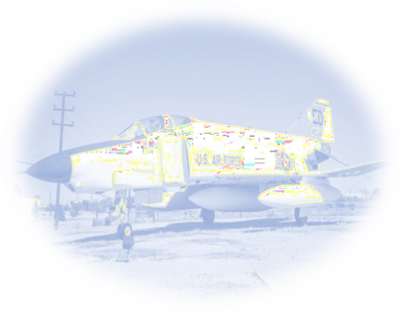






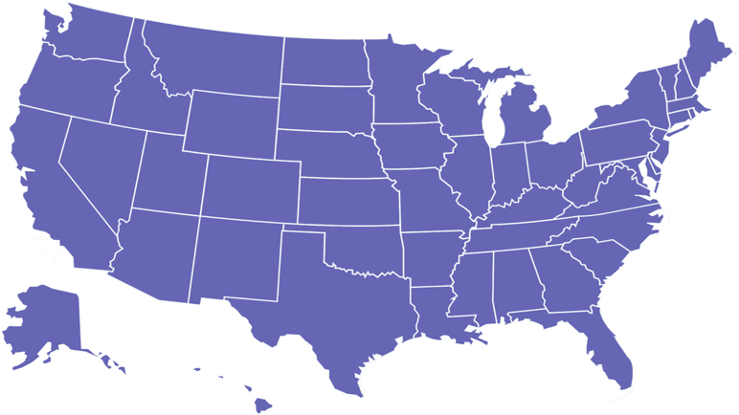
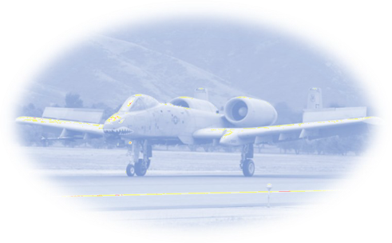

Six Purpose Built Centers…ONE DYNAMIC COMMAND!
AIR FORCE MATERIEL COMMAND (AFMC)
AIR FORCE RESEARCH LABORATORY (AFRL)
The Air Force Research Laboratory (AFRL) is dedicated to leading the discovery, development, & integration of warfighting technologies in air, space, and cyberspace.
AFRL leads the pursuit of basic and
applied research and advanced technology development for aerospace systems, sensors, materials & manufacturing, human performance, cyber technology, directed energy, space vehicles, & munitions. Contact the AFRL Small Business Office if you are pursuing innovative, leading edge technology or submit your idea to https://airforcetechconnect.org.
DISCOVERY & DEVELOPMENT (AFRL)
Wright-Patterson AFB, OH (HQ Director: Jeff Mellott)
Phone: 937-257-3211
Email: afmc.sb.workflow@us.af.mil
Website: https://www.afmc.af.mil/About-Us/Small-Business/
Wright-Patterson AFB, OH (Director: Brian McJilton)
Phone: 937-999-1719
Email: AFRL.SB.Questions@us.af.mil
Wright Research Site — Wright-Patterson AFB, OH (Sarah Bell) Phone: 937-713-0963
Email: sarah.bell.12@us.af.mil
Rome Labs, NY— Information Directorate (Michael Graniero) Phone: 315-330-4625
Email: michael.graniero@us.af.mil
The Air Force Installation & Mission Support Center (AFIMSC) provides operational support to Air & Space Force installations worldwide spanning expeditionary space & installation support programs. This includes base communications, chaplains, civil engineering, contracting, financial management, logistics readiness, public affairs, security forces, resourcing and combat support operations for Airmen and their families. Contact the AFIMSC Small Business Office if your product or service is capable of supporting the world’s finest Airmen.
The Air Force Test Center (AFTC) conducts developmental testing & evaluation of aircraft and flight systems including avionics, weapons systems (manned & unmanned), flight-controls, and munitions. Center operations include aerodynamic & propulsion wind tunnels, rocket & turbine engine test cells, environmental chambers, ballistic ranges, and centrifuges in the evaluation of air, space, and cyber systems. Contact the AFTC Small Business Office if your capabilities can support developmental testing and evaluation of complex systems.
AIR FORCE SUSTAINMENT CENTER (AFSC)
Tinker AFB, OK (Director: Ronald Hobbs )
Phone: 405-739-2601
Email: AFSC.SB.workflow@us.af.mil
Hill AFB, UT (Director: Lynn Garrett) Phone: 801-777-4143
Email: AFSC.OL.SB@us.af.mil
Robins AFB, GA (Director: Timothy Inman)
Phone: 478-926-5873
Email: wralc.bc.frontoffice@us.af.mil
Air Force Office of Scientific Research, VA (Calvin Scott) Phone: 703-696-7308
Email: calvin.scott@us.af.mil
Kirtland AFB, NM (Carmen Chavira)
Phone: 505-503-9311
Email: Carmen.Chavira@us.af.mil
AIR FORCE
TEST CENTER (AFTC)
AIR FORCE LIFE CYCLE MANAGEMENT CENTER (AFLCMC)
Edwards AFB, CA (Director: Cindy Randall) Phone: 661-277-4519
Email: cynthia.randall@us.af.mil
Wright-Patterson AFB, OH (Director: Luke Schultz) Phone: 937-904-5999
Email: aflcmc.sb.org.mailbox@us.af.mil
AIRMEN & BASE SUPPORT SERVICES (AFIMSC)
TEST AND EVALUATION (AFTC)
Arnold AFB, TN (Stacey Lamb) Phone: 931-454-5868
Email: stacey.lamb.1@us.af.mil
Eglin AFB, FL (Director: Anita Jackson) Phone: 850-882-2843
Email: aflcmc.sb.eglin@us.af.mil
Eglin AFB, FL (Director: Anita Jackson)
Phone: 850-882-2843
Email: aflcmc.sb.eglin@us.af.mil
Hanscom AFB, MA (Director: Andrea Panagoulias)
Phone: 781-225-6470
Email: andrea.panagoulias@us.af.mil
Maxwell AFB-Gunter Annex, AL (Director: Yolanda Mccain) Phone: 334-416-4137
Email: yolanda.mccain@us.af.mil
The Air Force Nuclear Weapons Center (AFNWC) provides nuclear material management to the Air Force Global Strike Command. AFNWC provides the backbone for national nuclear assurance and deterrence programs through Air Delivered Capabilities; Ground Based Strategic Deterrent Systems; Minuteman III Systems; Nuclear Command, Control, and Communications (NC3) Integration; and Nuclear Technology & Integration. Contact the AFNWC Small Business Office if your product or service is capable of supporting Nuclear Management.
The Air Force Life Cycle Management Center (AFLCMC) is charged with bringing weapon systems out of the development & testing stages and into the hands of the Warfighter
while focusing on “Cradle-to-Grave” support in the production and fielding of major USAF weapon systems, AFLCMC operates globally to acquire and maintain systems such as; Aircraft, IT Networks, C3ISR Systems, simulators, personal equipment and other aerial systems.
Contact the AFLCMC Small Business Office if you have a product or service capable of supporting Life Cycle Management.
AIR FORCE INSTALLATION &
MISSION SUPPORT CENTER (AFIMSC)
Joint Base San Antonio, TX (Director: Gregory Santiago) Phone: 210-395-8907
Email: AFIMSC.SB.workflow@us.af.mil
AIR FORCE NUCLEAR WEAPONS CENTER (AFNWC)
Wright-Patterson AFB, OH (Director: David Boris) Phone: 937-257-2822
Email: AFICA.SB.workflow@us.af.mil
Kirtland AFB, NM (Director: Roberto Acosta) Phone: 505-846-4366
Email: AFNWC.SB.workflow@us.af.mil
The Air Force Sustainment Center (AFSC) provides the Air Force with supply chain and logistics management to maintain all Air Force weapon systems in operating condition for the Warfighter. This includes the modification, maintenance, repair and overhaul of weapon systems such as aircraft, avionics, electronic systems, and munitions among others. If you specialize in providing items and services designed to keep established weapon systems in peak condition, contact the AFSC Small Business Office to learn about opportunities to join our mission.
WEAPON SYSTEM SUSTAINMENT (AFSC)
POC Map Legend
Headquarters AFMC/SB Center Headquarters Center Operating Location
NUCLEAR SYSTEM MANAGEMENT (AFNWC)
WEAPON SYSTEMS LIFE CYCLE MANAGEMENT PROGRAM SUPPORT
(AFLCMC)

Slide 20

Air Force Nuclear Weapons Center (AFNWC)

Slide 21
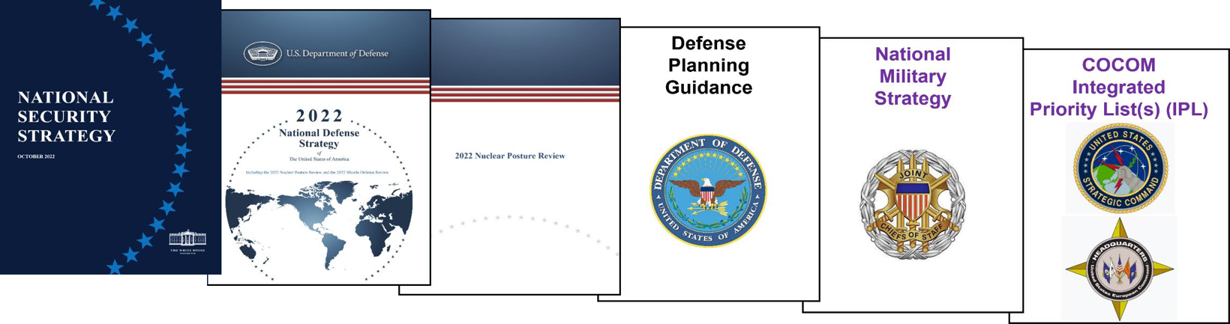
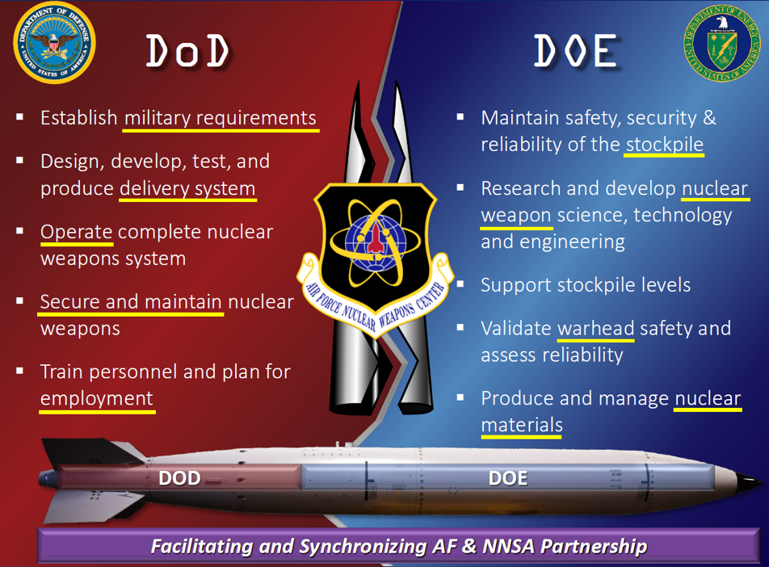
AFNWC
Mission
  Deterrence & Assurance
  Modernization & Materiel Management
Opportunities
  SAM.Gov + Enterprise Contracts
  Prime or Subcontracting
  Small Business Innovation Research (SBIR)
Never Doubted, Always Feared

Slide 22
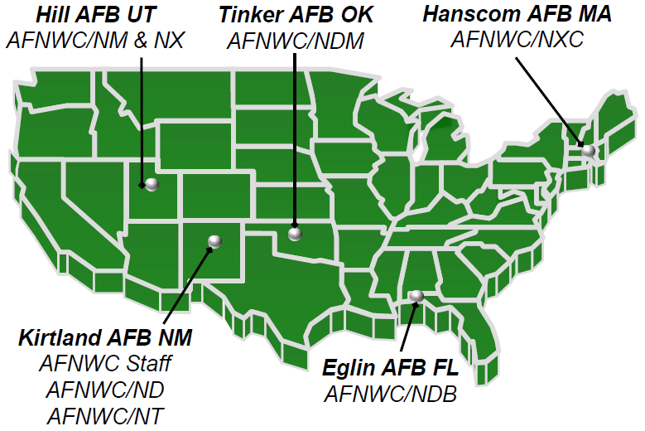
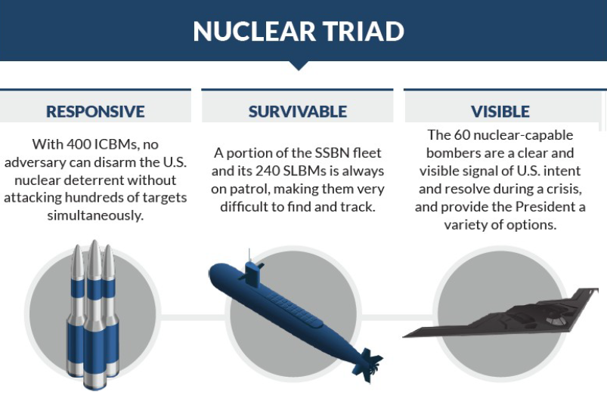
AFNWC Deterrence & Assurance
5 Tenant Locations
  Services and Systems acquisitions
  O&M supported by Host Base
2 Program Portfolios
  Strategic Systems (Kirtland AFB)
    ICBMs
    Air Delivered Weapons
  Nuclear C3 (Hanscom AFB)
    Command,
    Control, &
    Communications

Slide 23
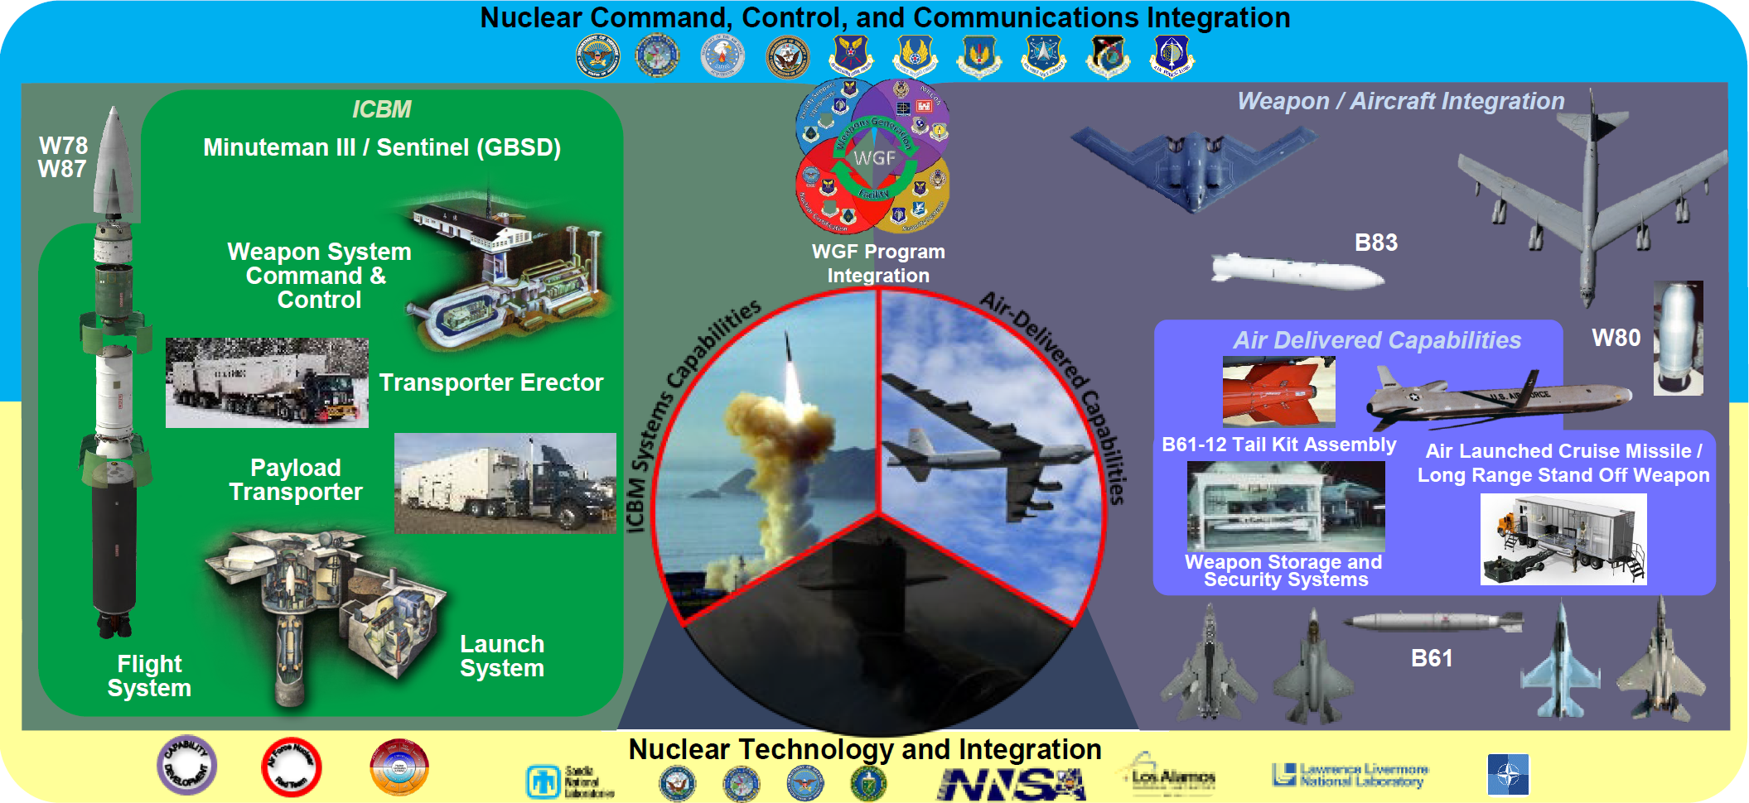
AFNWC Modernization & Materiel Management

Slide 24
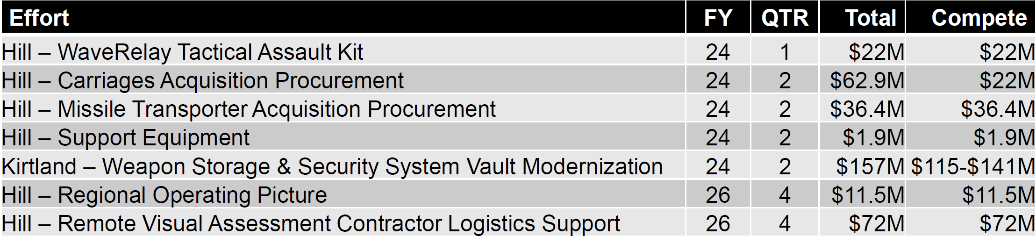
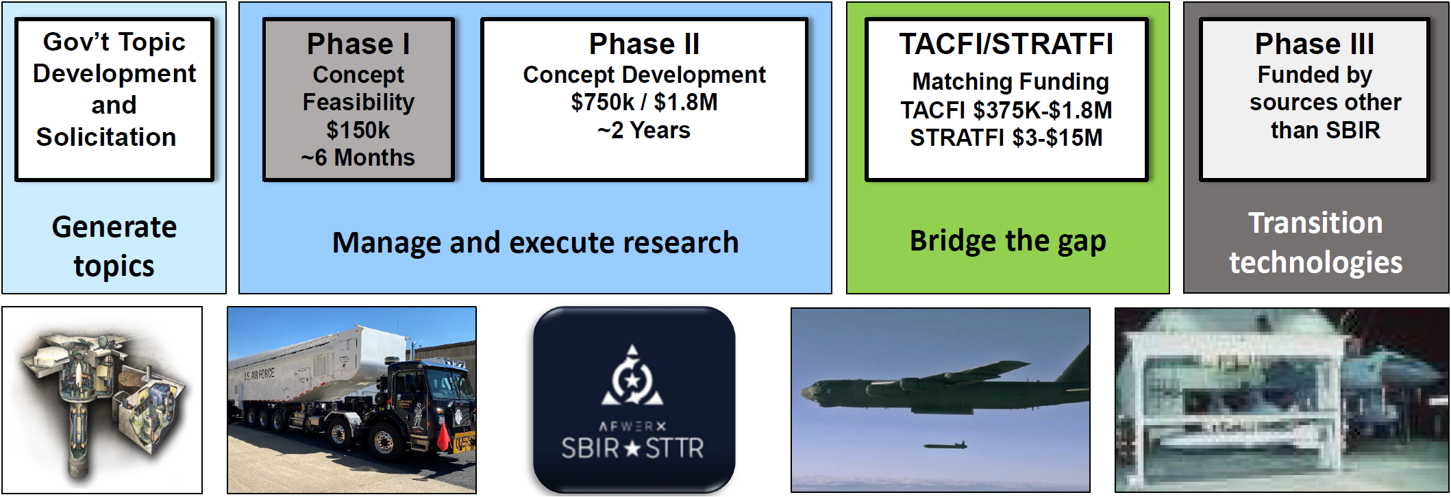
AFNWC Opportunities
SAM.gov + Enterprise Contracts
Subcontracting
On board relevant GSA and Gov’t-wide contract vehicles
Keep business registration current for effective market research
Small Business Innovation Research (SBIR)
https://www.afnwc.af.mil/innovation/
AFNWC.SBIRSTTR@us.af.mil
Contact AFNWC Small Business Office roberto.acosta.2@us.af.mil
  Provide a capabilities statement
  Discuss opportunities + IR&D and S&T investments + new ventures

Slide 26
Jeff Mellott, AFMC
Laura Anderson, NDA
afmc.sb.workflow@us.af.mil
outreach@mda.mil
937-255-3211
(256) 450-2872
https://www.afmc.af.mil/About-Us/Small-Business/
www.mda.mil
Rob Acosta, AFNWC
AFNWC.SB.Workflow@us.af.mil
505-846-4366
https://www.afnwc.af.mil/innovation/
Carlen Capenos, DISA
www.disa.mil
301-225-45008
www.disa.mil

