Slide 1
CMMC
Stuart Itkin & Ben Tchoubineh

Slide 2
Agenda
Why are we talking about CMMC
A Refresher: What is CMMC again?
An Update: What’s happened, what’s happening
What should you be doing today

Slide 3
Stuart Itkin
Senior Vice President
NeoSystems

Slide 4
Ben Tchoubineh
President
Phoenix TS

Slide 5
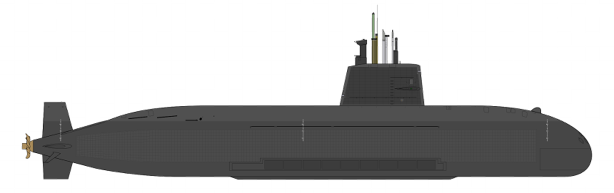
Why are we here talking about CMMC?
It has nothing to do about compliance.
It has a lot to do with submarines.

Slide 6
Alan Turing: Why we’re we talking CMMC
Alan Mathison Turing OBE FRS English mathematician, computer scientist, logician, cryptanalyst, philosopher, theoretical biologist Broke German Enigma code in 1943
Decoded >84,000 secret messages/month
Protected North Atlantic merchant convoys
Credited with accelerating the end of WW II
Notes:
Born: June 23, 1912 Died: June 7, 1954 Education: Princeton University

Slide 7
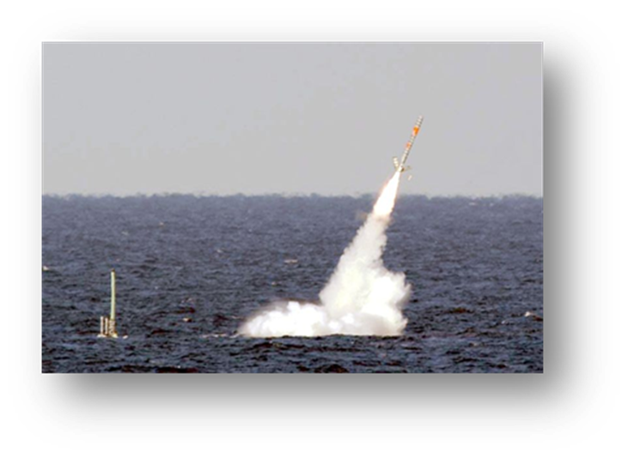
Alan Turing: Why we’re we talking CMMC
Sea Dragon – June 2018
614 gigabytes of data stolen by China
Undersea warfare data
Plans for a submarine-based, supersonic anti-ship missile
Sensor and cryptographic information
Navy submarine development unit’s electronic warfare library
Notes:
Born: June 23, 1912 Died: June 7, 1954 Education: Princeton University

Slide 8
Why are we here talking about CMMC?
Scenario | CEO of a government contractor was notified of an auction on the dark web selling access to the firm’s data, which included access to DoD CTI/CUI.
Attack | A phishing attack with malware in the email attachment: A senior employee downloaded a malicious attachment believing it was from a trusted source
Response | IT shut off access to the affected server and ran network scans to identify any additional breaches. A cybersecurity forensics firm was hired, assisted by the U.S. Secret Service. Each potential impacted agency was notified.
Impact | The operational and financial impact from the breach exceeded $2M. The company was offline for over a week, disrupting business. The company purchased and implemented new security software and a new server. The company’s largest contract was not renewed by DoD.
60% of Data Breaches are Fatal to Small and Medium Businesses

Slide 9
Why are we here talking about CMMC?
It has nothing to do about compliance.
It is about ensuring that what we deliver to our war fighters has not been compromised
It is about ensuring our safety and the safety of our nation
It is about the ensuring the viability of your business

Slide 10
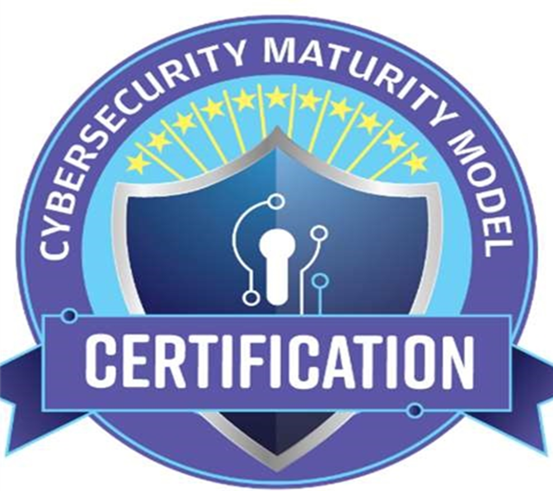
So, Real Quick: What is CMMC Again?

Slide 11
Where Exactly Did this Come From?
The official statement around why CMMC came about reads:
Department of Defense (DOD) is planning to migrate to the new CMMC framework in order to assess and enhance the cybersecurity posture of the Defense Industrial Base (DIB). The CMMC is intended to serve as a verification mechanism to ensure appropriate levels of cybersecurity practices and processes are in place to ensure basic cyber hygiene as well as protect controlled unclassified information (CUI) that resides on the Department’s industry partners’ networks

Slide 12
Why is this Happening????
The DoD realized that they needed something with teeth in order to, you know, DEFEND our country.

Slide 13
CMMC: Why Me???
REAL TALK:
That 2016 NIST 800-171 rollout.
Also, that 2018 NIST 800-171 update.

Slide 14
No, really. Why me? Can’t I file an exemption?
No. If you are part of the Defense Industrial Base
as a contractor or subcontractor, you have to participate.

Slide 15
So….what did we do wrong, again???

Slide 16
Wait. What is FCI and why do I need to protect it?

Slide 17
So…what’s this CUI thing everyone is talking about???

Slide 18
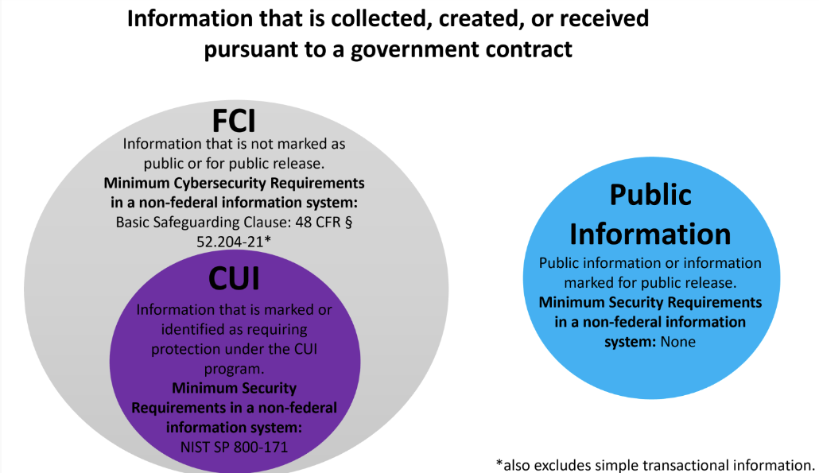
WHERE DOES IT ALL FIT???

Slide 19
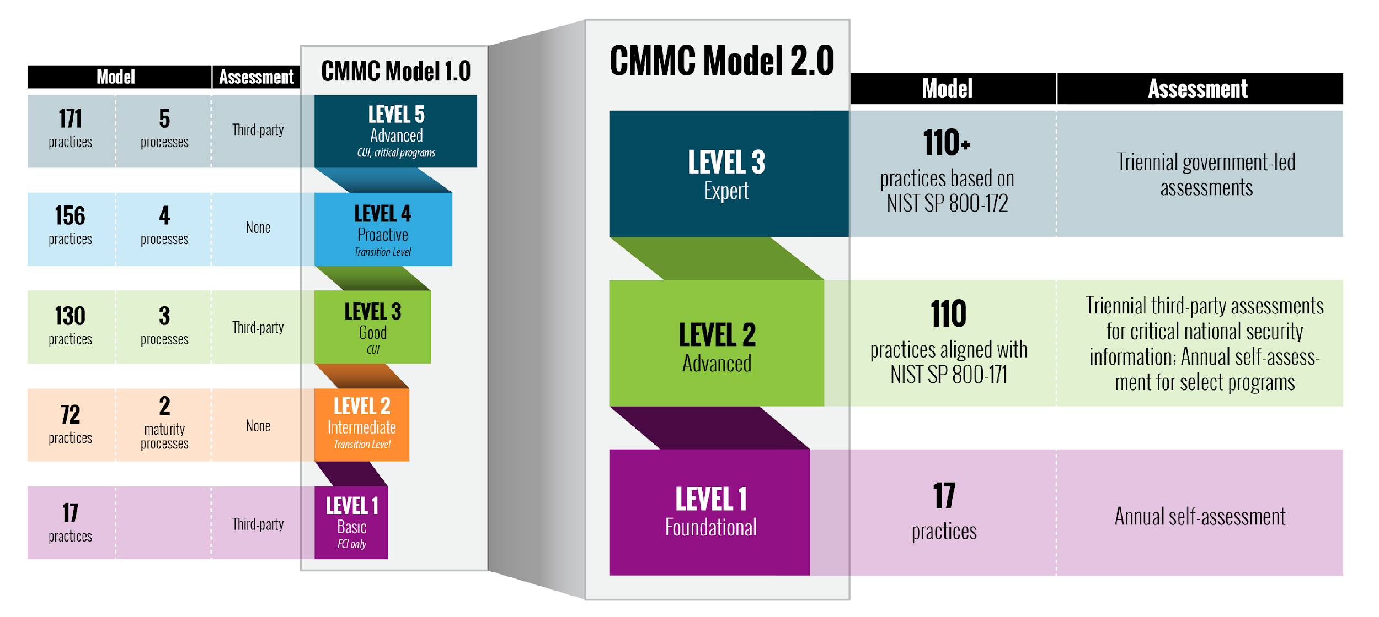
The CMMC Tree

Slide 20
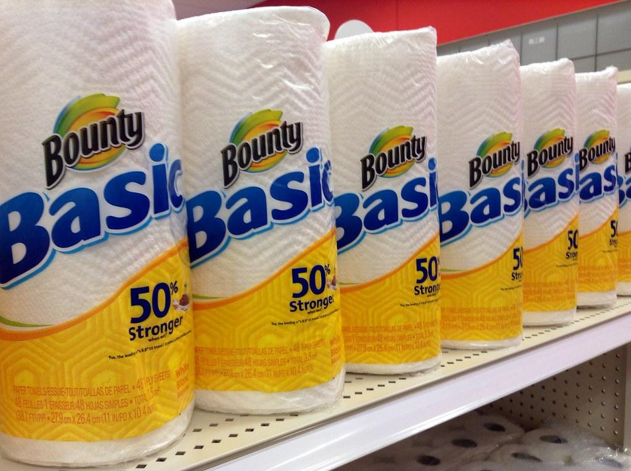
Level 1: Performed / Basic Cyber Hygiene Subject to 17 Practices Basic Safeguarding of FCI Self-attestation

Slide 21
Level 2: Managed / Good Cyber Hygiene Each Practice is Documented, Including Lower Levels A policy exists that covers all activities 110 Practices from NIST SP 800-171r2

Slide 22
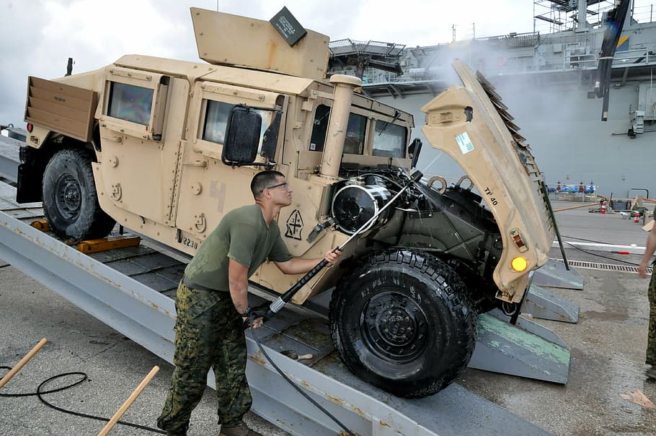
Level 3: Optimizing / Advanced / Progressive Cyber Hygiene Practices based around NIST SP 800-172 This level will be assessed by the government

Slide 23
Why does this keep changing? Will it ever STOP changing?

Slide 24
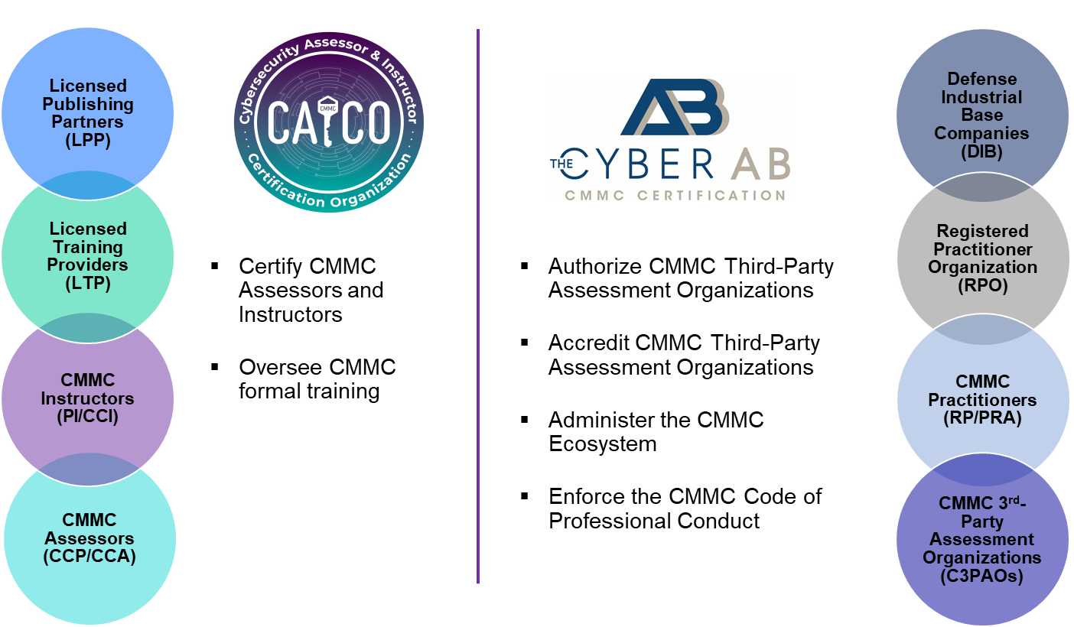
Who’s who in the zoo? The CMMC Ecosystem
The CMMC Accreditation Body and the CAICO have supporting and/or oversight relationships with ALL members of the CMMC Ecosystem

Slide 25
Will it ever STOP changing?
Ask me about Revision 3 of
NIST 800-171

Slide 26
What isn’t CMMC?
CMMC is not new requirements
The requirements have existed for 5 years, 6 months, 13 days
There is nothing to wait for
And if you are waiting, you’re late
And if you are late, there will be consequences
CMMC is a DOD program to assess defense contractors’ ability to protect CUI in accordance with NIST 800-171. It will become a means of enforcing compliance.

Slide 27
Compliance Is Being Increasingly Enforced
DFARS 252.204-7019
Requires submitting a Basic Self-Assessment via SPRS
DFARS 252.204-7020
Allows DIBCAC to come on-site and perform an audit
DIBCAC 5-Day Audits are real (and increasing in frequency)
Civil Cyber Fraud Initiative and the False Claims Act
Prosecutions under the FCA are increasing
The U.S. Supreme Court recently made defense harder
DFARS 252.204-7024
Allows Contracting Officers to consider cybersecurity when making awards
Ultimately, expect large Primes to drive the timeline

Slide 28
What is the CMMC timeline?
The draft change to 48 CFR that will “create” CMMC should leave DoD in +/- 2 days
The draft requires review and sign-off by SBA and OMB
This could take as long as 90 days
Expect the rule to be published this Fall
If an “Interim Rule” it becomes effective after a 60-day public comment period
If an “In Process Rule” public comments must be adjudicated before it becomes “Final”
Given DoD’s Posture Toward Enforcement, It Doesn’t Matter That Much

Slide 29
Now Ask Me About NIST 800-171r3
NIST released 800-171r3 for comments May 2023, due in July.
Much of r3 is ALREADY required
The r3 rewritten controls and discussions provide better clarity.
Much required before r3 changes can be implemented; it will take time
The FedRAMP PMO has just released the approved FedRAMP Rev. 5 baselines and a Transition Guide. The intent is to move those seeking FedRAMP authorization to the controls of NIST SP 800-53 Revision 5.
NIST released the final Rev. 5 on September 2020. It took 32 months for FedRAMP to release the new baselines and describe what is expected during the transition. (The transition is not immediate)
The implementation of NIST 800-171r3 will likely follow suite

Slide 30
What the r3 Announcement means to you?
You will be held accountable for complying with existing DFARS requirements including 800-171r2 long before r3 goes into effect
Everything in r2 is required in r3
r2 is not only an existing requirement; it is a foundation for r3
No “wasted” effort
Be ready early; Certify while r2 is in effect
You’ll be able to take an easier test !

Slide 31
What should you be doing today
Don’t let the NIST 800-171r3 announcement distract you
If you completed a basic assessment and submitted to SPRS:
Complete your POA&M items
Complete an 800-171 High Assessment through an Authorized C3PAO or a Voluntary Joint Surveillance Assessment
If you believe you have a Basic Assessment Score of 110:
Complete an 800-171 High Assessment through an Authorized C3PAO or a Voluntary Joint Surveillance Assessment
Remediate your POA&M items
If you’ve not started:
Look toward fast-path solution to build a minimal enclave
Expand scope incrementally
Or get a time machine

Slide 32
Stuart Itkin
Stuart.Itkin@NeoSystemsCorp.Com
www.NeoSystemsCorp.com

Slide 33
Ben Tchoubineh
ben@phoenixts.com
www.PhoenixTS.com

