Slide 1
The Impact of Recent and Pending Cybersecurity Regulations on 8(a) Organizations, and Strategies to Affordably Achieve and Maintain Compliance
Stuart Itkin, Senior Vice President, NeoSystems Ben Tchoubineh, President, Phoenix TS

Slide 2
Stuart Itkin
Senior Vice President
NeoSystems

Slide 3
Ben Tchoubineh
President
Phoenix TS

Slide 4
Agenda
Developments on the regulatory front
National Cybersecurity Strategy
Cybersecurity Maturity Model Certification (CMMC)
Why is compliance hard?
Strategies to make compliance less hard, less expensive, less risky
Summary

Slide 6
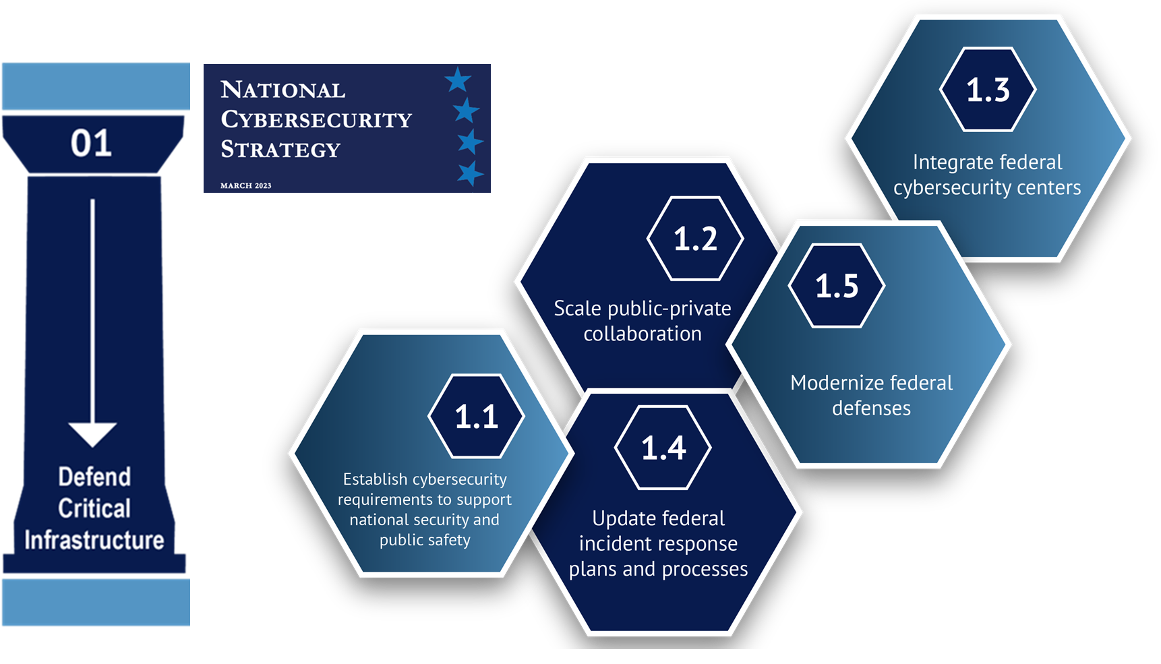

Slide 7
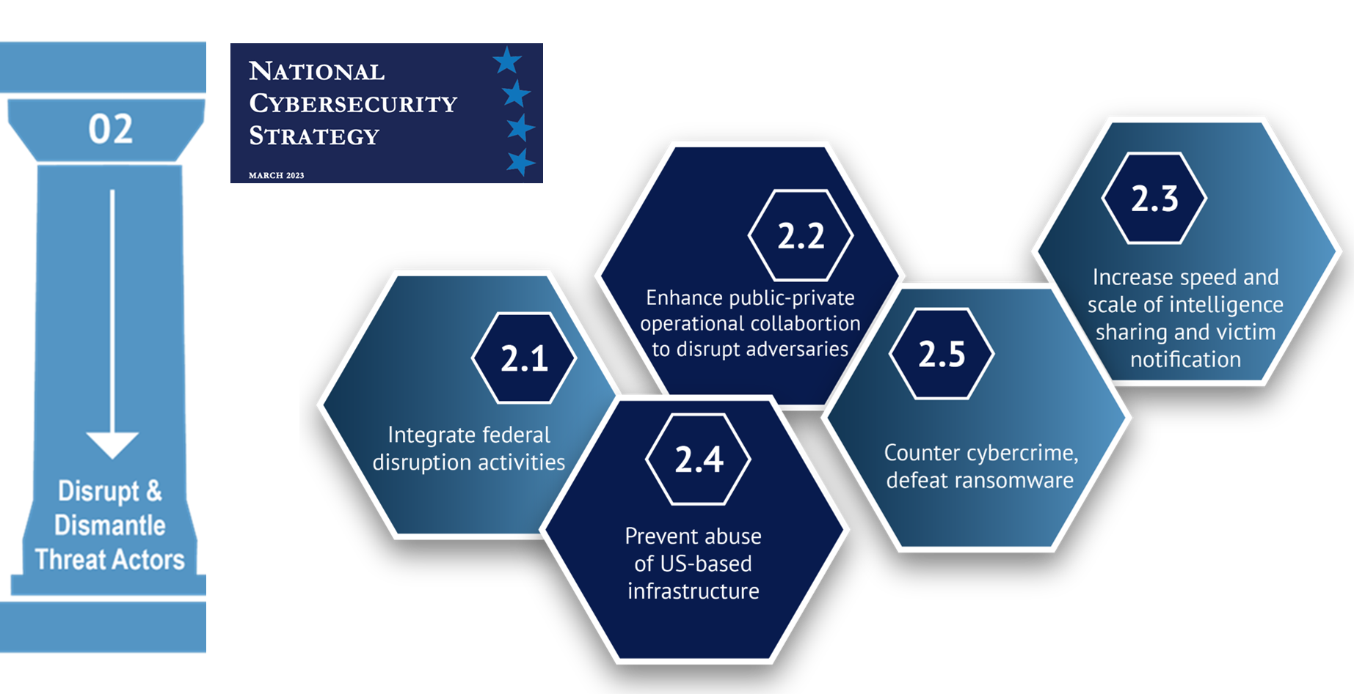

Slide 8
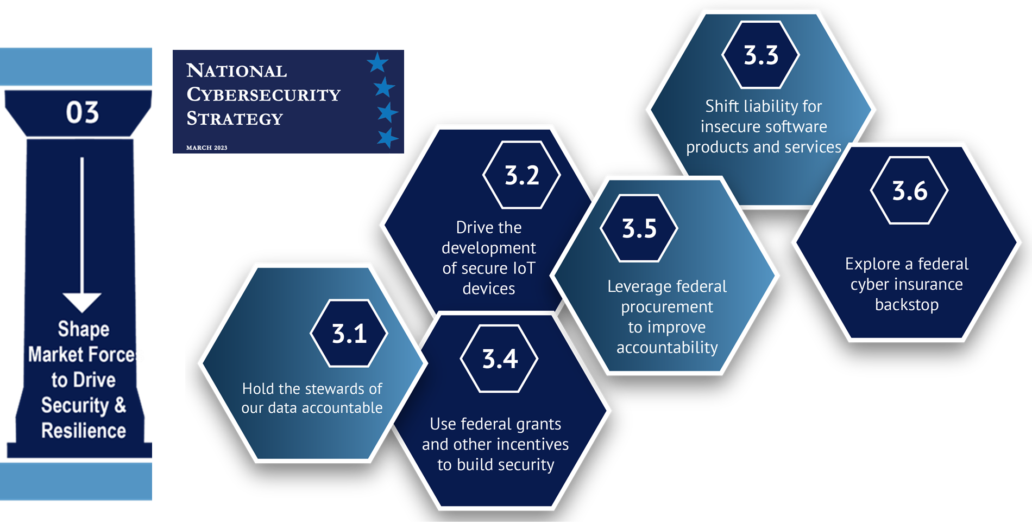

Slide 9
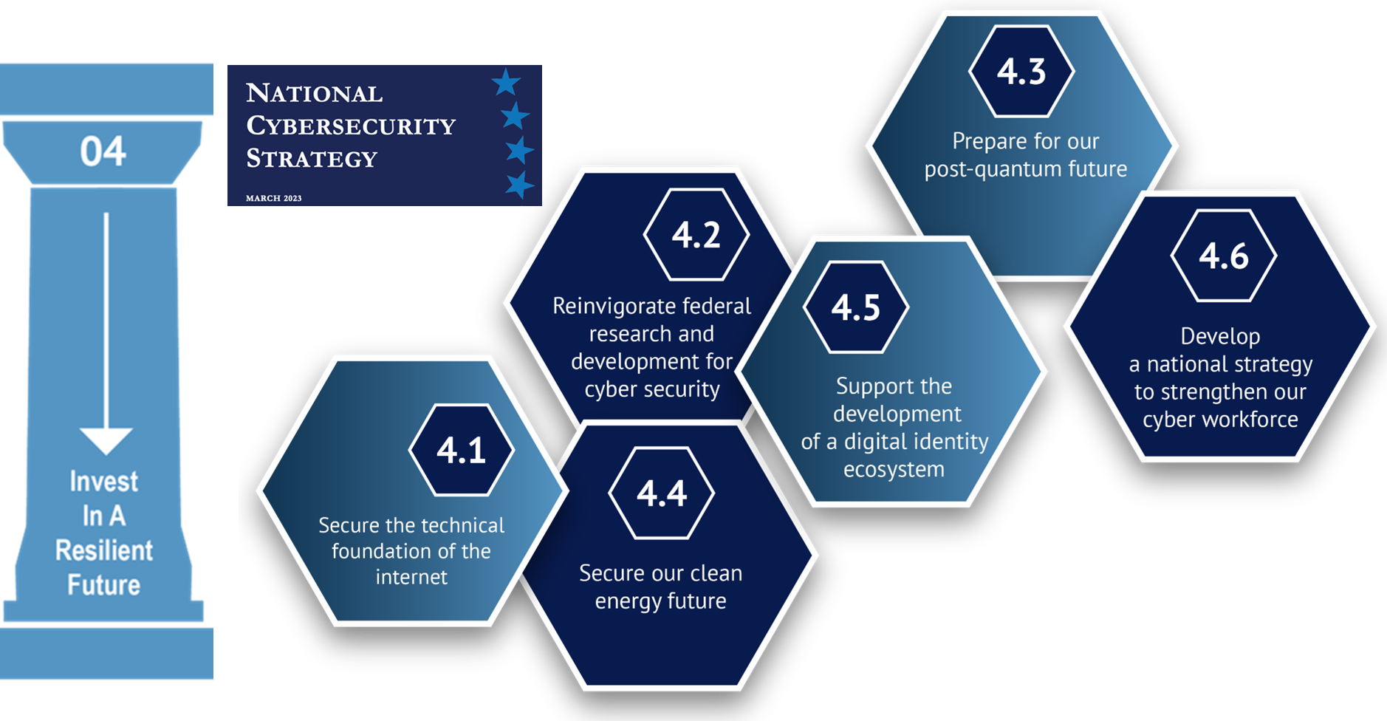

Slide 14
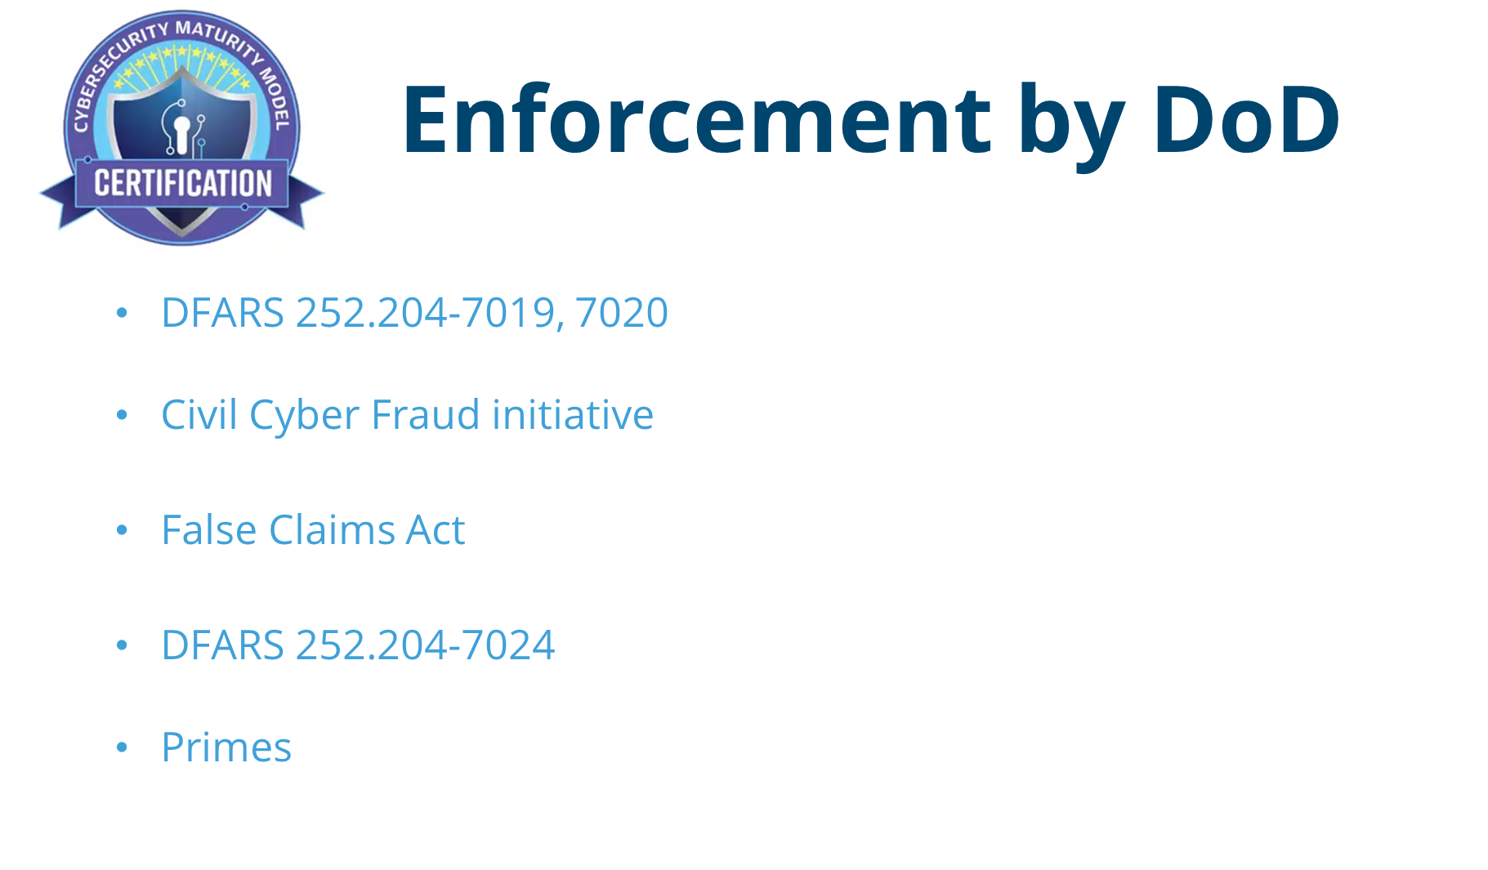

Slide 20
Two Questions
If NIST 800-171 has been a requirement for >5 years and the DFARS for >11 years, why are we here?
What makes CMMC a challenge?

Slide 21
If NIST 800-171 has been a requirement for >5 years and the DFARS for >11 years, why are we here?
Lack of enforcement
Many that tried, got it wrong
Disincentive

Slide 22
What makes CMMC a challenge?
Understanding CUI
Scope
Understanding NIST 800-171 requirements
Satisfying NIST 800-171 requirements
Technology
Policy and Procedure
Environment
People
Operating according to the Policy and Procedure established
Having the required talent
Skill sets
Capacity
Being ready for an assessment
The requirements are exacting The assessment process rigorous
It’s hard
It can be expensive
It can be risky and time consuming

Slide 23
Let’s start with understanding CUI
Controlled Unclassified Information (CUI) is information the Government creates or possesses, or that an entity creates or possesses for or on behalf of the Government, that a law, regulation, or Government-wide policy requires or permits an agency to handle using safeguarding or dissemination controls. 32 CFR § 2002.4 (h)
Your responsibility:
Understand, Identify, & Handle CUI
Understand the CUI Security Requirements
Implement Correctly
Operate as intended
Produce the desired outcome
It’s supposed to be (accurately) marked, but seldom is
Received or Created by or on behalf of the DoD and which falls within 1 of the 125 NARA registry CUI categories or 1 of the 4 DoD CUI categories

Slide 24
Why is CUI hard to identify
Vague contract details Even talking to experts about whether a particular data type is CUI or not, the answer is often “probably” or “it depends.”
Pushing risk down the food chain Historically, contract clauses that direct the implementation of CUI protections have too often been “thrown into contracts” as a “CYA” effort.
“Better safe than sorry” With so much uncertainty across the board about CUI, a Prime’s response, “if you’re not sure, treat it as CUI.”
Marking is indiscriminate, lack of labeling is rampant Don’t believe everything you read

Slide 25
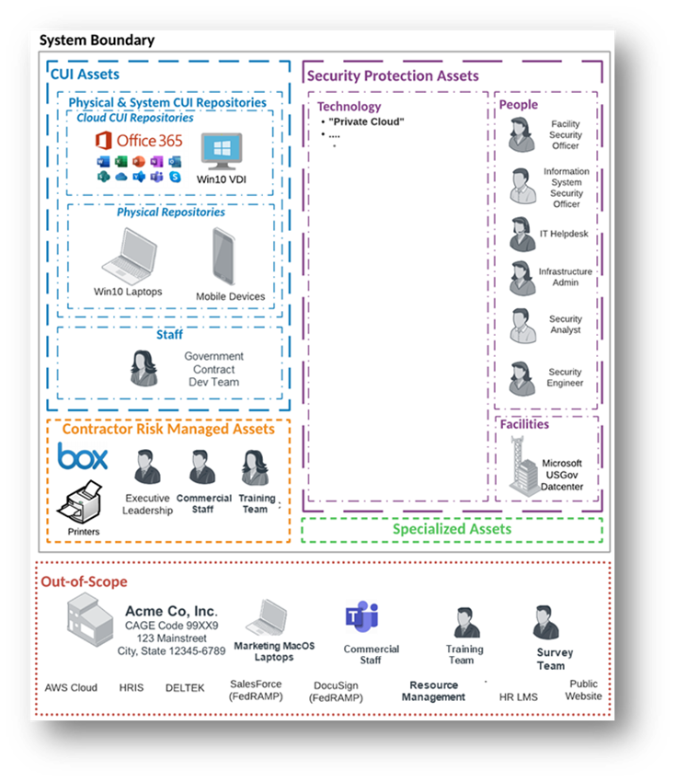
Let’s move on to scope
Business processes drive where CUI exists
Technology enables business processes
But technology may not always be the answer
In addition to IT, scope also includes:
People
Facilities
3rd Parties
Tooling / Capital Equipment / OT / IoT
Without segmentation the enterprise environment is in scope

Slide 26
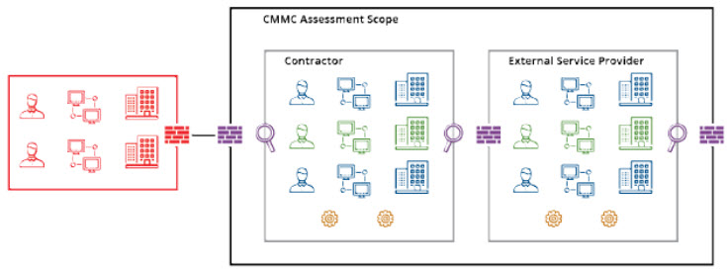
Defining what is in scope
CMMC scope is defined by:
CUI Assets: IT, people, facilities that store, process, or transit CUI
Security Protection Assets: People, Technology, Facilities that provide security functions
Risk Managed Assets: Assets capable of but which do not handle CUI
Specialized Assets: GFE, OT, IoT that may or may not handle CUI
Cloud Services are in scope if they store, process, or transmit CUI
They must meet the requirements of the FedRAMP Moderate Baseline
They relieve the contractor of some, but not all responsibilities
Shared responsibilities and Customer Responsibilities can be challenging

Slide 27
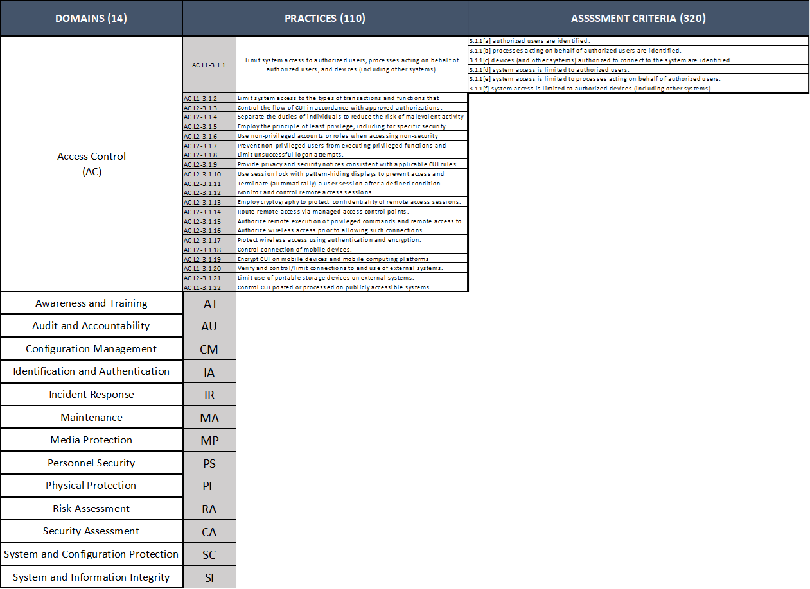
Understanding NIST 800-171r2?
800-171r2 Structure
Domains = 14
Practices = 110
Criteria = 320
Written by Regulatory and Compliance Experts for Regulatory and Compliance Experts
Plus: 62 NFO (Non-Federal Organization Controls)

Slide 28
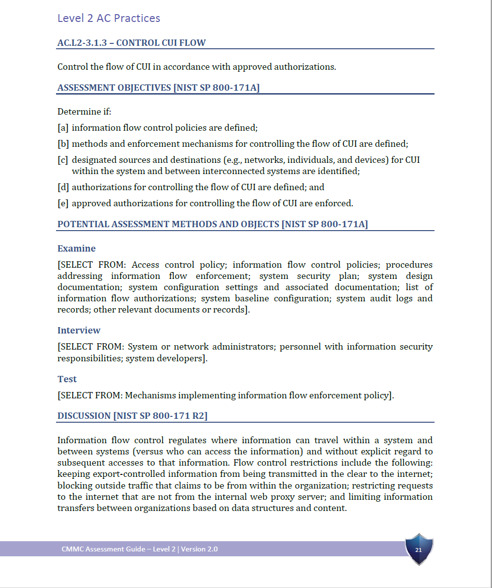
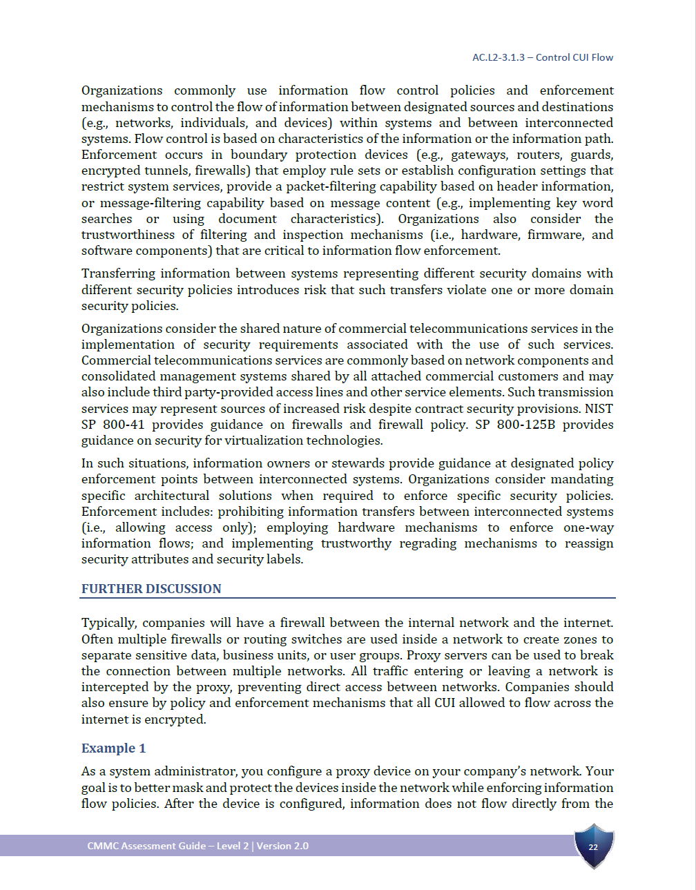
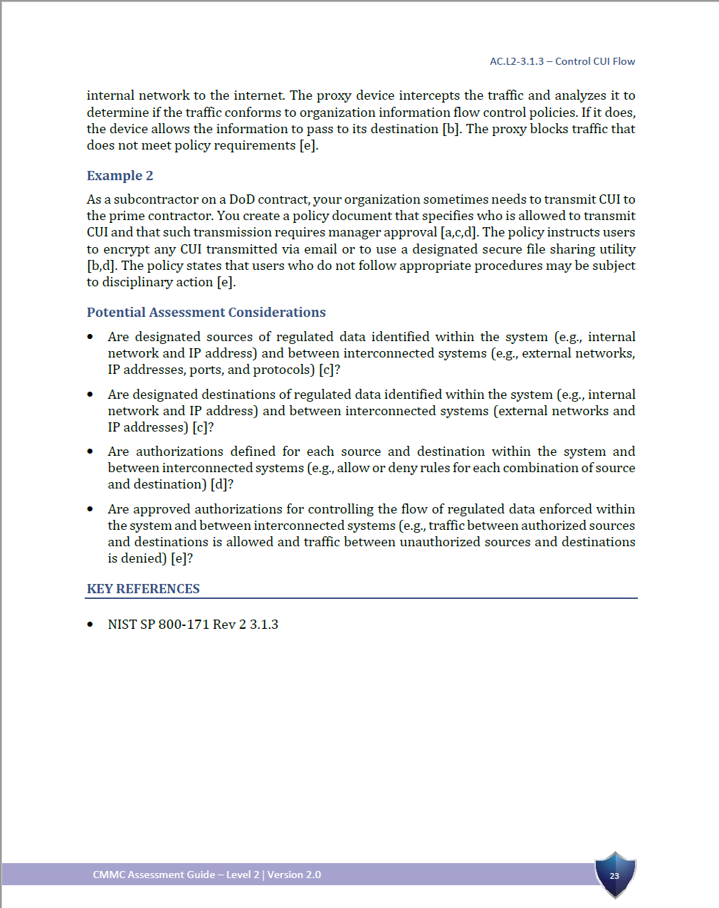
Understanding: AC.L2-3.1.3

Slide 29
Satisfying 800-171 Requirements
Technically sufficient, properly configured and maintained IT environment
Security and Access Control tools, properly configured and maintained
Physical security to limit access
Institutionalized Policies and Procedures
Change and Risk Management
System Maintenance and Patching
Media Protection
Acceptable Use
On-Boarding and Off-Boarding
Network and Endpoint Monitoring
Incident Response
And you need people capable of developing, implementing, maintaining, and operating all the above

Slide 30
Who are the People capable of developing, implementing, maintaining, and operating a compliant environment
Compliance Experts
System Architects
IT Technicians
IT Support (Desk Desk)
Information Security Experts
Incident Responders
(Human Resources)
Capacity and Availability
To cover PTO, terminations, periods of high demand
The fire department: available when they need someone to be available
How many of these people do you have today?

Slide 31
IT/Security Skillsets for CMMC Implementation*
What are the required skills for implementing and maintaining a compliant IT infrastructure?
NIST’s NICE Framework (SP 800-181), defines roles based on knowledge, skills, and abilities (KSAs)
Role | Training | Salary | Notes
Systems Requirements Planner (Securely Provision) | Minimum 2 years of apprenticeship/hands-on training; systems requirements documentation, computer and system engineering | $88,000–130,000 | KSAs may only be required annually, per RMF minimums
System Administrator (Operate and Maintain) | Systems administration, security fundamentals | $60,000-87,000 | KSAs may only be required a few days per week
IT Project Manager (Oversee and Govern) | Workplace-provided training, online training, workshops, boot camps for IT project management, leadership, public speaking, network security vulnerability | $85,000-95,000 | KSAs will be time-intensive during projects, less so during continuous upkeep and lifecycle management
Cyber Defense Incident Responder (Protect and Defend) | Network security vulnerability, advanced network analysis, basic cyber analysis/operations, network traffic analysis, cyber operator, computer forensics invest and response, information security, information systems, network security, information assurance, troubleshooting, security operations, cryptography | $90,000-137,000 | Availability of this role’s KSAs must be maintained, however cannot be planned for without historical data regarding incident likelihood
The estimated annual salary costs for 4 qualified FTEs to implement and manage a DFARS 7012 compliant IT infrastructure is between $323,000 and $449,000.
*Source: NDIA

Slide 32
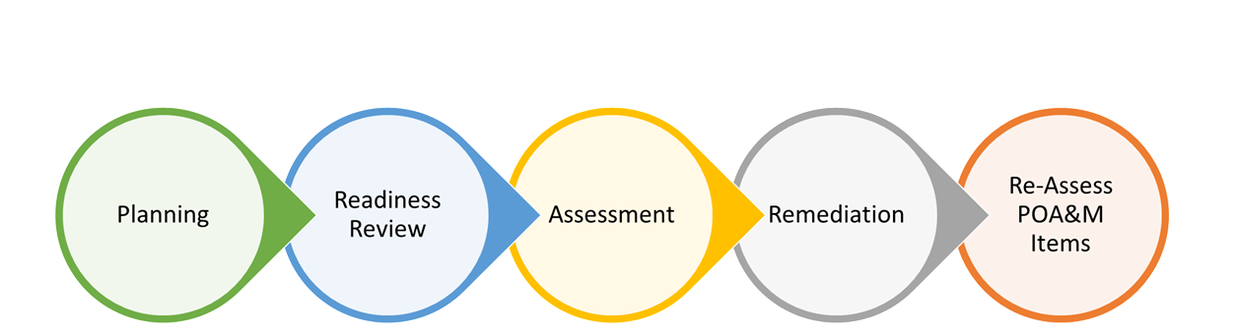
Being Prepared for the Assessment
If you satisfy all requirements, you can still fail the assessment
CMMC assessments are rigorous
All 320 criteria are assessed
Assessment methods: 2 of 3 for each requirement
Interview – Hold discussions with individuals or groups
Examine – Review, inspect, observe, study, or analyze assessment objects
Test – Exercising assessment objects to compare actual vs expected behavior
What you’ve said you’re doing is compliant, you’re doing it, and its working
Primary reasons OSCs fail
CUI improperly identified; CUI boundary improperly defined
Documentation inadequate or insufficient
You must be prepared to tell your story the way a C3PAO expects to hear it

Slide 33
Strategies to Achieve Compliance
Manage Scope
Understand Cost
Share Responsibility
D-I-Y or Outsource

Slide 34
Strategy 1 Manage Scope

Slide 35
Managing Scope
Business processes drive where CUI exists
Technology enables business processes
But technology may not always be the answer
In addition to IT, scope also includes:
People
Facilities
3rd Parties
Tooling / Capital Equipment / OT / IoT
Without segmentation the enterprise environment is in scope

Slide 36
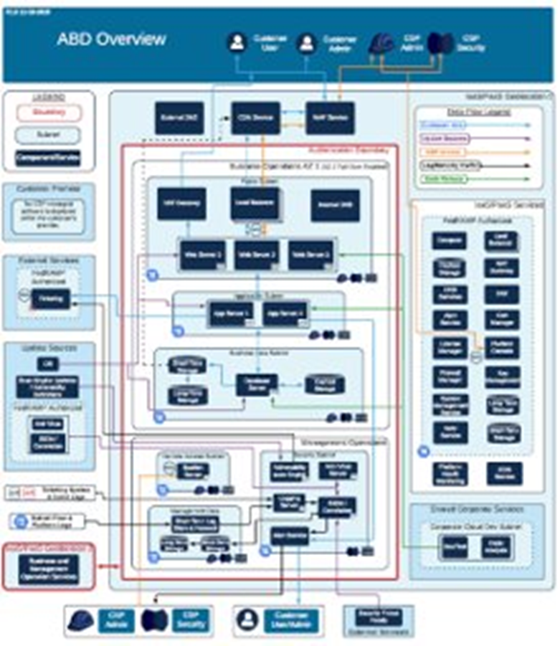
Scope and Boundary
Inventory all existing contracts
Follow the data - Map Data Flows
Inventory Assets
CUI Assets
Contractor Risk Managed Assets
Security Protection Assets
Specialized Assets
External connections
Cloud Service Providers
Managed Service Providers (MSP)
Managed Security Service Providers (MSSP)
Customer and Supplier Systems
Consider isolation or segmentation

Slide 37
Segmentation of Networks and Systems
By separating assets, the CMMC Assessment Scope can be limited
Network segmentation
An architectural approach that divides a network into multiple segments or subnets, each acting as its own small network
Achieved by:
Isolation
Controlled Access
Without adequate segmentation, the entire enterprise environment will be “in scope”

Slide 38
Isolation of Systems and Data: Enclaving
Isolated virtual work environment built and maintained to Federal cybersecurity standards
Powerful scope and cost control technique
Consider whether federal data can be sequestered:
Separate users or;
Separate systems
Pros:
Existing corporate systems out of scope
Reduced exposure to threats
Easy for users to understand
Quick to implement
Cons:
Must segregate users and/or data
Duplicate productivity environments
More difficult to communicate across platforms
Potential for data leakage

Slide 39
Strategy 2 Understand Costs

Slide 40
Looking at Cost
Achieve | Design and implement an IT environment that satisfies all technical controls aligned with your organization’s business requirements Develop and institutionalize required policies and procedures Create documentation, System Security Plan, training materials, artifacts
Manage | IT operations Help Desk/On-demand support/Problem Resolution Continuous monitoring Patching, Back-ups, Maintenance Security Incident response management Vulnerability identification and mitigation Network and Endpoint Compliance
Maintain | Compliance isn’t an end state; it’s a continuous process Regulatory changes New IT requirements, business growth, restructuring/M&A New Security Requirements
One-time costs get you compliant;
Monthly costs keep you compliant

Slide 41
Other Factors Affecting Cost
Technical Debt
Virtually impossible to band-aid security onto legacy systems
Common practices often entrenched
Migration to a compliant environment can be confused with compliance costs
Cybersecurity is a good reason to pay off tech debt
Older, weaker systems are targeted by attackers
Isolate legacy data on archive systems (reduce attack surface)
Wise spending
Insist on service providers that will contractually commit to compliance
Use trusted advisors to build confidence ahead of an assessment
Assessors cannot give advice. Failing an audit is the most expensive way to learn
Ensure you understand ongoing support/operational costs for all solutions
Ongoing operations is often the dominant financial factor

Slide 42
Costs – Getting Compliant / Staying Compliant*
Non-technical implementation
1 year to prepare is a reasonable estimate
ROM: ½ internal FTE = $30K - $52K minimum
Developing/Organizing 250-300 pages of documentation
Technical implementation
$150K - $250K if in-sourcing
Sustainment
A similar expense to maintain required programs
~$3,500 - $4,000 / user / per year operational expense
$87,500 - $100,000 for 5 person to 25-person company
IT spend related to compliance, not all IT spend
Economies of scale: ~100+ employees
One-time costs get you compliant;
Monthly costs keep you compliant
*NDIA Estimates

Slide 43
Cost: Key Takeaways
Operational cost is a dominant factor
Solution selection can greatly affect total cost
Tech debt cost and cybersecurity compliance cost can be hard to distinguish

Slide 44
Strategy 3 Share Responsibility

Slide 45
Shared Responsibility Model
Third-Party MSPs and MSSPs can act as an extension of your staff
Certain controls can be inherited or partially inherited
ESPs are “In-Scope”
Compliance responsibility may not be transferred to a third party.
Cloud Services (CSPs) can satisfy certain controls for themselves only
Certain controls can be inherited or partially inherited
Must meet requirements of FedRAMP Moderate baseline
Client responsibilities for the remaining practices include:
Approval decisions (35 practices)
Physical security of on-premises equipment, media, and paper documents (6 practices)
Personnel screening (2 practices)
Monitoring controls provided by client (1 practice)

Slide 46
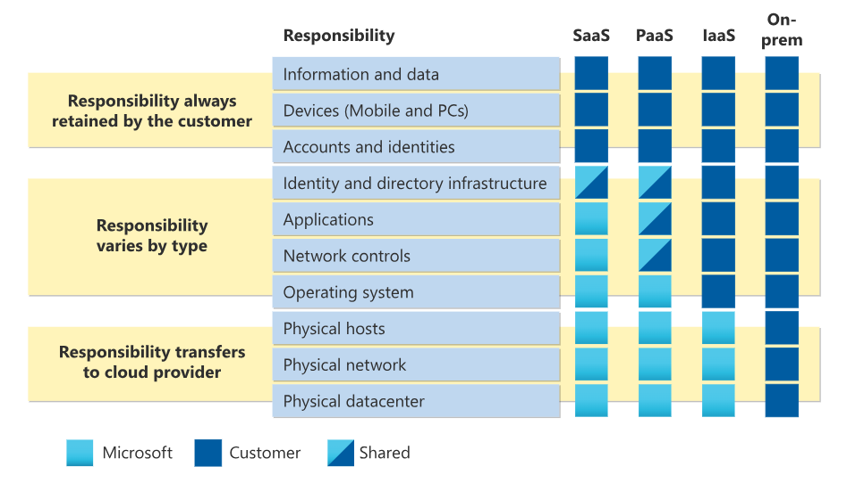
Typical Responsibilities for Cloud Services

Slide 47
Shared Responsibility - Conclusions
Shared responsibility is a means of reducing scope and obligations
Lower Cost
Lower Risk Faster
Faster Implementation
Ensure there is a Shared Responsibility Matrix (SRM)
Verify ESP claims
FedRAMP Moderate Equivalency Body of Evidence
MSP/MSSP Experience and Certifications

Slide 48
Strategy 4 D-I-Y or Outsource

Slide 49
D-I-Y or Outsource
To become and stay compliant you need to:
Architect and implement your IT, network, and Security Tools
Establish and institutionalize policies and procedures
Operate your IT in accordance with established policy and procedures
Manage your security program and incident response in accordance with established policy and procedures
Perform other business functions in accordance with established policy and procedures

Slide 50
D-I-Y or Outsource Considerations

Slide 51
Strategy Conclusions
Consider migrating to a modern, purpose-built IT architecture
Consider enclaving
Segregate people and/or data to limit compliance scope
Start small and grow as needed
Leverage cloud services that can easily demonstrate compliance
Select managed services that contractually promise ongoing compliance
Implement a standardized solution with minimal customization
Integrate IT, security, and compliance operational functions

Slide 52
Summary
Minimum cybersecurity requirements will cascade across all industries
Those requirements will become increasingly more
Lack of compliance will have consequences
Understand the true cost of compliance
Consider segregating and isolating sensitive information
Build with security in mind
Consider CSPs and Outsourcing where it makes sense

Slide 53
Stuart Itkin
Stuart.Itkin@NeoSystemsCorp.Com
www.NeoSystemsCorp.com

Slide 54
Ben Tchoubineh
ben@phoenixts.com
www.PhoenixTS.com

