Slide 2
LIFECYCLE OF AN ACQUISITION
Identify and contact potential target
Execute NDA
Assemble deal team and professionals
Develop purchase price
Execute letter of intent
Negotiate definitive agreement/conduct due diligence
Complete financing (if applicable)
Execute definitive agreement
Obtain SBA approval/third party consent
Close on acquisition
Integration

Slide 3
BENEFITS OF M&A
Buy Side
Sell Side
Backlog
Future value
Past performance
Access to contract vehicles
Cash out
Expiration of 8(a) life span
Additional capital to grow
Earn out

Slide 4
IDENTIFY POTENTIAL TARGET
Buy Side
Sell Side
Current business partners, subcontractors, prime contractors
Brokers/consultants
Cold calls (market research re: entities with contracts/work that you want to acquire)
8(a) conventions
Current business partners, subcontractors, prime contractors
Brokers/consultants
8(a) conventions

Slide 5
NONDISCLOSURE AGREEMENT
In connection with a potential purchase of __________________ by ___________________ (the "Purpose"), either party ("Disclosing Party") may disclose Confidential Information (as defined below) to the other party ("Recipient"). Recipient shall use the Confidential Information solely for the Purpose and, subject to Section 2, shall not disclose such Confidential Information other than to its designated employees, officers, directors, attorneys, accountants and financial advisors (collectively, "Representatives") who:
need access to such Confidential Information for the Purpose;
are informed of its confidential nature; and
are bound by confidentiality obligations no less protective of the Confidential Information than the terms contained herein. Recipient shall safeguard the Confidential Information from unauthorized use, access or disclosure using no less than a commercially reasonable degree of care. Without limiting the foregoing, Recipient shall take at least those measures that it takes to protect its own most highly confidential information.
Recipient will be responsible for any breach of this Agreement caused by its Representatives.
Permits target to provide financial information for Buyer to evaluate transaction/interest and begin pricing negotiations
Considerations:
  Identify purpose
  Length of NDA if deal does not close
  Non-solicitation of employees
  No warranty regarding information

Slide 6
DEVELOP SALE PRICE
Multiple of Revenue, Sales or EBITDA
  Historical or Projected
  Don’t price in value you are bringing (i.e., 8(a) status)
  Account for one-time events/spikes
  Average over X number of years
Asset Value
  Appraisal of assets
  Not applicable for most service oriented-entities
Backlog
  Buying revenue, but need to verify profitability
  IDIQ/MAC contracts can inflate backlog unless certain/confident to receive task orders
Book Value
  Likely not realistic gauge of true value
NOTE: Working Capital Adjustments will impact final purchase price
EBITDA: Earnings Before Interest, Taxes, Depreciation and Amortization
  Measure of profitability
  Focused on core financial performance versus non-core expenses
Backlog: Total amount of funding allotted to government contracts
  May or may not account for expenses related to performance
Book Value: Net asset value of a company, calculated as its total assets minus intangible assets (patents, goodwill) and liabilities.
  Book value is often lower than a company’s market value

Slide 7
STRUCTURING SALE PRICE
Cash at Closing and/or Earn-Out
Payment at closing will generally be a specific amount plus excess working capital
Earn-out is paid after closing over a period of years based on agreed upon metrics
Earn-Out
Based on specific metrics (revenue, gross profit, EBITDA, etc.)
For a specific period of time (X number of years)
Intent of earn-out is to allocate some risk of performance of Target post-closing to Seller
Can be a flat amount or a percentage of revenue, net income, or some other metric

Slide 8
STRUCTURING SALE PRICE
Flat Fee Earn-Out:
  Buyer shall pay to Seller with respect to each Calculation Period within the Earn-out Period an amount, if any (each, an “Earn-out Payment”), equal to $XXXXXXX, except that if the Company’s EBITDA is less than the Projected EBITDA for that Calculation Period, the Earn-Out Payment shall be reduced by the amount by which the Company’s EBITDA is less than the Projected EBITDA for that Calculation Period. The Earn-out Payment cannot be reduced to below zero ($0).
Percentage Earn-Out:
  An earn-out equal to 4.75% of the ‎Company’s gross profit, defined as total revenue minus direct costs. Direct costs will ‎include the fringe rates included in the projections provided to Buyer. The earn out will to ‎be paid in annual installments based on the Company’s annual revenue gross profits each ‎year over five (5) years after Closing. ‎

Slide 9
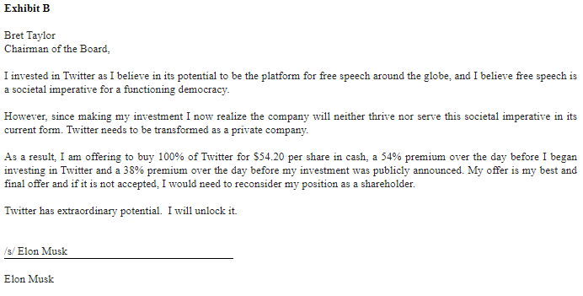
LETTER OF INTENT
Non-binding and binding provisions
  Non-binding regarding transaction
  Potentially binding regarding exclusivity of negotiations
Provides the general outline of the deal so the parties are on the same page prior to going though the expense of negotiating the definitive agreement and due diligence

Slide 10
TOPICS TO ADDRESS IN THE LETTER OF INTENT
Stock versus asset purchase (or option to convert from one to the other)
Purchase price, including any earn-out (subject to adjustment in due diligence)
Specific mandatory terms one party will insist on
  Specific indemnities, employment contracts, etc.
Financing contingencies
Due diligence length and access
  Can you talk to employees of Target? If so, which ones?
Exclusivity period
Deadline for negotiation and execution of Definitive Agreement
Projected Closing date

Slide 11
LETTER OF INTENT
Exclusivity period
Period in which Seller cannot market their company to others; typically period between execution of letter of intent and execution of definitive agreement
Seller will be required to operate their business in the normal course during that exclusivity period

Slide 12
LETTER OF INTENT: SBA ISSUES
A binding Letter of Intent results in immediate affiliation, even though the transaction has not yet closed
Agreements to negotiate will not result in affiliation because they are not binding or have “present effect”
Some risk with “exclusivity” terms in non-binding LOIs given the SBA’s “present effect” rule and the negotiating imbalance given to the Buyer in this position
13 CFR 121.103(d)(2): “In determining size, SBA considers stock options, convertible securities, and agreements to merge (including agreements in principle) to have a present effect on the power to control a concern. SBA treats such options, convertible securities, and agreements as though the rights granted have been exercised.”
13 CFR 121.103(d)(2): “Agreements to open or continue negotiations towards the possibility of a merger or a sale of stock at some later date are not considered “agreements in principle” and are thus not given present effect.”

Slide 13
DEFINITIVE AGREEMENT
Definitive Agreement is the binding contract to acquire the Target
Contains all of the terms of the parties’ agreement
All terms are negotiable
Buyer should want to provide first draft of Definitive Agreement
Potential new entity formation (NewCo to acquire assets or stock)

Slide 14
STOCK PURCHASE V. ASSET PURCHASE
Fundamental deal structure term
Impacts:
  Buyer’s potential liability for Target’s liabilities
  Tax impact on Seller and tax basis for Buyer
  Need for third party consents
  Regulatory issues

Slide 15
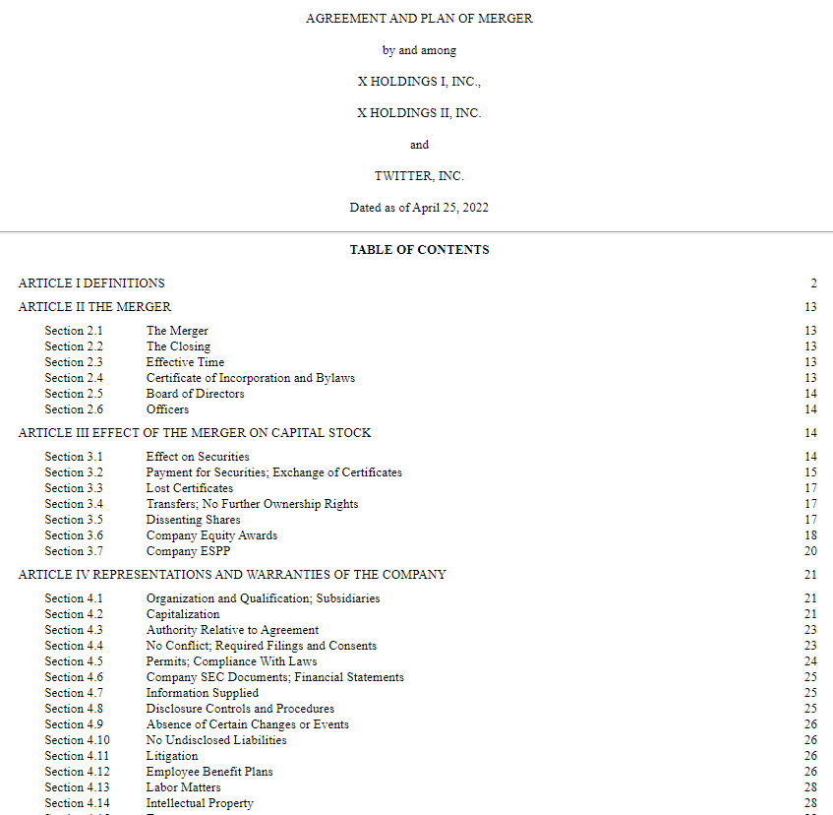
STOCK PURCHASE
Acquiring the stock/membership interests of the Target
Reduces need for assignments/transfers
  Bank accounts, leases, etc., generally don’t need to be changed because assets are staying with same legal entity
Increased risk to Buyer because liabilities of Target remain with Target
  Buyer’s protection from pre-closing liabilities of Target limited to indemnity obligations from Seller
No consent of contracting officers/novation of government contracts required for stock purchase

Slide 16
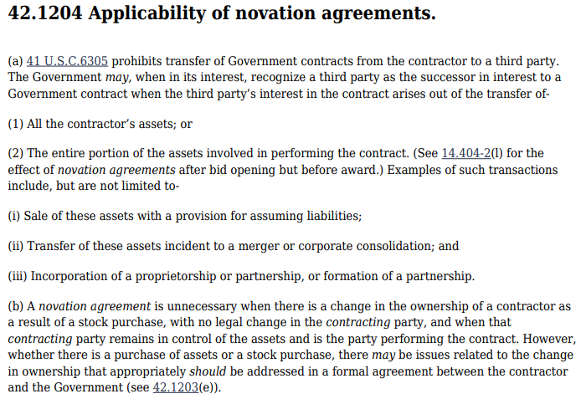
ASSET PURCHASE
Acquiring assets of the target
Assets have to be transferred to Buyer at Closing
  Leases, contracts, vehicles all need to be assigned to Buyer
Reduced risk to Buyer because Buyer only assumes specific liabilities of Target included in the Definitive Agreement
  Potential successor liability risk
Consent of contracting officers and novation of government contracts is required for asset purchase

Slide 17
ASSET PURCHASE -42.1204 Applicability of novation agreements
(e) When a contractor asks the Government to recognize a successor in interest, the contractor shall submit to the responsible contracting officer three signed copies of the proposed novation agreement and one copy each, as applicable, of the following:
  (1) The of all affected contracts between the transferor and the Government, as of the date of sale or transfer of assets, showing for each, as of that date, the document describing the proposed transaction, e.g., purchase/sale agreement or memorandum of understanding.
  (2) A list -
    (i) Contract number and type;
    (ii) Name and address of the contracting office;
    (iii) Total dollar value, as amended; and
    (iv) Approximate remaining unpaid balance.
  (3) Evidence of the transferee’s capability to perform.
  (4) Any other relevant information requested by the responsible contracting officer.
Documents to Provide to Contracting Officer:
  (1) An authenticated copy of the instrument effecting the transfer of assets; e.g., bill of sale, certificate of merger, contract, deed, agreement, or court decree.
  (2) A certified copy of each resolution of the corporate parties’ boards of directors authorizing the transfer of assets.
  (3) A certified copy of the minutes of each corporate party’s stockholder meeting necessary to approve the transfer of assets.
  (4) An authenticated copy of the transferee’s certificate and articles of incorporation, if a corporation was formed for the purpose of receiving the assets involved in performing the Government contracts.
  (5) The opinion of legal counsel for the transferor and transferee stating that the transfer was properly effected under applicable law and the effective date of transfer.
  (6) Balance sheets of the transferor and transferee as of the dates immediately before and after the transfer of assets, audited by independent accountants.
  (7) Evidence that any security clearance requirements have been met.
  (8) The consent of sureties on all contracts listed under paragraph (e)(2) of this section if bonds are required, or a statement from the transferor that none are required.

Slide 18
TAX IMPACTS OF STOCK VERSUS ASSET PURCHASE—
ASSET PURCHASE
Asset sales allow Buyers to “step-up” the Target’s basis in its assets. By allocating a higher value for assets that depreciate quickly and by allocating lower values on assets that amortize slowly, Buyer can gain additional tax benefits. This reduces taxes sooner and improves the Target’s cash flow during the first years.
Asset sales generate higher taxes for Sellers because while intangible assets, such as goodwill, are taxed at capital gains rates, “hard” assets can be subject to higher ordinary income tax rates. If the entity sold is a C-corporation, the Seller faces double taxation. The corporation is first taxed on selling the assets to the Buyer. The corporation’s owners are then taxed again when the proceeds transfer outside the corporation.

Slide 19
TAX IMPACTS OF STOCK VERSUS ASSET PURCHASE—
STOCK PURCHASE
Buyers lose the ability to gain a stepped-up basis in the assets and do not get to re-depreciate certain assets. The basis of the assets at the time of sale, or book value, sets the depreciation basis for the new owner. The lower depreciation expense can result in higher future taxes for the Buyer through limiting their ability to depreciate the assets of the Target.
Seller’s proceeds are generally taxed at a lower capital gains rate, and in C-corporations, the corporate level taxes are bypassed.

Slide 20
ALLOCATION OF PURCHASE PRICE
Allocation of purchase price to assets or asset classes
Applies to stock and asset sales
What is good for buyer may be bad for seller and vice versa
IRS Form 8594 breaks down the assets of the business being purchased or sold into seven classes
  Each type of asset is treated differently for tax purposes

Slide 21
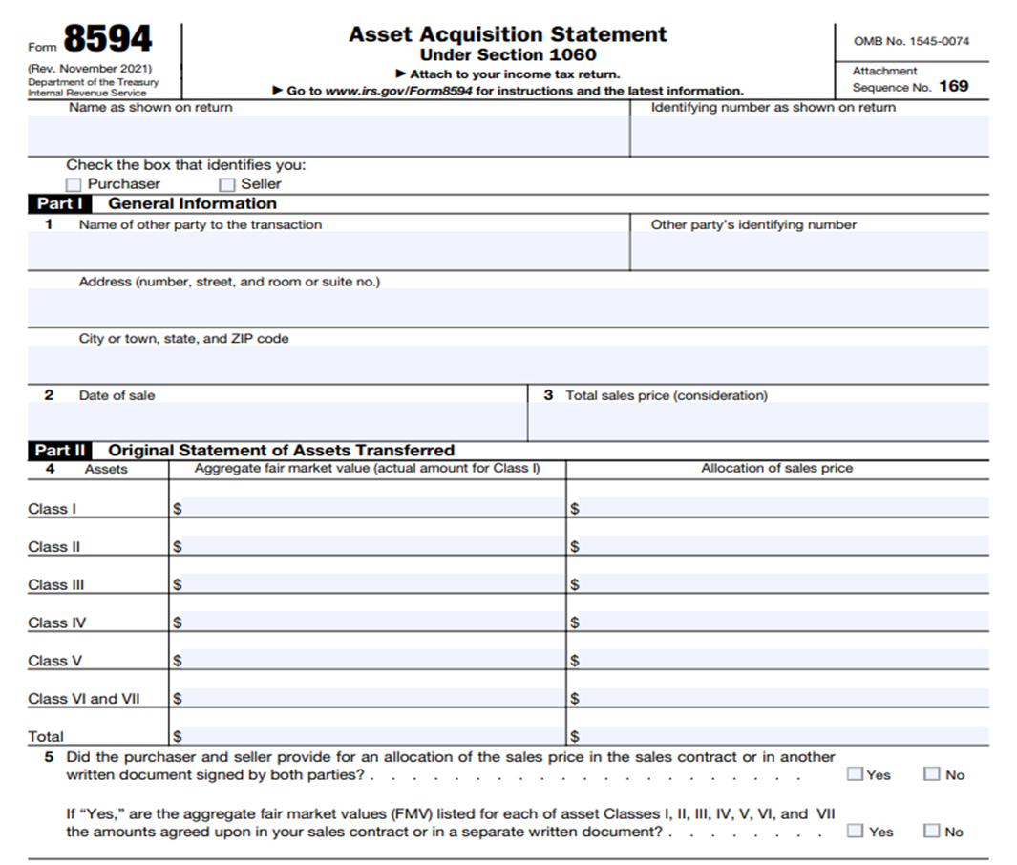
PURCHASE PRICE ALLOCATION
Stock Sale
Asset Sale
Majority of price allocation to stock
Remainder to value of non-competition agreements and consulting agreements
Purchase price allocated to specific assets/asset classes
  Class I: Cash and Bank Deposits
  Class II: Securities, including Actively Traded Personal Property & Certificates of Deposit
  Class III: Accounts Receivables
  Class IV: Stock in Trade (Inventory)
  Class V: Other Tangible Property including Furniture, Fixtures, Vehicles, etc.
  Class VI: Intangibles (Including Covenant Not to Compete)
  Class VII: Goodwill of a Going Concern

Slide 22
EARN-OUT
Buyer
Seller
Benefits
  Reduced up-front payment
  Incentivizes owner in continued success of target
  Reduced risk of owner departing post-sale
Risks
  Claims that new owner is manipulating economics to reduce earn-out
  Focused on earn-out metrics versus overall health of company
  Potential short-term focus based on when earn-out expires
Benefits
  Payments over time versus one time payment
  Potential to increase payment based on performance
  Financial benefit to leveraging new resources
Risks
  Additional costs/overhead may be pushed down, reducing overhead
  Success is subject to oversight of new owners
  New owner may prioritize other subsidiaries, reducing opportunity to succeed

Slide 23
EARN-OUT CRITICAL TERMS
Basis for calculation
Length of time earn-out is in effect
Impact of termination of employment on right to receive earn-out
  For cause or without cause/resignation
Which entities are covered/included in the earn-out calculations
  Target
  Target plus sister subsidiaries
  Family of companies

Slide 24
EARN-OUT BASIS FOR CALCULATION
Basis for calculation—Net Income/EBITDA/Operating Profit/Gross Revenue
  Net Income: harder to calculate, multiple inputs, factors out of Seller’s control (taxes and depreciation)
  EBITDA: easier to calculate, largely captures what is under Seller’s control, does not reflect bottom line cash flow to new owner, may encourage higher debt load by Seller
  Operating Profit: includes only factors in control of Seller, does not accurately capture all costs of the business, disincentives control of overhead and G&A by seller
  Gross Revenue: incentivizes growth, entirely under control of Seller, incentivizes growth without regard to margin

Slide 25
EARN-OUT
Payment to Seller(s) based on financial performance after closing
Different metrics
  Gross Revenue
  Operating Profit
  EBITDA
  Net Income
Different time frames
  1 to 5 years
Different organizations
  Target only
  Family of companies
  Target + sister company (i.e., new 8(a) established for Seller to operate)

Slide 26
EARN-OUT
“The Seller Members shall have the right to receive as additional Purchase Price cash proceeds based upon Adjusted Earnings in all or a portion of the calendar years 2014, 2015, 2016, 2017, 2018 and 2019 in accordance with Exhibit C....”
“Adjusted Earnings means, with respect to the Company, the sum (without duplication) of the following, determined in accordance with the Company Accounting Protocols: pre-tax earnings of the Company, net of any annual bonus based on earnings of the Company paid to XXXXX or XXXXX, excluding any pre-tax earnings related to any business or entity acquired by the Company during the Earn-Out Period and treating any intracompany transactions between the Company or its Affiliates and an acquired business or entity as though such transactions had occurred between unrelated parties on arms-length terms….”

Slide 27
EARN-OUT CONSIDERATIONS
Seller acknowledges and agrees:
  Buyer shall have the right to own, operate, use, license, develop and otherwise Commercialize the assets of the Company in any way that Buyer deems appropriate in its sole discretion,
  Buyer does not have any obligation, expressed or implied, to own, operate, use, license, develop or otherwise Commercialize the assets of the Company in order to maximize or expedite the earn-out payments, including any obligation to pursue particular business opportunities, engage in particular advertising or marketing campaigns or otherwise,
  Buyer shall owe no duty, as a fiduciary or otherwise, to Seller in connection with its operation of the Company or its assets following the Closing,
  the parties hereto intend the express provisions of Schedule 2.7 to govern their contractual relationship and to supersede any standard of efforts or implied covenant of good faith and fair dealing that might otherwise be imposed by any court or other Governmental Entity or otherwise;
  provided, that notwithstanding the foregoing, Buyer shall not take any actions, the primary purpose of which is to deprive the Seller, or reduce the amount, of any payment of Post-Closing Contingent Consideration.
Buyer wants freedom to operate with need to maximize Seller’s earn-out
Seller wants to insure Buyer does not intentionally take action to reduce earn-out artificially

Slide 28
CLOSING WORKING CAPITAL
Applies to both Asset and Stock Purchase structures
Working Capital = Accounts Receivable (AR) plus Cash minus Accounts Payable (AP)
  Working Capital stays with the Target and become Buyer’s benefit (AR and cash) and expense (AP)
Buyer wants to have some working capital in Target at closing to permit Target to continue to operate without having to immediately infuse cash/capital
Buyer and Seller agree upon target working capital to be in the Target at Closing
Seller generally receives a payment of excess working capital at Closing
Remainder of working capital paid after Closing after true-up to confirm actual amount of working capital in Target

Slide 29
CLOSING WORKING CAPITAL
Seller provides estimated amount of working capital in Target at closing
  Can be agreed upon amount or “not less than $x”
  May or may not include cash (Target may distribute all cash to Seller prior to closing)
At closing, Buyer pays amount by which working capital exceeds agreed-upon amount plus purchase price
True-up post closing, with remaining working capital paid 60 to 120 days after closing
  Can apply both ways – additional payment to Seller or repayment to Buyer

Slide 30
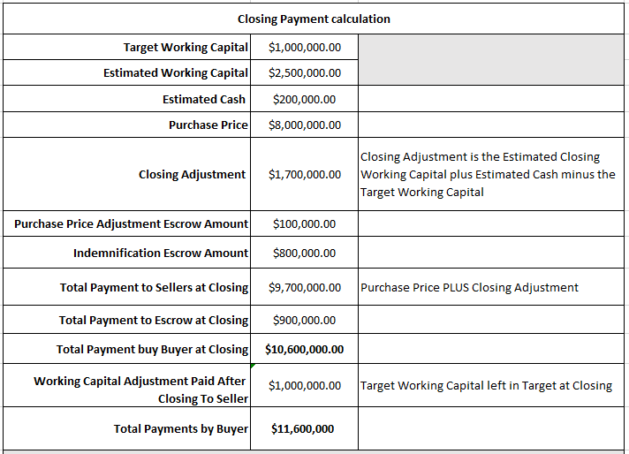
EXCESS WORKING CAPITAL AT CLOSING EXAMPLE
Working capital adjustment can significantly increase cash paid at Closing and the aggregate payment
Buyer needs to confirm that it has sufficient cash/financing for both purchase price and potential excess working capital

Slide 31
WORKING CAPITAL ISSUES
Issues
  Vague definition of “Working Capital” or lack of clarity as to how to calculate working capital
  No method for Seller to force Buyer to complete calculation and pay working capital or release escrow funds
  Lack of access by Seller to records to confirm Buyer’s post-closing calculation of working capital
Remedies
  Deadlines for resolution of working capital issues or automatic release of escrow funds to Seller
  Agreed upon arbiter of working capital disputes (independent CPA/accounting firm)
  Clear definitions and language in working capital clauses
Buyer and Seller may work together effectively during acquisition period—both are motivated
Buyer less motivated to deal with Seller post-closing
Seller will want protections to insure post-closing working capital adjustments are done timely and payments are made

Slide 32
REPRESENTATIONS AND WARRANTIES
Representations of Seller regarding status of Target at closing
Basis for indemnity/breach claims post-closing for events/discoveries that are inconsistent with representations and warranties
Disclosure schedules identify specific issues and qualify representations and warranties

Slide 33
REPRESENTATIONS AND WARRANTIES
Buyer
Seller
Ability to purchase
No legal action preventing purchase
Purchasing for investment purposes
Sufficiency of funds
Buyer is relying on own investigation and express warranties of Seller and no other promise or statement by Seller
Ability to sell
Existing claims/lawsuits or threats of claims/suits
Validity of contracts; lack of breach or claims of breach
Status of employees; compliance with wage & hour laws
Environmental compliance; no hazardous material spills
Compliance with law
Tax filings
Accuracy and completeness of financial statements
Ownership of Intellectual property
Consents required for transaction

Slide 34
MATERIALITY LIMITATION
Materiality qualification limits breaches of representations to “material” breaches
“Materiality” may be undefined
Negotiation point—can attempt to limit materiality qualification to only certain representations
Representations to which “materiality” qualification should not apply:
  Ownership of Target
  Ability to sell to Buyer
  Filed or threatened litigation
  Cure Notice/Show Cause letters
The books and records of XXX and its subsidiaries (i) have been kept in the ordinary course consistent with past practice, (ii) have been maintained in compliance in all material respects with U.S. GAAP and XXX’s applicable accounting requirements, (iii) are true and complete in all respects, except as would not be material to the Business, taken as a whole, and (iv) correctly and accurately reflect, in the aggregate based on the Business, taken as a whole, all material dealings and transactions in respect of the Business.

Slide 35
KNOWLEDGE LIMITATION
Limits scope of representation
Buyer Can only prove breach if it can show Seller “knew” that representation was not accurate
Sellers will push for “actual knowledge” limitation
Buyer does not want any qualification
Potential middle grounds:
  After reasonable inquiry
  Knowledge of specified individuals
  Knowledge of managerial personnel
  Knowledge of employees
“Seller’s Knowledge” limitation is appropriate when addressing intentions/actions of third parties
  “Neither the Company or, to ‎Seller’s knowledge, any other party thereto is in breach of or default under (or is alleged ‎to be in breach of or default under) any Contract in any material respect….”
“Seller’s ‎knowledge,” “knowledge of Seller,” and any similar phrases shall mean the actual knowledge of any director or officer of Seller and/or Company, after due inquiry.
"Company's Knowledge," "Knowledge of the Company" and words of similar effect means the actual knowledge of each of the individuals identified in Schedule K hereto, in each case after due and reasonable inquiry of their direct reports.

Slide 36
GOVERNMENT CONTRACTING SPECIFIC REPRESENTATION
Section XXXX of the Disclosure Schedules lists and identifies each ‎outstanding Government Bid, including whether the Government Bid is for a ‎Government Prime Contract or a Government Subcontract and the customer program ‎name.‎
All of the Company’s Government Contracts were legally awarded, and ‎are binding on the Company. Except as set forth in Section XXXX of the Disclosure ‎Schedules, to the Knowledge of the Company, no Government Contract or Government ‎Bid is currently the subject of any bid or award protest proceedings, and the Company ‎has not received any notice that such Government Contract or Government Bid will ‎become the subject of bid or award protest proceedings.‎
Since December 31, XXX, the Company has (i) complied in all material ‎respects with (1) all applicable statutory and regulatory requirements pertaining to each of ‎its Government Contracts and Government Bids, (2) all material terms and conditions, ‎including (but not limited to) all clauses, provisions, specifications, and quality assurance, ‎testing and inspection requirements of its Government Contracts, whether incorporated ‎expressly, by reference, or by operation of Law, and (3) all key personnel provisions in ‎Government Contracts; and (ii) has not made any unauthorized substitutions with respect ‎to key personnel.‎
All facts set forth in or acknowledged by any representations, ‎certifications or disclosure statements made or submitted by or on behalf of the Company ‎in connection with each of the Company’s Government Contracts and each of the ‎Company’s Government Bids were true and accurate as of the date of submission in all ‎material respects and were made by an authorized representative of the Company. The ‎Company has complied in all material respects with applicable representations, ‎certifications and disclosure requirements under the Company’s Government Contracts ‎and each of the Company’s Government Bids.‎
‎ The Company has not received any past performance evaluations or ‎ratings by any Governmental Authority that are adverse, negative, or less than a ‎‎“Satisfactory” rating, and, to the Company’s Knowledge, no facts exist that could result ‎in any adverse or negative past performance evaluation or rating by any Governmental ‎Authority regarding the Company’s Government Contracts, or that could affect the ‎evaluation of the Company’s Government Bids.‎
Buyer should want a representation from Seller that:
  All representations and certifications regarding size and compliance with SBA programs are accurate; and
  No affiliates other than disclosed affiliates

Slide 37
GOVERNMENT CONTRACTING SPECIFIC REPRESENTATION
Except as set forth in Section XXXX of the Disclosure Schedule, in the ‎past three (3) years, the Company has not undergone and it is not currently undergoing ‎any audit, review, inspection, investigation, survey or examination of its records relating ‎to any of the Company’s Government Contracts (other than in the ordinary course of ‎business consistent with past practice); and, to the Company’s Knowledge, there is no ‎basis for any such audit, review, inspection, investigation, survey or examination or ‎examination of records, other than in the ordinary course of business.‎
There are no outstanding claims or disputes relating to the Company’s ‎Government Contracts that have been asserted in writing by the Company or against the ‎Company by any Governmental Authority, any prime contractor, any higher-tier ‎subcontractor, any lower-tier subcontractor, or any third party; and, to the Company’s ‎Knowledge, no facts or allegations exist that would be reasonably likely to give rise to ‎such a claim or dispute.‎
Neither the Company nor, to the Company’s Knowledge, any of its ‎employees has been or is now under any administrative, civil or criminal investigation, ‎indictment, information, or proceeding involving alleged false statements, false claims or ‎other improprieties relating to the Company’s Government Contracts or Government ‎Bids; and, except as set forth in Section XXXX of the Disclosure Schedules, to the ‎Company’s Knowledge, no facts or allegations exist that would be reasonably likely to ‎rise to such an investigation or indictment. Except as set forth in Section XXXX of the ‎Disclosure Schedules, the Company has not conducted or initiated any internal ‎investigation, or made any mandatory or voluntary disclosures under Federal Acquisition ‎Regulation (“FAR”) 52.203-13 or analogous rules or regulations with respect to any ‎alleged misstatement or omission arising under or relating to any Government Contract or ‎Government Bid at any time and, to the Company’s Knowledge, no facts or allegations ‎exist that would be reasonably likely to rise to such an investigation or disclosure. In ‎addition, the Company has not conducted or initiated any internal investigation, or made ‎any mandatory or voluntary disclosures with respect to a violation of federal criminal ‎Law involving fraud, conflict of interest, bribery, or gratuity violations found in Title 18 ‎of the United States Code or a violation of the civil False Claims Act or of any significant ‎overpayment(s) on any Government Contracts, other than overpayments resulting from ‎contract financing payments as defined in FAR 32.001, and the Company has not ‎conducted, nor is it currently conducting, an investigation to determine whether credible ‎evidence exists of such a violation or overpayment.‎
Since December 31, XXX, the Company has not been issued a show cause, ‎cure, deficiency, default or similar written notice from any Governmental Authority or ‎any prime contractor or higher-tier subcontractor relating to the Company’s Government ‎Contracts, and, to the Company’s Knowledge, no facts or allegations exist that would be ‎reasonably likely to rise to such a notice.‎
Neither the Company nor any director, officer, employee, consultant or ‎Affiliate of the Company has within the last three (3) years been or is currently ‎suspended, debarred, or otherwise precluded from participating in programs funded by ‎any Governmental Authority or from the award of any Government Contract.
Buyer should want a representation from Seller that:
  All representations and certifications regarding size and compliance with SBA programs are accurate; and
  No affiliates other than disclosed affiliates

Slide 38
GOVERNMENT CONTRACTING SPECIFIC REPRESENTATION
Section XXXX of the Disclosure Schedules sets forth each Government ‎Contract awarded to the Company on or after December 31, XXX by a Governmental ‎Authority under which the Company certified or represented that it was a Small Business ‎Concern, a Small Disadvantaged Business, an 8(a) concern, a Serviced-Disabled Veteran ‎Owned Small Business Concern, a Veteran-Owned Small Business Concern, a ‎Historically Underutilized Business Zone Small Business Concern, a Woman-Owned ‎Small Business Concern, or any other preferential status (collectively, a “Preferred ‎Bidder Status”) pursuant to the Small Business Act and regulations promulgated ‎thereunder, as amended, or any other similar federal, state or local Law. At the time of ‎submission, each representation regarding size status was accurate, complete, and in ‎compliance in all material respects with all applicable Laws. The Company has never been ‎‎“affiliated” with any other entity as defined by FAR 19.101. Since December 31, XXXX, ‎the Company has been in compliance with all limitations on subcontracting, including ‎FAR 52.219-14. Except as set forth on Section 4.18(k) of the Disclosure Schedules, the ‎Company has not certified or represented in writing to any prime contractor or any ‎higher-tier subcontractor that the Company has a Preferred Bidder Status under the Small ‎Business Act and regulations promulgated thereunder, as amended, or any other similar ‎federal, state or local Law. The Company is not currently party to, and has never been ‎party to any mentor-protégé agreements
All representations, warranties, and certifications made by the Company ‎with respect to each Government Contract, including all invoices and claims arising in ‎connection with each Government Contract, were proper and accurate in all material ‎respects as of their effective dates, and the Company has complied in all material respects ‎with such representations, warranties, and certifications, including any representations, ‎warranties, or certifications by the Company regarding its SBA 8(a) status, small business ‎status, small disadvantaged business status, protégé status, HubZone certification or other ‎preferential status afforded by statute or regulation pursuant to the Small Business Act ‎and regulations promulgated thereunder, as amended, or any other similar federal, state or ‎local Law. In the past three (3) years, the Company has not defaulted under, or failed to ‎perform or comply with, any material financial, contractual or legal obligation to any ‎Governmental Authority respecting a Government Contract, including without limitation ‎under any program administered by the Small Business Administration.‎
Section XXXX of the Disclosure Schedules sets forth each Government ‎Prime Contract awarded by a Governmental Authority using other than full and open ‎competitive source selection.‎
To the Company’s Knowledge, no employee of the Company has had ‎access to non-public information or provided systems engineering, technical direction, ‎consultation, technical evaluation, source selection services, or prepared specifications or ‎statements of work, or engaged in any other conduct, that creates an unmitigated ‎organizational conflict of interest for the Company with respect its Government Contracts ‎or Government Bids.‎
Buyer should want a representation from Seller that:
  All representations and certifications regarding size and compliance with SBA programs are accurate; and
  No affiliates other than disclosed affiliates

Slide 39
REPRESENTATIONS REGARDING AFFILIATES
If prior owner or officers are going to continue to own part of Target, or continue working for the Target post acquisition, Buyer should conduct due diligence into their role and/or ownership of other entities/companies due to affiliation concerns
Potential risk of affiliation, or at least size protests, if officers of a small business have outside business interests, under the common ownership/management standard
Definitive Agreement can require the owners/officers continuing in ownership or employment with Target to disclose their other business interests so that Buyer can properly evaluate affiliation risks
13 CFR 121.103(a)(1):
Concerns and entities are affiliates of each other when one controls or has the power to control the other, or a third party or parties controls or has the power to control both. It does not matter whether control is exercised, so long as the power to control exists.

Slide 40
INDEMNITY OBLIGATIONS
Subject to the other terms and conditions of this ARTICLE XXX, Sellers shall, severally (in ‎accordance with each Seller’s Pro-Rata Percentage) and not jointly, indemnify and defend each ‎of Buyer and its Affiliates (including the Company after the Closing) and their respective ‎Representatives (collectively, the “Buyer Indemnitees”) against, and shall hold each of them ‎harmless from and against, and shall pay and reimburse each of them for, any and all Losses ‎incurred or sustained by, or imposed upon, the Buyer Indemnitees based upon, arising out of, ‎with respect to or by reason of:‎
  ‎any inaccuracy in or breach of any of the representations or warranties of ‎the Company contained in this Agreement; ‎
  ‎any breach or non-fulfillment of any covenant, agreement or obligation to ‎be performed by the Company pursuant to this Agreement; ‎
  ‎any inaccuracy in or breach of any of the representations or warranties of ‎Sellers contained in this Agreement, which Losses will be borne solely by the breaching ‎Seller;‎
  ‎any breach or non-fulfillment of any covenant, agreement or obligation to ‎be performed by the Sellers pursuant to this Agreement, which Losses will be borne solely ‎by the breaching Seller;‎ and
  ‎any Transaction Expenses or Indebtedness of the Company outstanding as ‎of the Closing (to the extent not taken into account in the Estimated Closing Working ‎Capital Statement or the Closing Working Capital Statement).
Permits and limits claims against seller for events/costs arising out of events occurring prior to closing
Primary issues:
  Duration of indemnity
  Caps and deductibles on indemnity obligations
  Effect of Buyer’s investigation
  Joint or several liability in the case of multiple sellers

Slide 41
DURATION OF INDEMNITY
Survival. Subject to the limitations and other provisions of this ‎Agreement, the representations and warranties contained herein shall survive the Closing and ‎shall remain in full force and effect until the date that is eighteen (18) months from the Closing ‎Date; provided, that the Fundamental Representations shall survive until the date that is six (6) ‎years following the Closing.‎ All covenants and agreements of the parties contained herein shall ‎survive the Closing until fully performed or for the period explicitly specified therein. ‎Notwithstanding the foregoing, any claims asserted in good faith with reasonable specificity (to ‎the extent known at such time) and in writing by notice from the non-breaching party to the ‎breaching party prior to the expiration date of the applicable survival period shall not thereafter ‎be barred by the expiration of the relevant representation or warranty and such claims shall ‎survive until finally resolved.‎
1 to 3 years
Applies as a time limit in which claims can be made against Seller
Length of time varies on the nature of representation/warranty
“Fundamental Representations”—longer time period
  Ability to sell
  Ownership of assets/equity
All others: 1 to 3 years (negotiable)

Slide 42
INDEMNITY ESCROW FUNDS
Except for (i) Losses based upon, arising out of, with respect to or by ‎reason of Fraud, or (ii) Losses based upon, arising out of, with respect to or by reason of ‎any inaccuracy or breach of any Fundamental Representation, (1) Sellers shall not be ‎liable to the Buyer Indemnitees for indemnification unless the Losses resulting from a single claim or aggregated claims arising from ‎the same facts, events or circumstances exceed $5,000 (the “Threshold”), and such ‎Losses not in excess of the Threshold will not be included in calculating the aggregate ‎amount of all Losses for purposes of determining whether the Basket has been met, (2) ‎Sellers shall not be liable to the Buyer Indemnitees for indemnification under until the aggregate amount of all Losses in respect of ‎indemnification under such Sections exceeds 1.00% of the Purchase Price (the “Basket”), ‎in which event Sellers shall be required to pay or be liable for all such Losses in excess of ‎the Basket, and (3) the aggregate amount of all Losses for which Sellers may be liable to ‎the Buyer Indemnitees for indemnification will ‎not exceed $XXXXXXXX. ‎
Buyer should want to ensure there are funds to pay any indemnity claim
Seller may leave and spend funds, with nothing left to reimburse/pay Buyer
Putting portion of purchase price in indemnity escrow provides for a bucket of funds to pay indemnity claims

Slide 43
CAPS ON INDEMNITY OBLIGATIONS
‎(a)‎ Once a Loss is agreed to by the Indemnifying Party or finally adjudicated ‎to be payable pursuant to this Section XXX, the Indemnifying Party shall satisfy its ‎obligations within fifteen (15) Business Days of such agreement or final, non-appealable ‎adjudication by wire transfer of immediately available funds.‎
‎(b)‎ Any Losses payable to a Buyer Indemnitee pursuant to this Section XXX shall be satisfied: (i) first from the Indemnification Escrow Fund; and (ii) to the ‎extent the amount of Losses exceeds the amounts available to the Buyer Indemnitee in ‎the Indemnification Escrow Fund, from Sellers on a several (in accordance with their Pro-‎Rata Percentages) and not joint basis.‎
‎(c)‎ Pursuant to the terms of the Escrow Agreement, on the date that is ‎eighteen (18) months from the Closing Date, Buyer and the Sellers’ Representative shall ‎deliver a joint written instruction to the Escrow Agent instructing the Escrow Agent to ‎pay and deliver to Sellers in accordance with their Pro-Rata Percentages by wire transfer ‎of immediately available funds in the Indemnification Escrow Fund the amount ‎remaining in the Indemnification Escrow Fund (for the avoidance of doubt, less amounts ‎being reserved with respect to pending and unresolved Direct Claims or Third Party ‎Claims).‎
Indemnity cap often expressed as a percentage of purchase price
  Can carve out specific issues identified in due diligence
Indemnity obligations can be subject to a deductible
  To avoid indemnity claims on small issues
  Vanishing or not
Exception for fraud or breaches of fundamental representations

Slide 44
EFFECT OF BUYER’S INVESTIGATION—
THE SANDBAGGING CLAUSE
The representations, warranties and covenants of the Indemnifying Party, and the Indemnified ‎Party’s right to indemnification with respect thereto, shall not be affected or deemed waived by ‎reason of any investigation made by or on behalf of the Indemnified Party (including by any of ‎its Representatives) or by reason of the fact that the Indemnified Party or any of its ‎Representatives knew or should have known that any such representation or warranty is, was or ‎might be inaccurate.‎
--------------------------------------------------------------------------------------
Notwithstanding anything to the contrary contained in this Agreement (including without limitation Seller’s failure to disclose any matter required to be disclosed on any Disclosure Schedule hereto), Purchaser agrees that no representation or warranty of either Seller in this Agreement or in any other Transaction Document shall be deemed to be untrue or incorrect, and Sellers shall not be deemed to be in breach thereof, if Purchaser had knowledge on the Effective Date or the Closing Date, as applicable, of any such undisclosed matter or that any such representation or warranty was untrue or incorrect.
Seller will want to prevent Buyer’s ability to seek indemnification for items that Buyer discovered (or should have discovered) during due diligence
Buyer wants the right to bring indemnity claims even over items they discovered (or should have discovered) during due diligence

Slide 45
JOINT OR SEVERAL LIABILITY IN THE CASE OF MULTIPLE SELLERS
When used in this Agreement, the term “Sellers” refers to each Seller individually and not jointly. ‎Any liability or obligation of a Seller under this Agreement shall be that Seller’s sole liability and ‎obligation and Sellers shall not be jointly and severally liable for each other’s liabilities or ‎obligations. To the extent Buyer is ‎entitled to indemnification under this Agreement, only the Seller that owned the asset (including ‎any contract) or, in the case of claims by an employee, employed the employee from which such ‎indemnification obligation arises shall be liable to Buyer. ‎
If multiple Sellers, each Seller will want to be responsible for only their share of any indemnity obligations or claims
Buyer may want to seek joint and several liability, meaning Buyer can seek 100% of its claims from any Seller, regardless of their role or fault in the claim
If Sellers are subject to joint and several liability – Sellers should seek contribution agreements

Slide 46
OTHER INDEMNITY ISSUES
Control of the defense of third party claims
Impact of insurance/control of litigation against insurer
Tax impacts of indemnity claims
Offsets against earn-outs

Slide 47
TAX MATTERS
Filing of tax returns
Straddle period
  Mid-year close
  Tax filings for before and after closing
Control of post-closing audit defense
Cooperation/sharing of tax information
Reporting to IRS based on purchase-price allocation

Slide 48
POST-SIGNING-/PRE-CLOSING-PERIOD COVENANTS
Continued operation of business
Maintain insurance
New leases/bids/agreements
  Only with approval of Buyer
Updates to Buyer regarding operations
No material adverse event

Slide 49
MATERIAL ADVERSE EVENT
Company “Material Adverse Event" means any Change that, individually or in the aggregate with all other Changes,
  would or would reasonably be expected to prevent or materially delay or impair the Company from consummating the transactions contemplated hereby or
  has had or would reasonably be expected to have a material adverse effect on the assets, liabilities, business, financial condition or results of operations of the Company and its Subsidiaries, taken as a whole, other than, for purposes of clause (B), any Change to the extent arising after the date hereof and resulting from….
Provides for option to terminate purchase agreement if a “material adverse event” occurs
Definition of material adverse event is subject to negotiation
More detail = more likely to be enforced

Slide 50
EXCLUSIONS FROM DEFINITION OF MATERIAL ADVERSE EVENT
    general economic conditions (or changes in such conditions) in the United States or any other country or region in the world, or conditions in the global economy generally;
    conditions (or changes in such conditions) in the securities markets, credit markets, currency markets or other financial markets in the United States or any other country or region in the world;
    changes in the conditions in the industries in which the Company and its Subsidiaries conduct business;
    political conditions (or changes in such conditions) in the United States or any other country or region in the world or acts of war, sabotage or terrorism (including any escalation or general worsening of any such acts of war, sabotage or terrorism) in the United States or any other country or region in the world;
    earthquakes, hurricanes, tsunamis, tornadoes, floods, mudslides, wild fires, weather conditions, natural or man-made disasters, emergencies, calamities, epidemics, pandemics, disease outbreaks, other acts of God or other force majeure events in the United States or any other country or region in the world;
    any COVID-19 Measures or COVID-19 Responses;
    the announcement of this Agreement or the pendency or consummation of the transactions contemplated hereby;
    any actions taken or failure to take action, in each case, to which the Buyer has approved or consented to in writing, or any action required to be taken (or required to be not taken) by the Company or any of its Subsidiaries pursuant to this Agreement;
    changes after the date hereof in applicable Law (or the interpretation thereof) or changes after the date hereof in GAAP (or the interpretation thereof), or that result from any action taken for the purpose of complying with any of the foregoing; or
    any failure by the Company and its Subsidiaries, in and of itself, to meet any budgets, plans or forecasts of its revenues, earnings or other financial performance or results of operations (but not, in each case, the underlying cause of such changes or failures, which may be taken into account whether a Company Material Adverse Effect has occurred, unless such changes or failures would otherwise be excepted from this definition), except, in each case of the foregoing clauses (a) through (f) and (i) to the extent any such Change has had or would reasonably be expected to have a disproportionate adverse effect on the assets, liabilities, business, condition or results of operations of the Company and its Subsidiaries, taken as a whole, relative to other participants in the industries and markets in which the Company and its Subsidiaries operate, in which case only the incremental disproportionate adverse Change may be taken into account in determining whether a Company Material Adverse Effect has occurred or would reasonably be expected to occur.

Slide 51
MORE SPECIFIC DEFINITION OF MATERIAL ADVERSE EVENT
A Material Adverse Event is any event (or events) that has occurred prior to Closing (or ‎is an event that, prior to Closing, becomes reasonably likely to occur after Closing) that ‎could reasonably be expected to, in any one or more of the five years after Closing, ‎reduce Company’s aggregate net operating income for that year by at least $1,000,000 as ‎compared to Company’s projected aggregate net operating income for 2022. ‎
A Material Adverse Event includes, but is not limited to: casualty events, such ‎as damage to or destruction of one or more of the Stores; changes in laws, ‎such as an increase in minimum wage or required employee benefits; strikes ‎or unionization by employees; lawsuits (including class actions); actions by ‎federal, state or local government agencies; or events that adversely impact ‎the reputation of the Company; provided that, in all ‎cases, the event has the financial impact on the Company’s net operating income ‎described above.‎
A Material Adverse Event does not include: general economic or political ‎conditions; any changes in financial or securities markets in general; acts of war ‎‎(whether or not declared), armed hostilities or terrorism, or the escalation or ‎worsening thereof; any changes in applicable accounting rules, including GAAP; ‎or the public announcement, pendency or completion of the transactions ‎contemplated by this Agreement.‎
The more detailed a material adverse event clause can be—i.e., the more the threshold impact is quantified in the agreement—the more likely the clause is to be enforced by a court.

Slide 52
CLOSING TERMS
The Closing shall take place at 10:00 a.m., Eastern Time, on the third (3rd) Business Day immediately following the satisfaction or waiver (to the extent permitted by Law) of each of the conditions set forth in Article VII (other than any such conditions that by their nature are to be satisfied at the Closing, but subject to the satisfaction or waiver of such conditions at the Closing) (the date on which such conditions are satisfied, the "Condition Satisfaction Date"), or at such other place, date and time as the Buyer and the Company may mutually agree in writing, remotely via the exchange of documents and signatures (electronically or otherwise); provided that if the Condition Satisfaction Date occurs on the fourteenth (14th) or later day of any month, then the Closing shall take place on the Business Day that is the last Business Day of the Company's fiscal month in which the Closing Satisfaction Date occurs; provided, further, that if the Condition Satisfaction Date occurs on or after the date that is the last Business Day of the Company's fiscal month but falls within such fiscal month, the Closing shall take place on the Business Day that is the first Business Day of the Company's immediately following fiscal month. In the event that the Condition Satisfaction Date occurs before the fourteenth (14th) day of any month, the Parties shall discuss in good faith mutually acceptable alternative arrangements to cause the Closing to occur as soon as reasonably possible following the Condition Satisfaction Date, but that would allow for an efficient and accurate closing of the Company's accounting books in connection with the Closing. The date on which the Closing actually occurs is referred to as the "Closing Date".
Delayed closing or not
  Sign Definitive Agreement at Closing; or sign Definitive Agreement and then close after necessary third party consents have been obtained
  Generally will need time to obtain third party consents (particularly if acquiring 8(a) entity)
Closing occurs when all conditions to closing are satisfied
Target month end/pay period end

Slide 53
DUE DILIGENCE
Investigation into the business and underlying legal, factual, financial, and regulatory affairs of a business.
Three goals:
  Full Disclosure: Gain an understanding (complete picture) of the business for a Target. Make sure that the Target and its business are accurately and adequately disclosed and understood.
  Transaction Evaluation: Understand the business and meaningfully understand and assess the risks associated with the Target. Identify issues that present structural or substantive problems for deal execution. Address risk allocation (price/indemnification).
  Limitation of Liability: Meet your standard of care as an officer/director.

Slide 54
DUE DILIGENCE
The party with the superior knowledge will be in the best position to:
  Negotiate the shifting of risks and achieve the negotiation advantage.
  Quantify the probability of a particular risk.
  Determine risks that they might be willing to assume.
  Accept some risk, concede others .
  Shift the most costly risks to the other party.
Purpose, scope, and focus of due diligence varies depending on the type of transaction.
There is no single comprehensive list. It is an evolutionary process.
The type and amount of information requested will depend on the facts and circumstances of the company and the transaction.

Slide 55
DUE DILIGENCE
Deal Team
  Legal counsel
  Accounting
  Tax
  Environmental (Phase 1 Reports)
  Title Company (real estate)
  Physical Condition of Assets/Property
Coordination between business lease and legal counsel/due diligence team

Slide 56
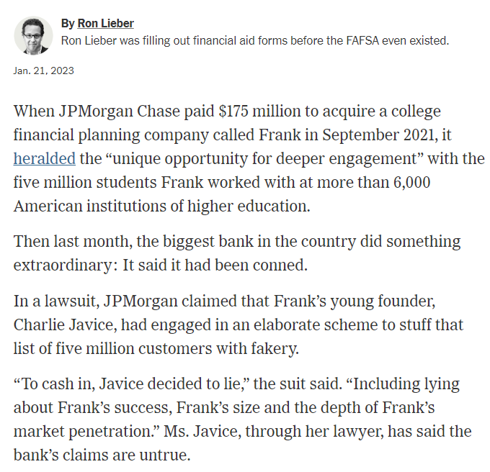
DUE DILIGENCE
Develop a transaction-specific list of due diligence materials to request.
Create a data room or other centralized repository to store the materials for review and access.
  Folders can be tied to Definitive Agreement provisions.
Document when materials are delivered, including identifying documents and which part of due diligence they refer to.

Slide 57
DUE DILIGENCE—TOPICS
Corporate Ownership/Governance – ownership, bylaws
Financial – financial statements, audits, accounting records, tax records
Human Resources – employee classification, employee manual, employee benefits, 401k
IT – software, cybersecurity, NIST/federal cybersecurity requirements
Property – leases, ownership of real property
Litigation – claims or lawsuits; cure and show cause notices
Insurance – status of insurance; insurance claims; loss reports
Filings – business licenses, permits, OHSA filings
Environmental – Phase 1 or 2 reports; use of hazardous materials; operating permits
Sales and Marketing – customer list; marketing efforts
Operations – backlog, revenue; revenue diversity; labor costs; labor utilization; guaranties or performance bonds

Slide 58
DUE DILIGENCE—GOVERNMENT SPECIFIC TOPICS
CPARS – copies of all CPARS in past x years
Compliance – Code of Conduct, compliance policies, training records, hotline records
Contract Performance – cure notices, show cause letters, debarment/suspension status
SBA Compliance – NAICS code analysis (avoiding duplicate NAICS codes in 8(a) program), Business Activity Target compliance, certifications regarding size; post–acquisition size analysis; affiliation issues
Security Clearances – Facility Security Officer; status of facility clearance
Labor – SCA compliance with health and welfare requirements; union obligations
Accounting – cost accounting systems; DCAA audits (pending and completed)
HR – affirmative action programs and plans
Teaming Agreements – exclusivity provisions; non-compete/non-solicitation provisions
Cybersecurity – compliance with obligations regarding top security and controlled defense information
Contracts – required off-ramps of IDIQ/MACs post-acquisition
SAM.gov – check for status of certifications (review usaspending.gov or sam.gov)

Slide 59
THIRD PARTY CONSENTS
Due diligence should identify what third party consents are required and which third party merely need to be notified of the entity change
Seller needs to conduct own due diligence as to third party consent, to properly complete schedules attached to Definitive Agreement/represent and warrant need for third party consents or notice
Third parties that only require notice can be notified post closing
Third parties that need to consent need to be contacted after Definitive Agreement is signed and before closing

Slide 60
SBA APPROVAL
8(a) Contracts may be terminated if transaction is closed completed (i.e., ownership conveyed) without SBA approval
Closing should be made contingent on SBA approval of transaction/waiver of termination of 8(a) contracts
Buyer and Seller should seek SBA approval upon execution of Definitive Agreement
BOS of Target will be the primary contact
Warning: BOS may not have experience with ANCs
Prepare packet on Buyer
  Socio-economic status
  Subsidiaries and NAICS codes
  ANC—affiliation exemption
  Purchase and Sale Agreement

Slide 61
FINANCING
Some acquisitions will be funded by debt, and therefore have a financing contingency
Terms of the financing contingency can be negotiated in the LOI and Definitive Agreement
Unlimited financing contingency permits Buyer to back out of deal up to closing by failing to obtain financing or declining to close on a loan
Can limit Buyer’s discretion by providing Buyer must accept financing if it has certain terms or by putting deadline to either fulfill or waive financing condition

Slide 62
FINANCING CONTINGENCY—TIME LIMIT
Buyer and Sellers expressly acknowledge and agree that Buyer’s ‎obligations to pay the Purchase Price and otherwise consummate the transactions contemplated ‎hereby are fully conditioned upon Buyer's ability to obtain an unconditional binding written ‎commitment for acquisition financing to purchase the Property, whether by way of debt ‎financing, equity investment, or otherwise, on terms acceptable to Buyer in its sole and absolute ‎discretion (the "Loan Commitment") by the expiration of the Due Diligence Period. ‎If Buyer does not receive the Loan Commitment on or before expiration of the Due Diligence Period, then ‎Buyer shall have the right to terminate this Agreement, by giving written notice of Buyer's ‎election to do so, to Sellers on or before expiration of the Due Diligence Period. If Buyer elects to terminate ‎this Agreement as provided in this Section 5.7, Escrow Agent shall return the Deposit to ‎Buyer, and upon such refund being made this Agreement shall terminate, and the parties shall ‎have no further liability hereunder (except with respect to those obligations hereunder which ‎survive the termination of this Agreement). If Buyer fails to give notice as provided in this ‎Section 5.7, Buyer shall be deemed to have waived any financing condition and this Agreement shall ‎be binding and may not be terminated except as provided in Section 12.‎

Slide 63
FINANCING CONTINGENCY—BEST EFFORTS
Purchaser shall use its, and shall cause its Affiliates to use their, best efforts to arrange the Financing as promptly as practicable (but no later than the earlier the Closing Date), including using best efforts to (i) negotiate and finalize definitive agreements with respect thereto (the "Financing Documents"), (ii) satisfy on a timely basis all conditions applicable to Purchaser (or its Affiliates) in such Financing Documents, (iii) comply with its and their obligations under any Financing Documents and consummate the Financing no later than the Closing Date, and (iv) enforce its and their rights under the Financing Documents. In the event that all conditions to the Financing Documents have been satisfied in Purchaser's good faith judgment, Purchaser shall use its best efforts to cause the lenders and the other persons providing such Financing to fund the Financing required to consummate the Share Purchase upon the terms set forth herein on or prior to the Closing Date (including by taking enforcement action to cause such lenders and other persons providing such Financing to fund such Financing).

Slide 64
FINANCING CONTINGENCY—SPECIFIC TERMS
Within ten (10) Business Days after the Effective Date, Buyer will apply for financing from a lender to acquire the Shares (the "Financing") and shall provide to Seller reasonable evidence of such application. In the event that Buyer timely applies for the Financing and thereafter uses commercially reasonable efforts to, but is unable to, obtain the Financing on or prior to the Closing in a proceeds amount greater than one hundred thirty million dollars ($130,000,000), with an interest rate of 5.10% or less, with a 30-year amortization, and on other terms the same or better than the terms contained in the term sheet attached hereto as Exhibit B, then Buyer shall have the right to terminate this Agreement by delivering written notice to Seller, in which case Seller shall return the Earnest Money to Buyer in accordance with Section 2.06 and, except for the rights and obligations that expressly survive the termination of this Agreement, neither Seller nor Buyer shall have any further rights, obligations or liabilities here under.

Slide 65
REMEDIES FOR BREACH/FAILURE TO CLOSE
Transactions take a lot of time, effort, and expense to initiate, conduct due diligence, and negotiate and execute Definitive Agreement
Parties will want remedies if transaction fails to close due to the breach of the definitive agreement by the other party
Typical remedies:
  Specific performance
  Termination fee
  Costs and expenses incurred in the transaction

Slide 66
SPECIFIC PERFORMANCE
Notwithstanding anything herein to the contrary, including the availability of the Parent Termination Fee or other monetary damages, remedy or award, it is hereby acknowledged and agreed that the Company shall be entitled to specific performance or other equitable remedy to enforce Parent and Acquisition Sub’s obligations to cause the Equity Investor to fund the Equity Financing, or to enforce the Equity Investor’s obligation to fund the Equity Financing directly, and to consummate the Closing if and for so long as, (i) all of the conditions set forth in Section 7.1 and Section 7.2 (other than those conditions that are to be satisfied at the Closing; provided, that such conditions are capable of being satisfied if the Closing were to occur at such time) have been satisfied or waived and Parent has failed to consummate the Closing on the date required pursuant to the terms of Section 2.2, (ii) the Debt Financing (or, as applicable, the Alternative Financing) has been funded or will be funded at the Closing if the Equity Financing is funded at the Closing, and (iii) the Company has confirmed that, if specific performance or other equity remedy is granted and the Equity Financing and Debt Financing are funded, then the Closing will occur.
Seller may seek to include a specific performance clause that permits Seller to force Buyer to consummate the transaction
  Twitter v. Musk
Specific performance is a court ordering a party to consummate the transaction

Slide 67
TERMINATION FEE/EARNEST MONEY DEPOSIT
(a) In the event that:
  (i) (A) a Third Party shall have made a Competing Proposal after the date of this Agreement, (B) this Agreement is subsequently terminated by (x) the Company or Parent pursuant to Section 8.1(b)(iii) or (y) Parent pursuant to Section 8.1(d)(i), and at the time of such Company Stockholders’ Meeting in the case of clause (x) or at the time of such breach in the case of clause (y), a Competing Proposal has been publicly announced and has not been withdrawn, and (C) within twelve (12) months of such termination of this Agreement, the Company consummates a transaction involving a Competing Proposal or enters into a definitive agreement providing for the consummation of a Competing Proposal and such Competing Proposal is subsequently consummated...;
  (ii) this Agreement is terminated by the Company pursuant to Section 8.1(c)(ii); or
  (iii) this Agreement is terminated by Parent pursuant to Section 8.1(d)(ii), then
the Company shall… pay, or cause to be paid, by wire transfer of immediately available funds, at the direction of Parent, the Termination Fee; it being understood that in no event shall the Company be required to pay the Termination Fee on more than one occasion.
Termination/Breakup Fee is also an option
Fee is intended to compensate non-breaching entity for expenses, time, and lost opportunity spent on transaction prior to breach/termination
Termination fee can also cap damages owed by a breaching party for not closing the transaction

Slide 68
CLOSING
Occurs when third party consents/conditions to closing have been reached
Payment of Closing Purchase Payment—typically by wire transfer
  Flow of Funds: Sellers, Escrow Company, Payment of Debt (if applicable), Payment of Transaction Expenses
Closing Deliverables
  Stock Certificates/Assignment of LLC interests
  Resignation of existing directors/managers
  Employment contracts
  Closing Certificates
  Buyer/Seller Certificates
  Estimated Working Capital worksheet
Closing can be virtual

Slide 69
CLOSING CERTIFICATE
This OFFICER’S CERTIFICATE is delivered pursuant to Section XXXX of that certain ‎Stock Purchase Agreement, dated as of XXXXXX (the “Purchase Agreement”), by and ‎among Entity A (“Buyer”); Entity B and Entity C (each, a “Seller” and ‎collectively, “Sellers”), and ‎Entity D (the “Company”). The capitalized terms ‎used herein shall have the same meaning as set forth in the Purchase Agreement unless another ‎meaning is specified.‎
As of the date hereof, the undersigned, in his capacity as the Chief ‎Executive Officer of Buyer, hereby certifies on behalf of Buyer and ‎not in any individual ‎capacity that:‎
  Other than the representations and warranties of Buyer contained in Section XXX, the representations and warranties of Buyer contained in the Purchase ‎Agreement are true and correct in all respects (in the case of any representation or warranty ‎qualified by materiality or Material Adverse Effect) or in all material respects (in the case of any ‎representation or warranty not qualified by materiality or Material Adverse Effect) on and as of ‎the Closing Date with the same effect as though made at and as of such date (except those ‎representations and warranties that address matters only as of a specified date, the accuracy of ‎which shall be determined as of that specified date in all respects). The representations and ‎warranties of Buyer contained in Section XXXX and Section XXX are true and correct in all respects ‎‎(other than de minimis inaccuracies) on and as of the Closing Date with the same effect as ‎though made at and as of such date.‎
  Buyer has duly performed and complied in all material ‎respects with all ‎agreements, covenants and conditions required by the Purchase ‎Agreement to be performed or ‎complied with by it prior to or on the Closing ‎Date; provided, that, with respect to agreements, ‎covenants and conditions that are ‎qualified by materiality, Buyer has performed such agreements, ‎‎covenants and conditions, as so qualified, in all respects. ‎
Closing certificate confirms that conditions to closing have been met and that the representations and warranties of the Buyer and Seller are accurate as of Closing

Slide 70
POST-CLOSING INTEGRATION
Determine lead on integration efforts
Calendar deadline for post-closing working capital adjustment calculation
Implement policy changes
Integrate with accounting and banking systems
Add to line of credit/debt facilities
Add to insurance policies
Determine any public relations efforts
Determine management changes
Determine benefit changes/additions (401k merger or termination)
Filed updated corporate documents with applicable state agencies (corporations divisions)
Contact contracting officers to explain changes
Inter-company service agreements

Slide 71
RECERTIFICATION OF SIZE AFTER ACQUISITION – ASSET SALE
An 8(a) entity that qualifies as small at the time it submits its initial offer that includes price is generally considered to be a small business throughout the life of that contract. But, there are exceptions when there has been an acquisition.
When novation of a contract is required (asset sale), the 8(a) entity must, within 30 days of the novation, recertify its small business size status to the procuring agency, or inform the procuring agency that it is other than small.
  If the contractor is other than small, the agency can no longer count the options or orders issued pursuant to the contract, from that point forward, towards its small business goals.”

Slide 72
RECERTIFICATION OF SIZE AFTER ACQUISITION— STOCK SALE
When novation is not required (stock sale), the 8(a) entity must, within 30 days of the transaction becoming final, recertify its small business size status to the procuring agency, or inform the procuring agency that it is other than small.
  If the contractor is other than small, the agency can no longer count the options or orders issued pursuant to the contract, from that point forward, towards its small business goals.

Slide 73
RECERTIFICATION OF SIZE AFTER ACQUISITION
If the merger, sale or acquisition occurs after offer but prior to award, the 8(a) entity must recertify its size to the contracting officer prior to award.
  If the merger, sale or acquisition occurs within 180 days of the date of an offer and the 8(a) entity is unable to recertify as small, it will not be eligible as a small business to receive the award of the contract.
  If the merger, sale or acquisition occurs more than 180 days after the date of an offer, award can be made, but it will not count as an award to small business.
  These requirements apply to binding letters of intent as well completed acquisitions.

Slide 74

Christopher Slottee
Shareholder
‎907-339-7130‎
cslottee@schwabe.com
“I strive to provide cost-effective and efficient solutions, ‎with a focus on finding creative and innovative methods of ‎getting past any roadblocks to my client’s goals.‎”
Chris has over 15 years of experience handling complex litigation matters, specifically working with Alaska Native Corporations, settlement trusts, and tribal governments.
Chris’s previous experience as Vice President and General Counsel for an ANC gives him an invaluable understanding of the inner workings of ANCs and the unique challenges they face. He is well-versed in issues of corporate governance, legal and risk management, government contracting, corporate transactions, mergers and acquisitions, land use, and real estate matters.
^{industry focus}
Indian Country & Alaska Native Corporations
Natural Resources

Slide 75

Andrew March
Of Counsel
‎907-339-7146‎‎
amarch@schwabe.com
“My goal is to efficiently achieve solutions for clients facing ‎the most difficult legal issues.‎‎”
Andrew works closely with Alaska Native Corporations (ANCs), tribal governments, private companies, and public entities throughout Alaska and the United States to solve complex legal problems.
He has nearly 10 years of experience litigating complex disputes for both plaintiffs and defendants in federal and state court at both the trial and appellate level. In addition to litigation and dispute resolution, he advises clients on a wide range of issues involving corporate governance, government contracting, the Small Business Administration’s 8(a) Business Development Program, and the Alaska Native Claims Settlement Act.
^{industry focus}
Indian Country & Alaska Native Corporations
Natural Resources
75

Slide 76

Jean Back
Shareholder
‎503-796-2960
jback@schwabe.com
Not every engagement requires the same solution. Creativity, collaboration, ‎resourcefulness, and excellent listening skills can often lead to unique and successful ‎business solutions.
With more than 30 years of experience, I help ‎manufacturers and technology-focused employers ‎solve problems to complicated employment scenarios. ‎I have broad expertise in litigation, mediation, and ‎settlement of employment and business tort claims. I am fluent in all areas of state and federal ‎employment, wage and hour, discrimination, and leave ‎laws. These skills make me effective at training managers and ‎employees in employment compliance.‎
^{industry focus}
Consumer Products, Manufacturing & Retail
Technology
76

Slide 77

Dan Eller
Shareholder
‎503-796-3762
deller@schwabe.com
I enjoy working with clients and their other advisors to achieve clients’ objectives.
I assist clients with tax and business law issues in ‎transactions and controversies. My transactional ‎practice emphasizes choice of entity and formation, ‎mergers and acquisitions, real property development, ‎foreign bank account and asset reporting, and tax-‎exempt entity formation, qualification, and operation. ‎On the controversy side, I handle a wide variety of tax ‎collection and controversy matters, both federally and ‎at the state level in Oregon and Washington. I litigate ‎cases before the United States Tax Court and the ‎Oregon Tax Court, where I formerly clerked for the ‎Hon. Henry C. Breithaupt.‎
^{industry focus}
Technology
Real Estate & Construction
Healthcare & Life Sciences
Consumer Products, Manufacturing & Retail
77

Slide 78

Charmin Shiely
Shareholder
‎503-796-2768
cshiely@schwabe.com
The joy of being a business attorney is that as a result of every project, something is built or improved upon, business relationships are established, and business objectives are realized.
I have over 23 of years’ experience in corporate transactions, including mergers, asset sales, and complex debt and equity finance transactions. I also advise clients on executive compensation matters (including structuring deferred compensation, options, grants, and quasi-equity arrangement).
^{industry focus}
Real Estate & Construction
78

Slide 79

Trevor Livingston
Shareholder
‎503-796-7452
tlivingston@schwabe.com
Let's get to work.
I counsel clients in a wide variety of commercial and ‎finance transactions, including debt and equity securities ‎offerings, asset sales and purchases, and mergers and ‎acquisitions. I enjoy working with start-up companies ‎just getting off the ground, more established ‎businesses in our community, and large multinational ‎companies. I am known for being an accomplished, ‎knowledgeable, and practical business lawyer who ‎knows how to find workable solutions for clients.‎
^{industry focus}
Consumer Products, Manufacturing & Retail
Natural Resources
79

Slide 80







INDIAN COUNTRY
AND ALASKA NATIVE
CORPORATIONS
HEALTHCARE AND
LIFE SCIENCES
REAL ESTATE AND
CONSTRUCTION
COMMERCIAL PRODUCTS, MANUFACTURING,
AND RETAIL
NATURAL RESOURCES
TECHNOLOGY
PORTS AND MARITIME

